Slide 1
the event of a thread | 2012-2013

Slide 2
Ann Hamilton
American installation Artist

Slide 3
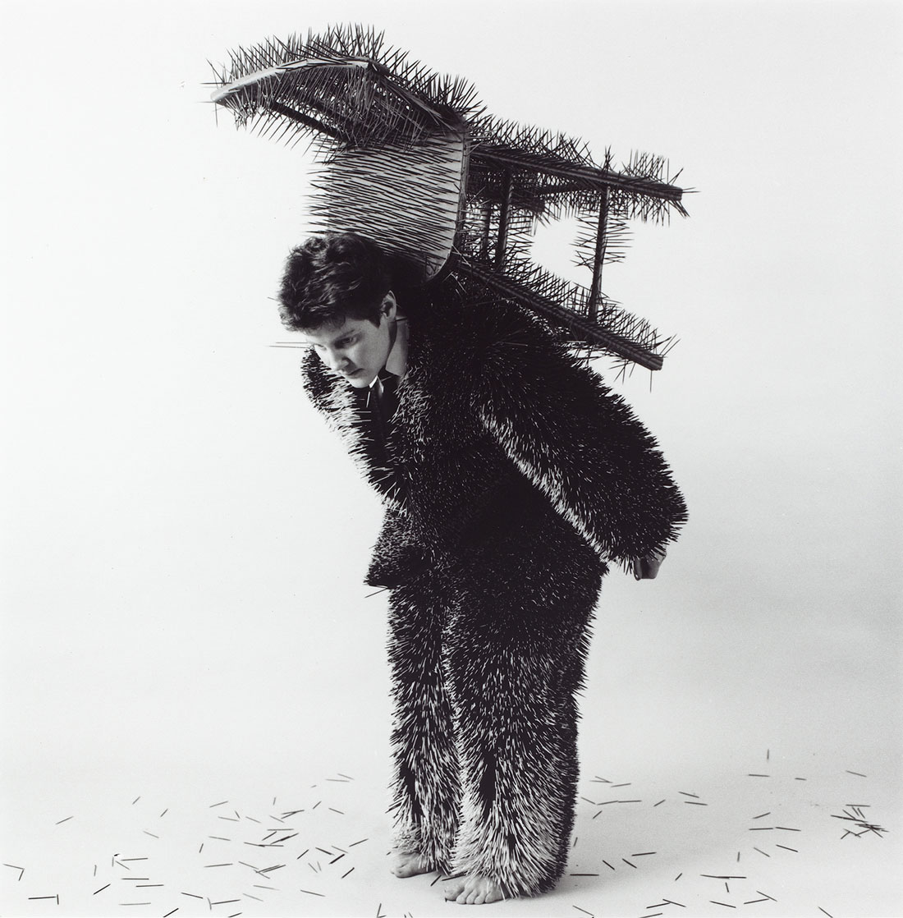

Slide 4
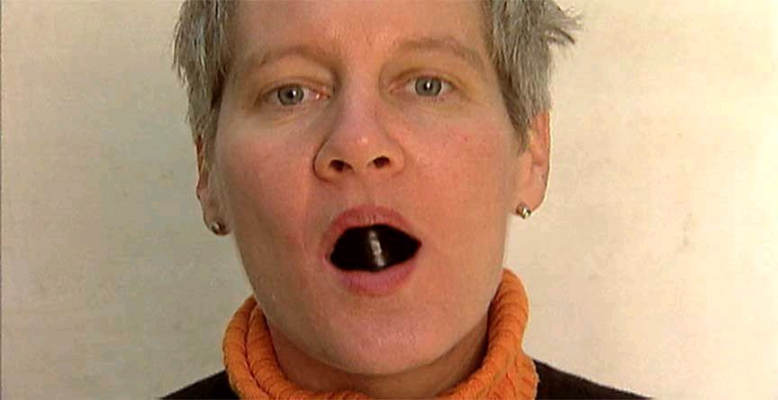
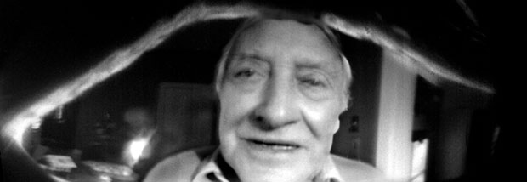
Face to Face

Slide 6
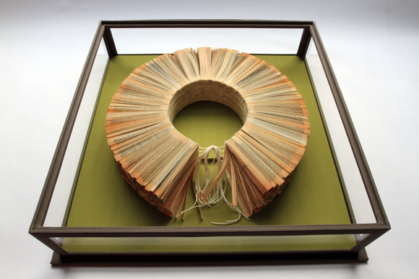
carriage | 2009
Slices of paperback books, cheese cloth, string, bookbinders glue, binders board, museum board, bookbinding cloth, acrylic panels

Slide 7
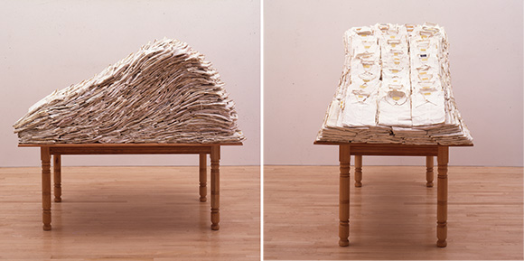
“Tables are my blank paper, my landscape, my figure, a plane that implies the solitary figure and all that is social . . . two people sitting face-to-face, working together, eating or speaking. . . . All tables inherit a history of their use as a site of communion and sacrifice.”
(still life) | 1988/1991
White shirts, gold leaf, wood table, chair

Slide 8
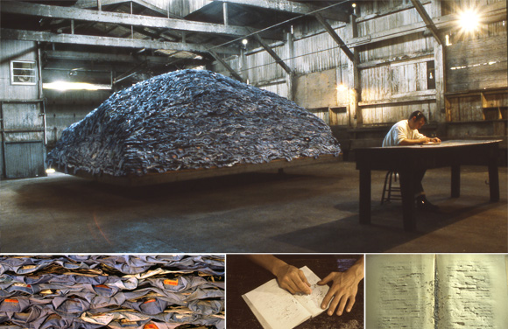
indigo blue | 1991 / 2007

Slide 9
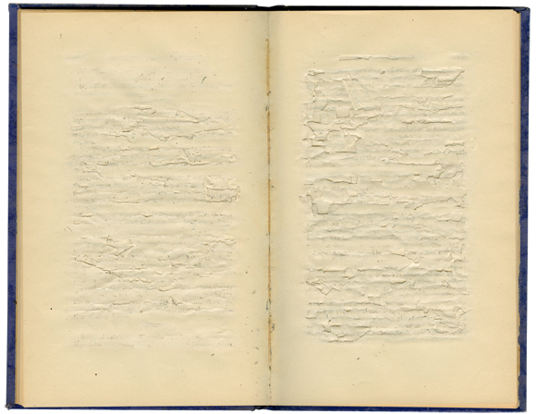
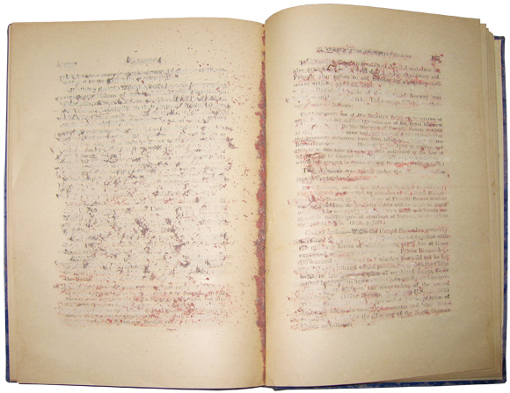
(indigo blue • books) | 1991
Four altered books, glass and wood vitrine

Slide 10
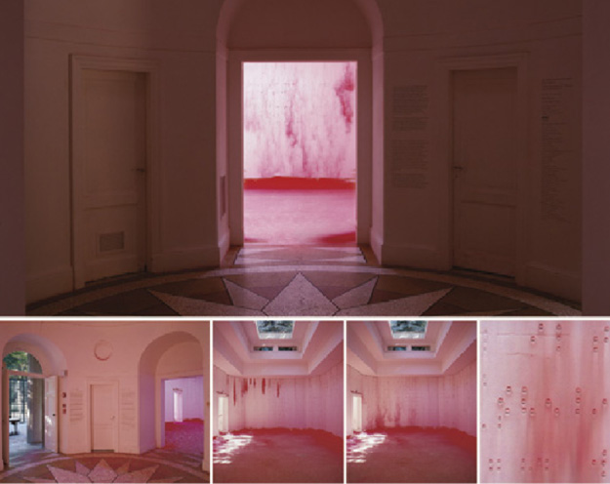
Myein | 1999

