Slide 1
Disney Concert Hall
Los Angeles
Frank Gehry

Slide 2
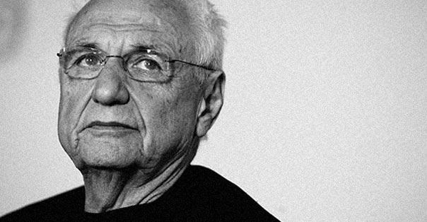
Frank Gehry
Canadian Born American Architect
Best known for his use of titanium

Slide 3
The Guggenheim Museum in Bilbao, Spain

Slide 4
Gehry Residence in Santa Monica, California

Slide 5
Dancing House
Prague

Slide 6
Hotel Marqués de Riscal in Elciego, Spain

Slide 7
The tower at 8 Spruce Street in Lower Manhattan,
completed in February 2011, has a stainless steel and glass exterior and is 76 stories high.

Slide 8
Neuer Zollhof in Düsseldorf, Germany

