Slide 1
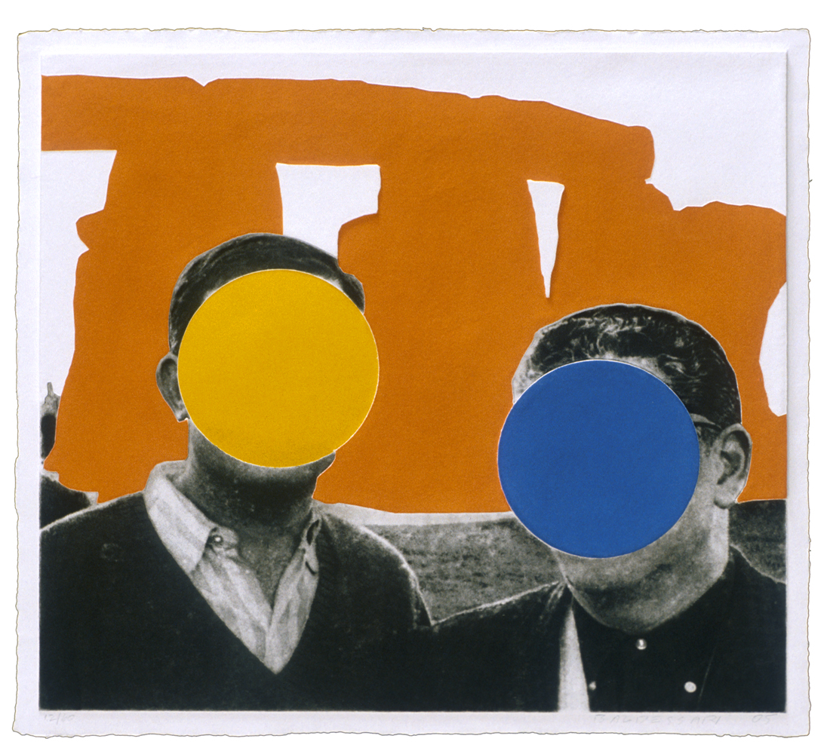
John Baldessari Stonehenge (With Two Persons) Green, 2005 Mixografia print on handmade paper Edition of 60 29 x 32 inches

Slide 2
John Baldessari
Tom Waits Video on John Baldessari
Conceptual Artist
Deals with Humor
Put Dots on Heads

Slide 3
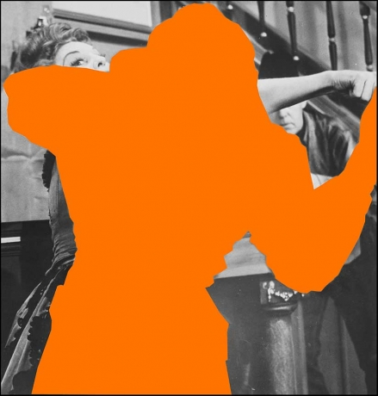

Slide 4
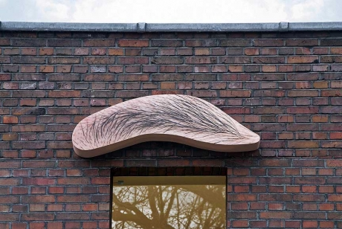

Slide 6
