Slide 1
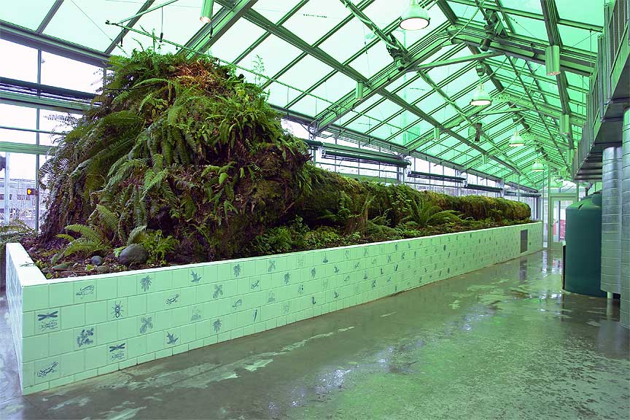
Neukom Vivarium Mark Dion

Slide 2
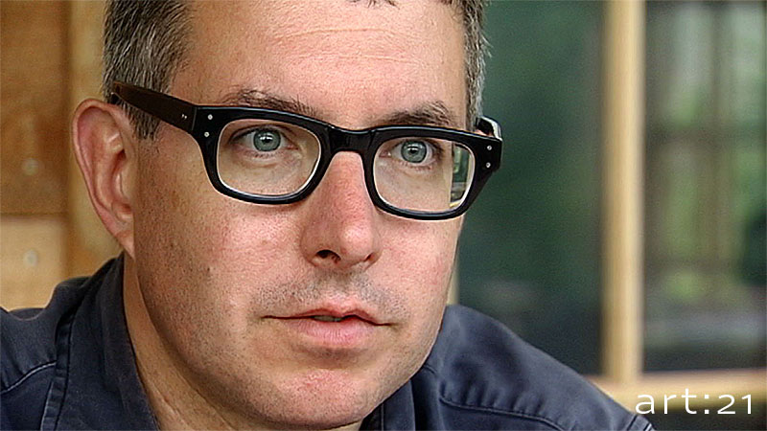
Mark Dion
American installation Artist
Interested in the connection between art and science

Slide 3
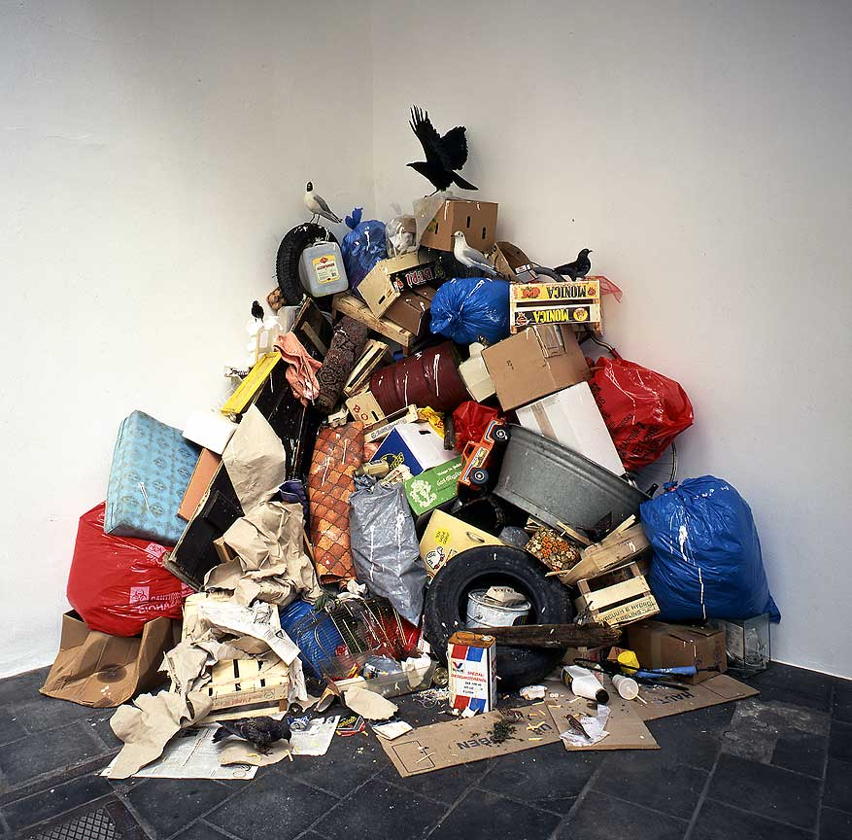
Concrete Jungle

Slide 4
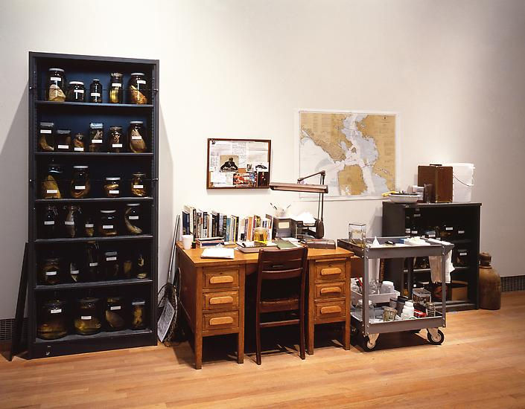
Department of Marine Animal Identification of the City of San Francisco (Chinatown Division)

Slide 5
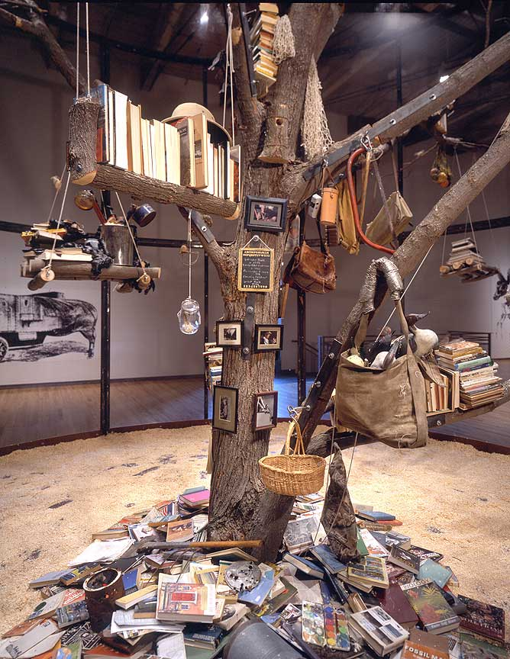
Aviary (Library for the Birds of Massachusetts)

Slide 6
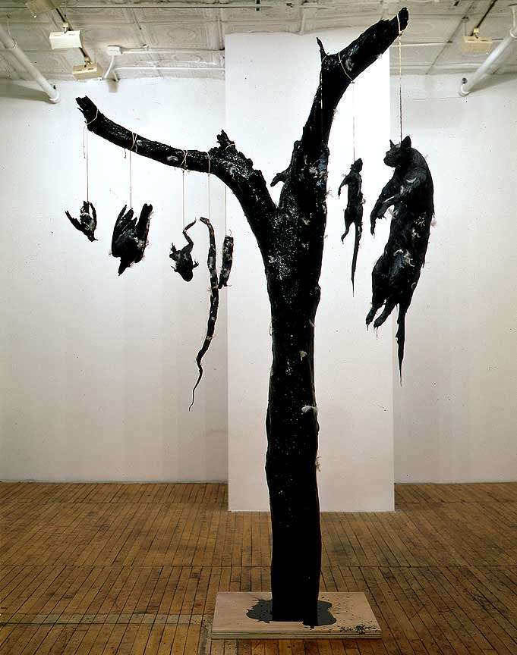
Tar and Feathers

Slide 7
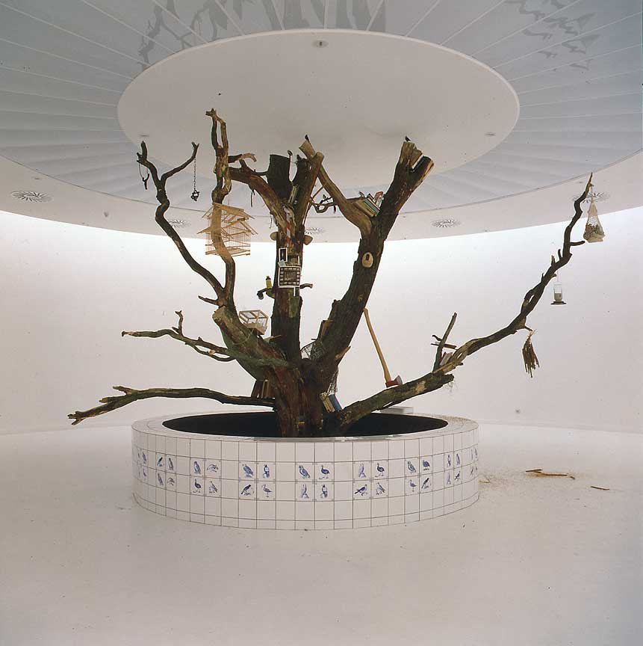
The Library for the Birds of Antwerp

