Slide 1
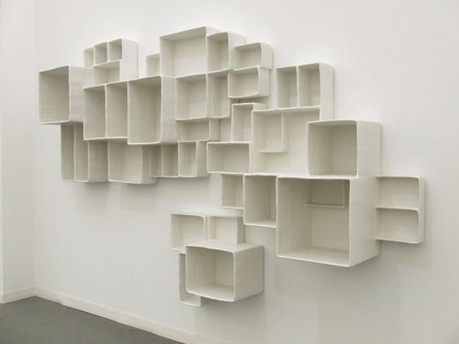
Andrea Zittel
“A-Z Aggregated Stacks” (2012)
“Liberation through limitation”

Slide 2
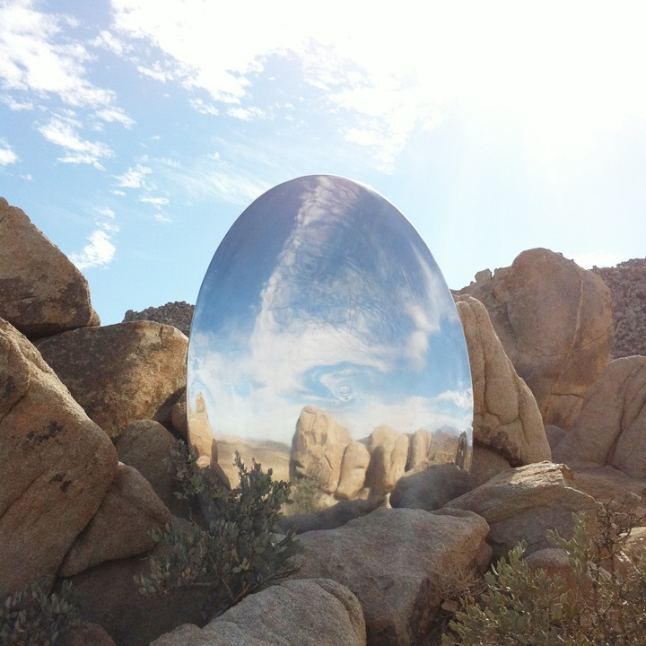
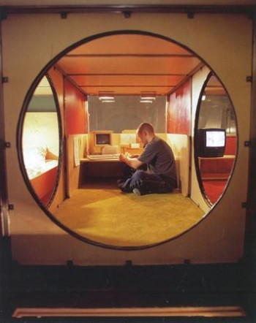
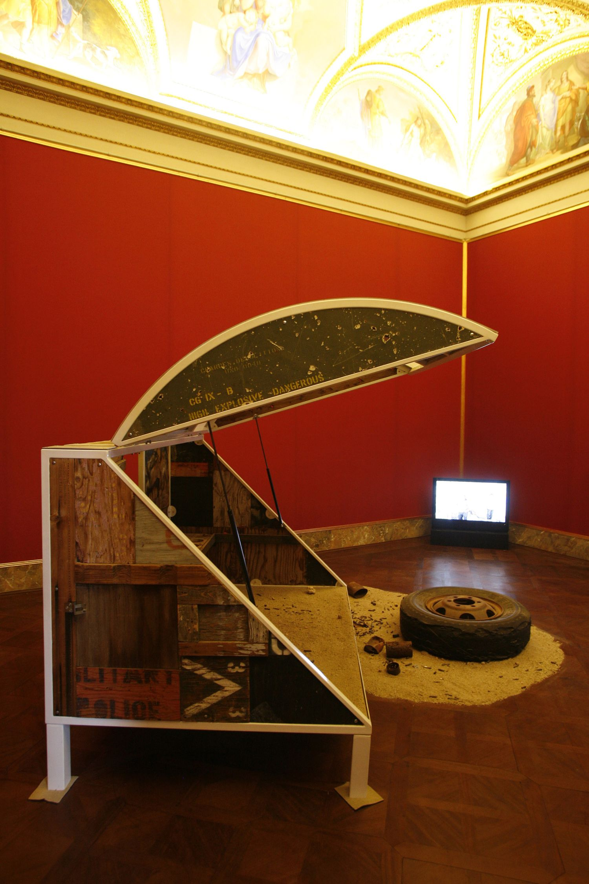
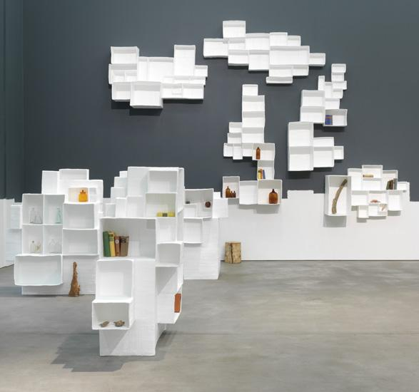
“What makes us feel liberated is not total freedom, but rather living in a set of limitations that we have created and prescribed for ourselves.”

Slide 3
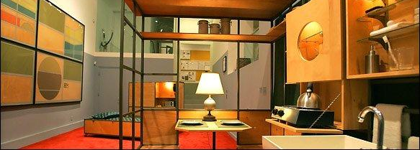
“How should we live?” “What gives life meaning?”
https://art21.org/watch/art-in-the-twenty-first-century/s1/andrea-zittel-in-consumption-segment/

Slide 4
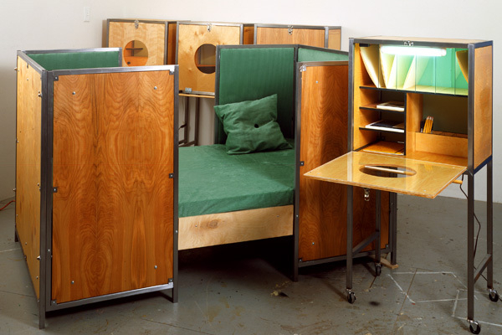
Zittel’s Homes: Art in living space
“Andrea Zittel transforms everything necessary for life--eating, sleeping, bathing, and socializing--into artful experiments in living.”

Slide 5
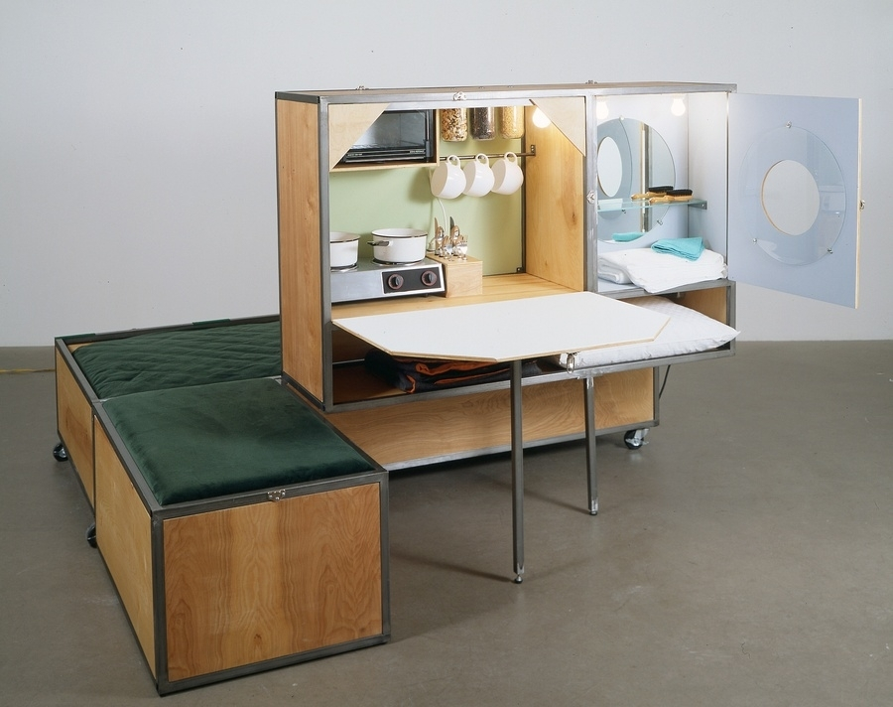
Her idea of perfection in art was creating a space that had everything someone would need to live.

Slide 6
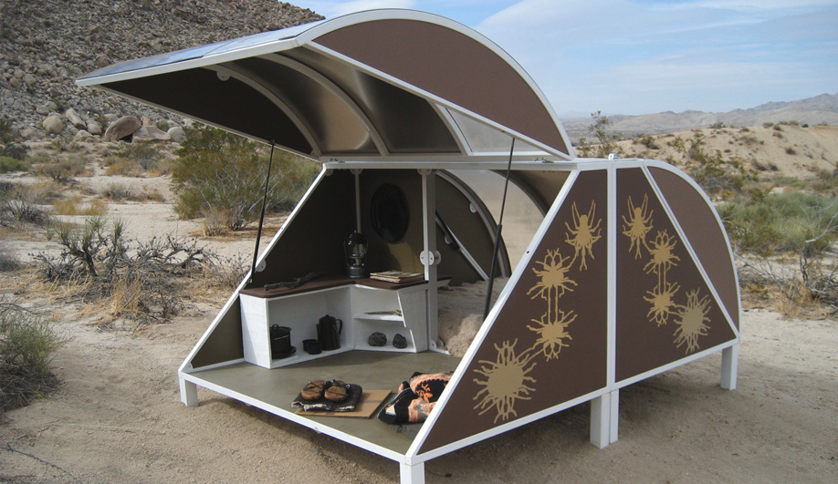
One of Zittel’s many desert installations

Slide 7
Pocket Property (1999)

