Slide 1
The Calling of Saint Matthew
Caravaggio
(1599–1600)

Slide 2
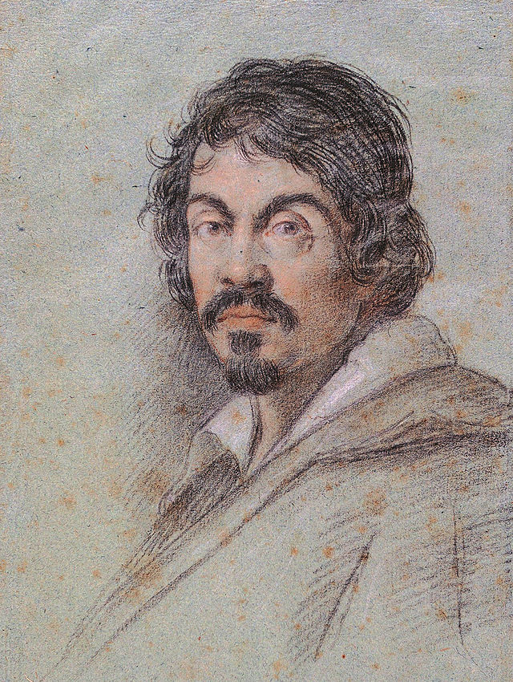
Caravaggio
Italian Painter between 1592-1610
Paintings combine a realistic observation of the human form with a dramatic use of lighting
His use of extreme light and dark came to be known as tenebrism

Slide 3
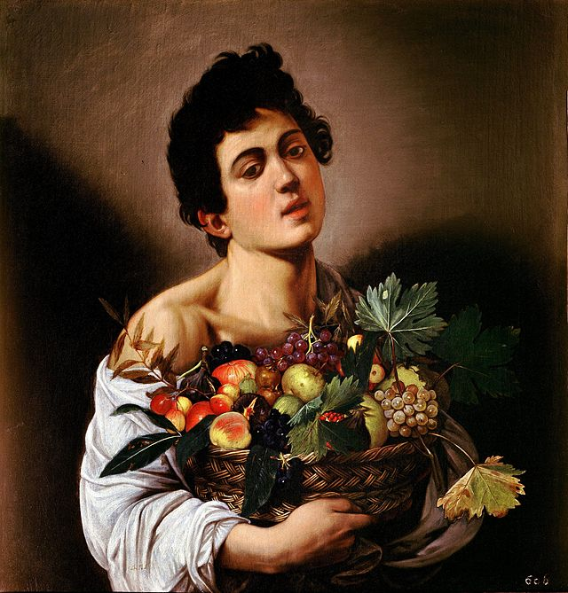
Boy with a Basket of Fruit, 1593–1594.
Oil on canvas,
67 cm × 53 cm (26 in × 21 in).

Slide 4
Basket of Fruit, c. 1595–1596,
oil on canvas

Slide 5
The Crucifixion of Saint Peter, 1601.

Slide 6
St. Jerome, 1605–1606,

Slide 7
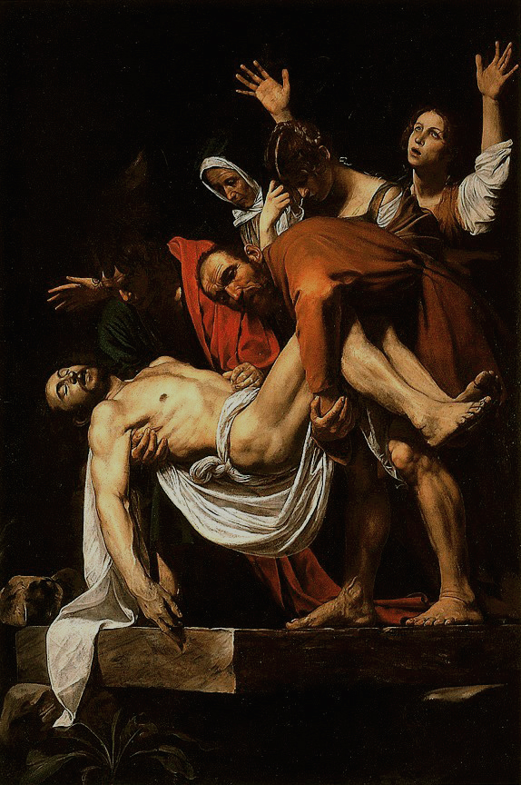
The Entombment of Christ, (1602–1603)

Slide 8
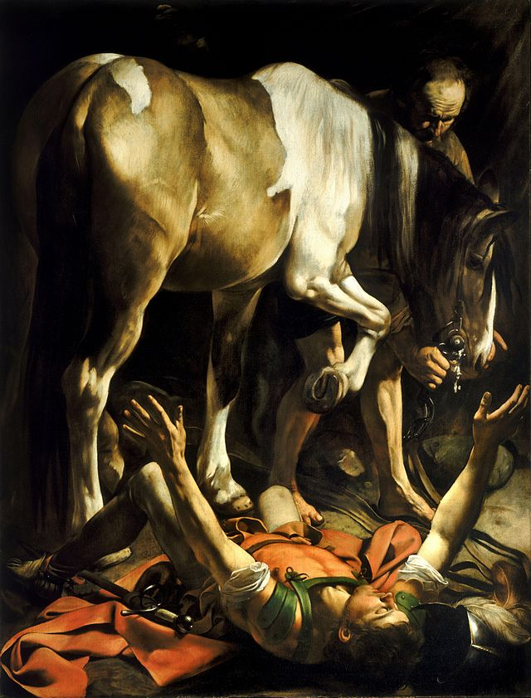
Conversion of Saint Paul, 1601

