Slide 1
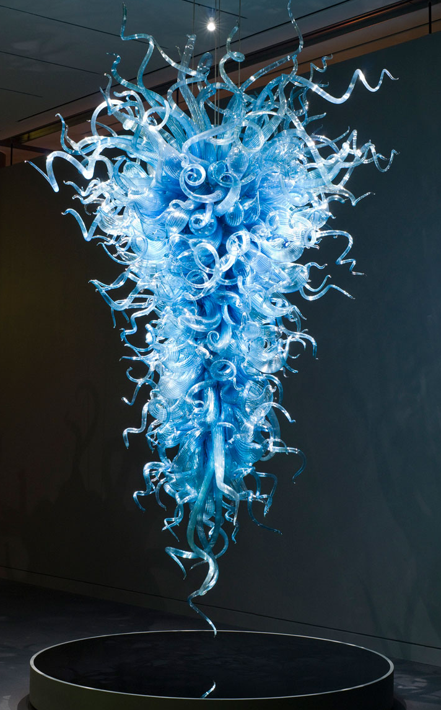
Dale Chihuly
Stonecipher Chandelier

Slide 2
Dale Chihuly
“I want people to be overwhelmed with light and color in a way they have never experienced.”

Slide 3
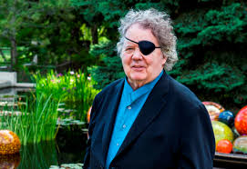
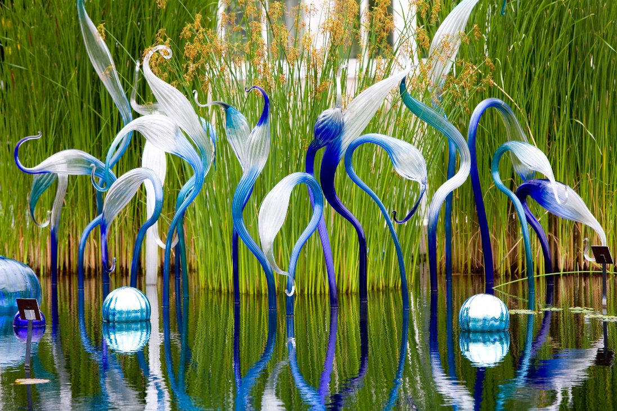
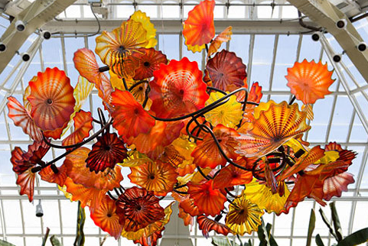
Dale Chihuly is an American glass sculptor.
From Tacoma, Washington
Uses glass for elaborate installations and environmental artwork.

Slide 4
“When you’re making and forming the glass, if you want to push it towards organic form, it happens naturally.”
“I like to think that my work does take people to a different place.”
“What I’ve always been interested in is space, so I was thinking not of the object itself but how the object would look in a room”
“I want people to be overwhelmed with light and color in a way they have never experienced.”
Notes:
What’s the purpose of Chihuly’s art? What do you think he’s trying to accomplish?
What do you like about the art? What do you dislike/ what would you change?

Slide 5
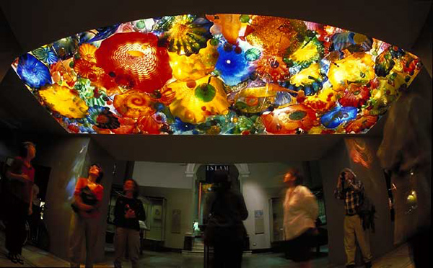
Perian Ceiling

Slide 6
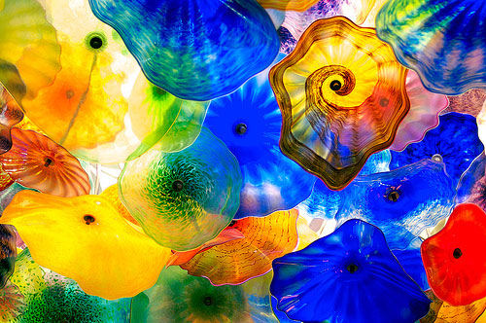

Slide 7
