Slide 1
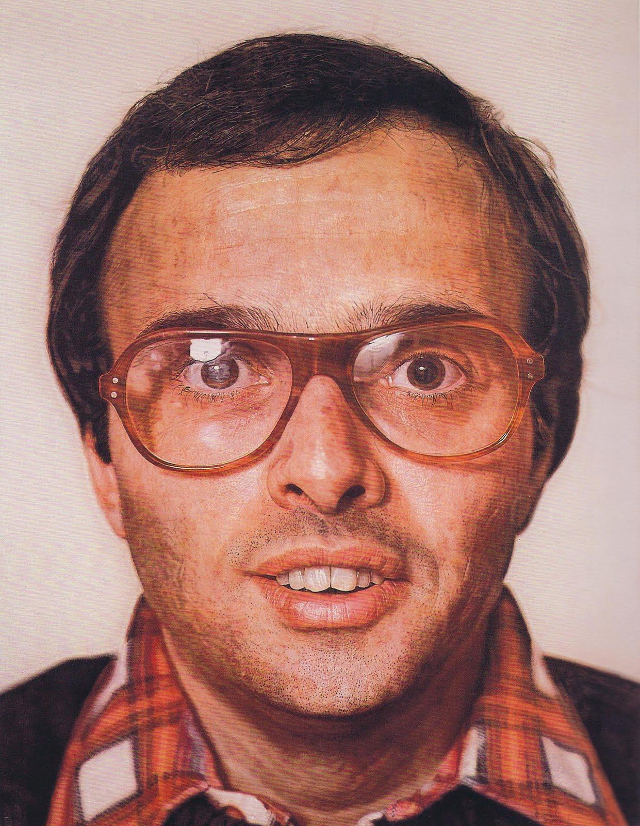
Mark
1978-1979
Chuck Close
Acrylic on canvas

Slide 2
Chuck Close
American Painter
Large Scale Heads
Uses Grid for every painting

Slide 3
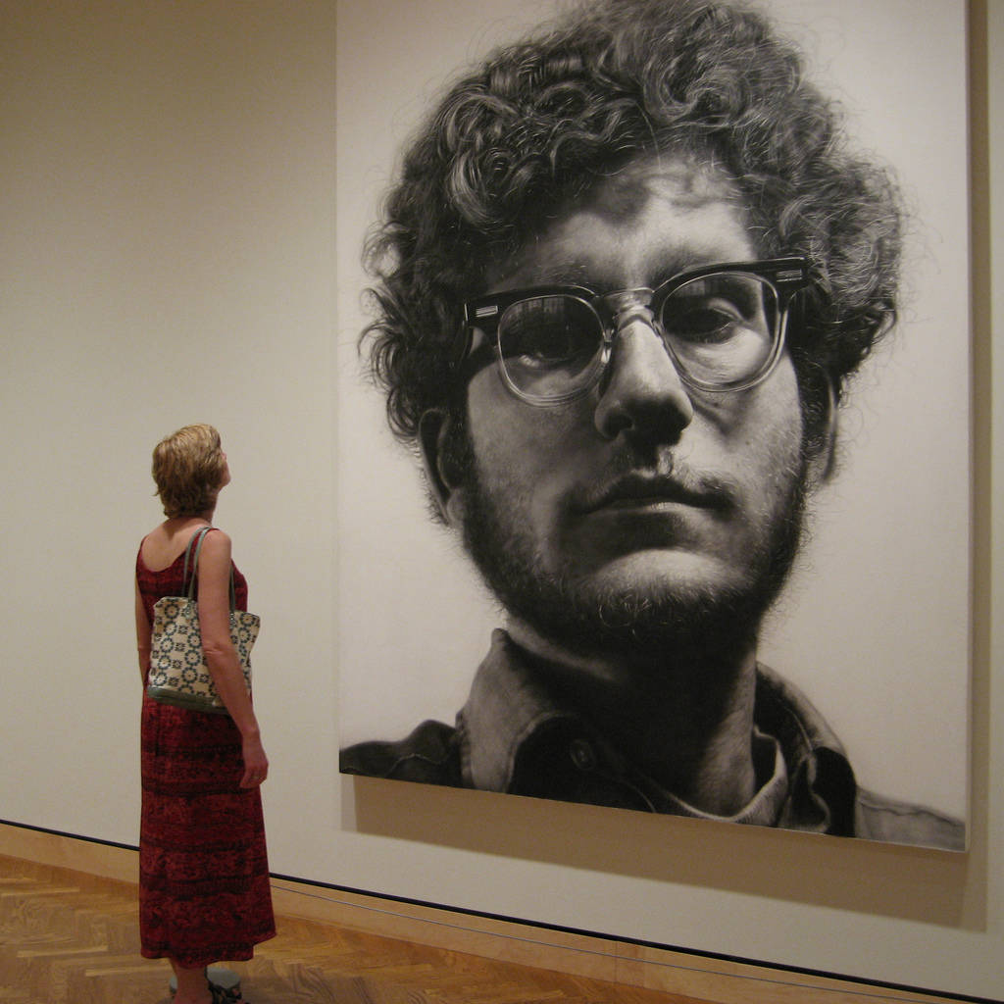

Slide 4
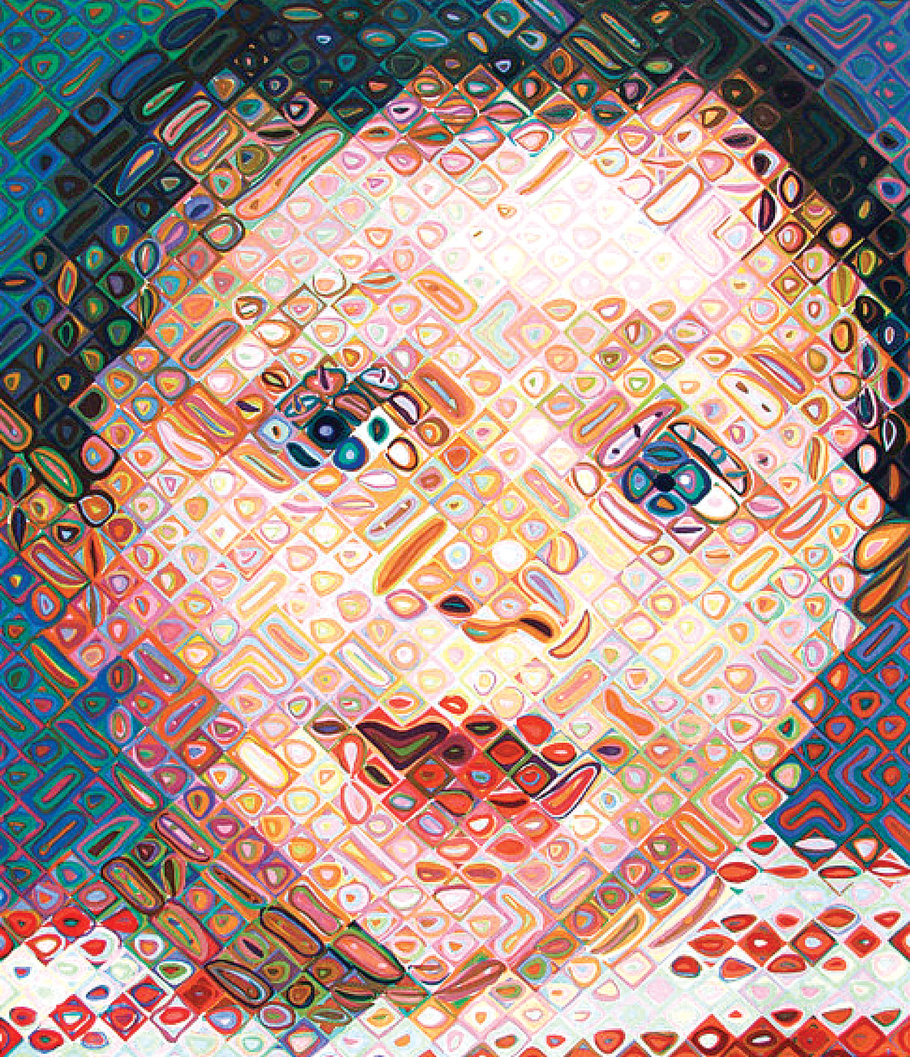

Slide 5
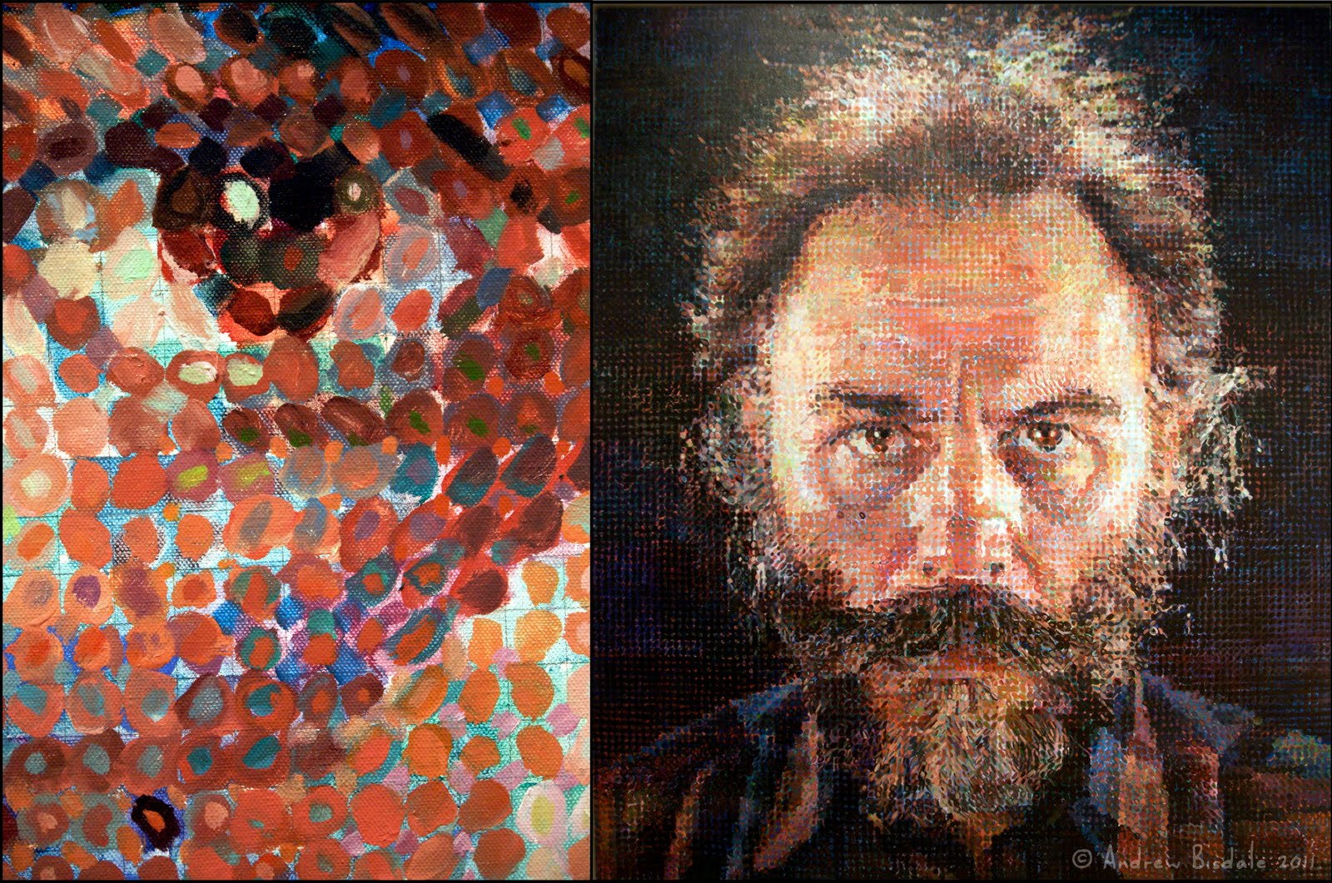

Slide 6
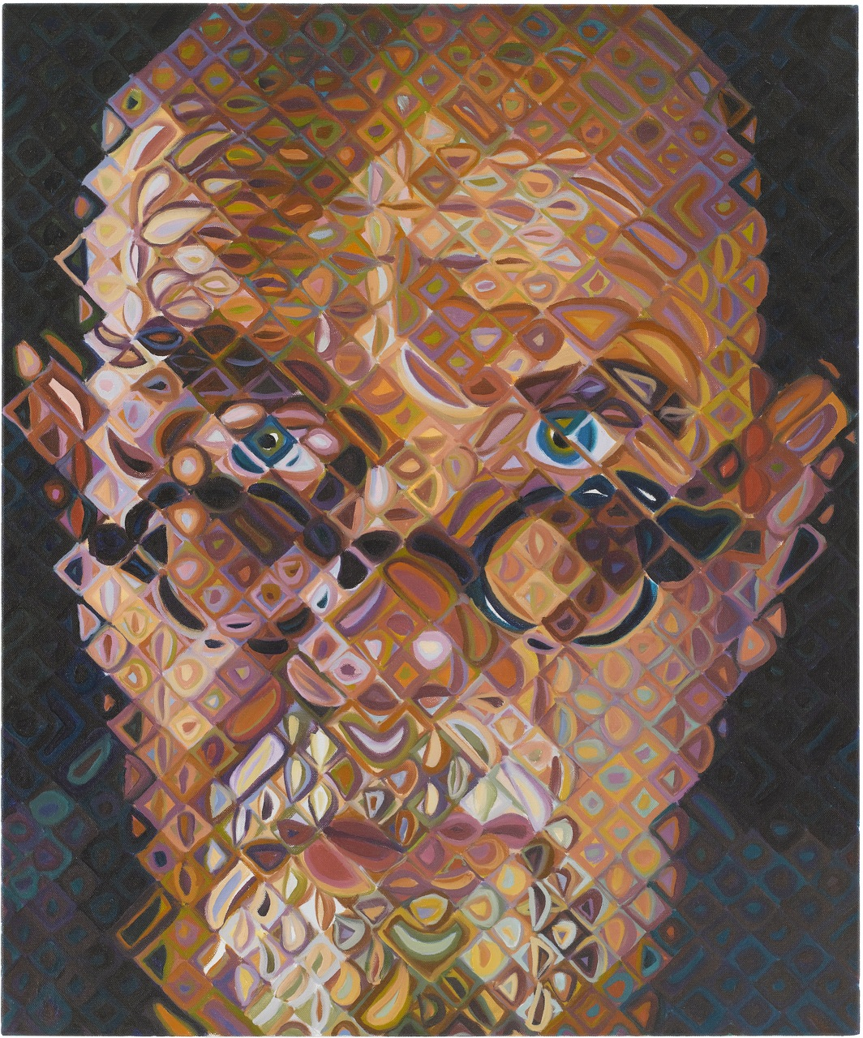

Slide 7
