Slide 1
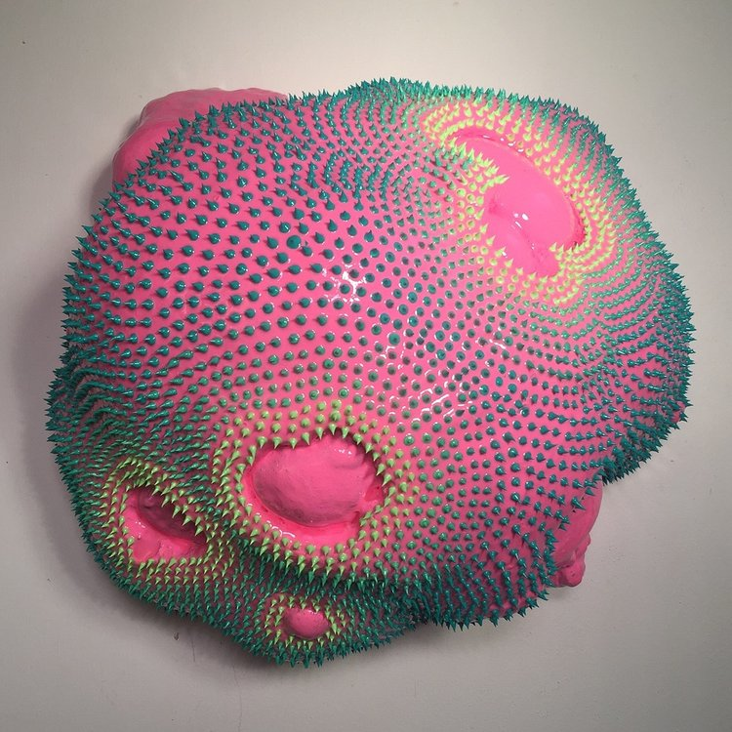
Dan Lam
“Fresh”

Slide 2
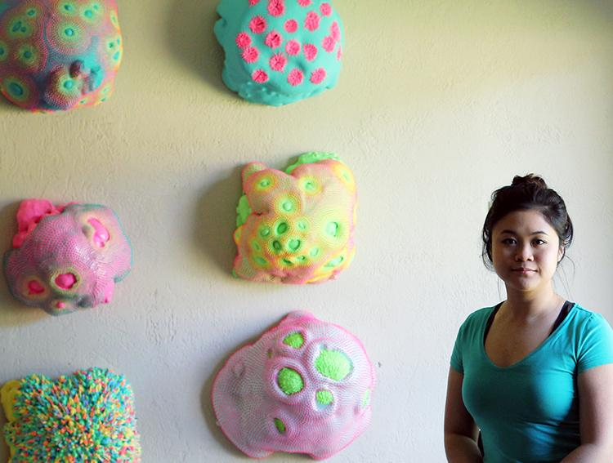
Dan Lam
Sculpture Artist
Raised in TX, Got her Masters at ASU
Experiments and plays with materials to make her work

Slide 3
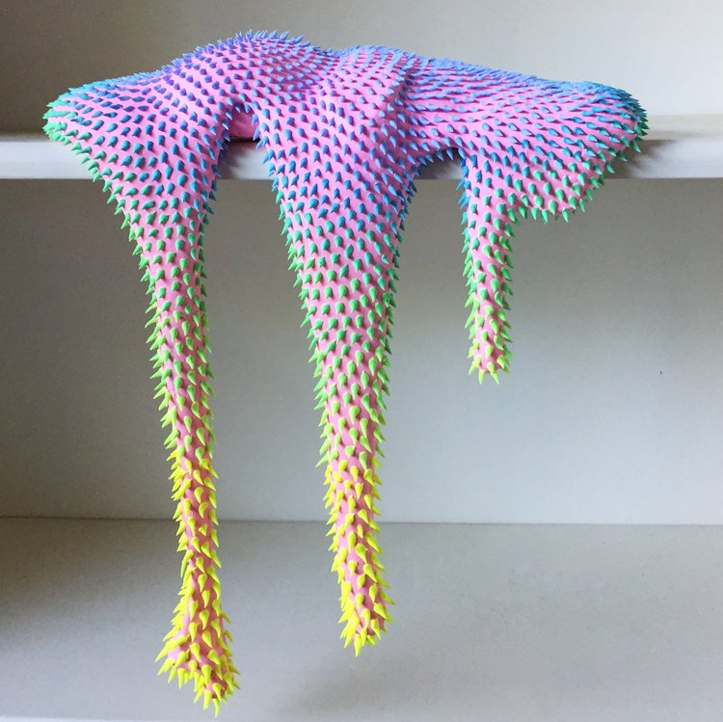

Slide 4
Base is made of foam and latex glove scraps
Pours foam over the base
Spikes are acrylic paint
Uses resin for a shiny finish

Slide 5
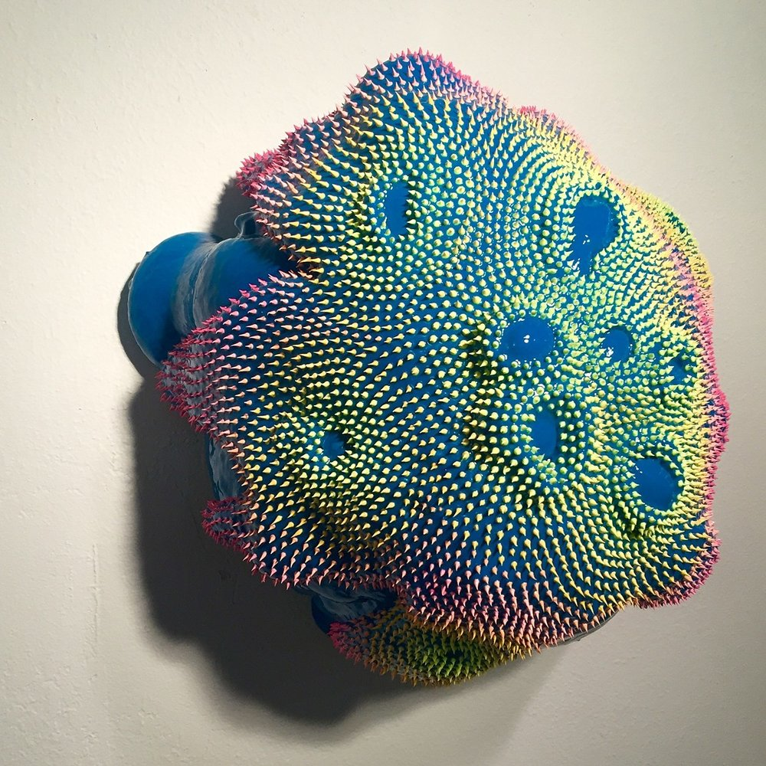

Slide 6
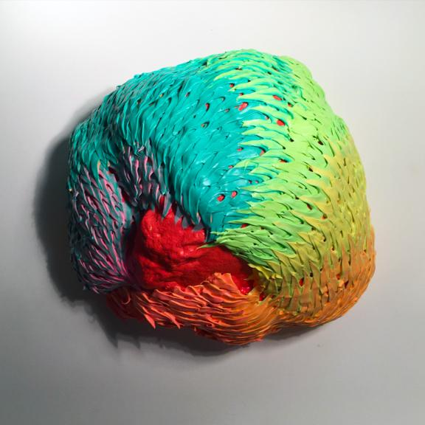

Slide 8
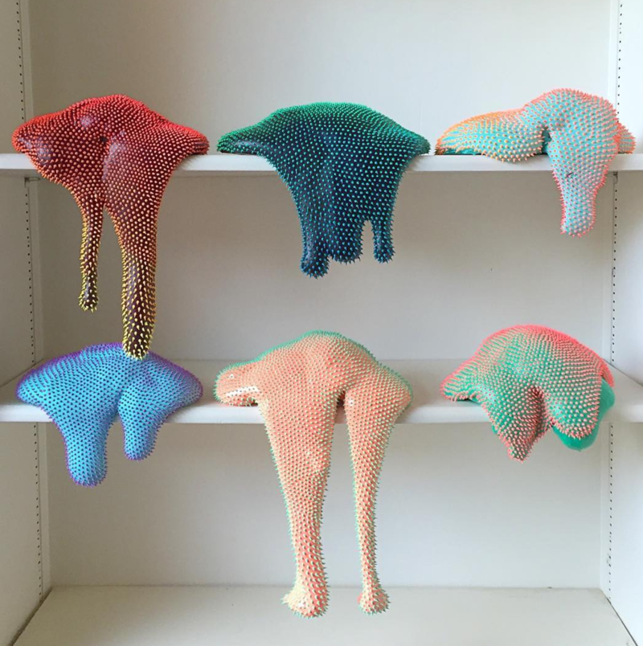

Slide 9
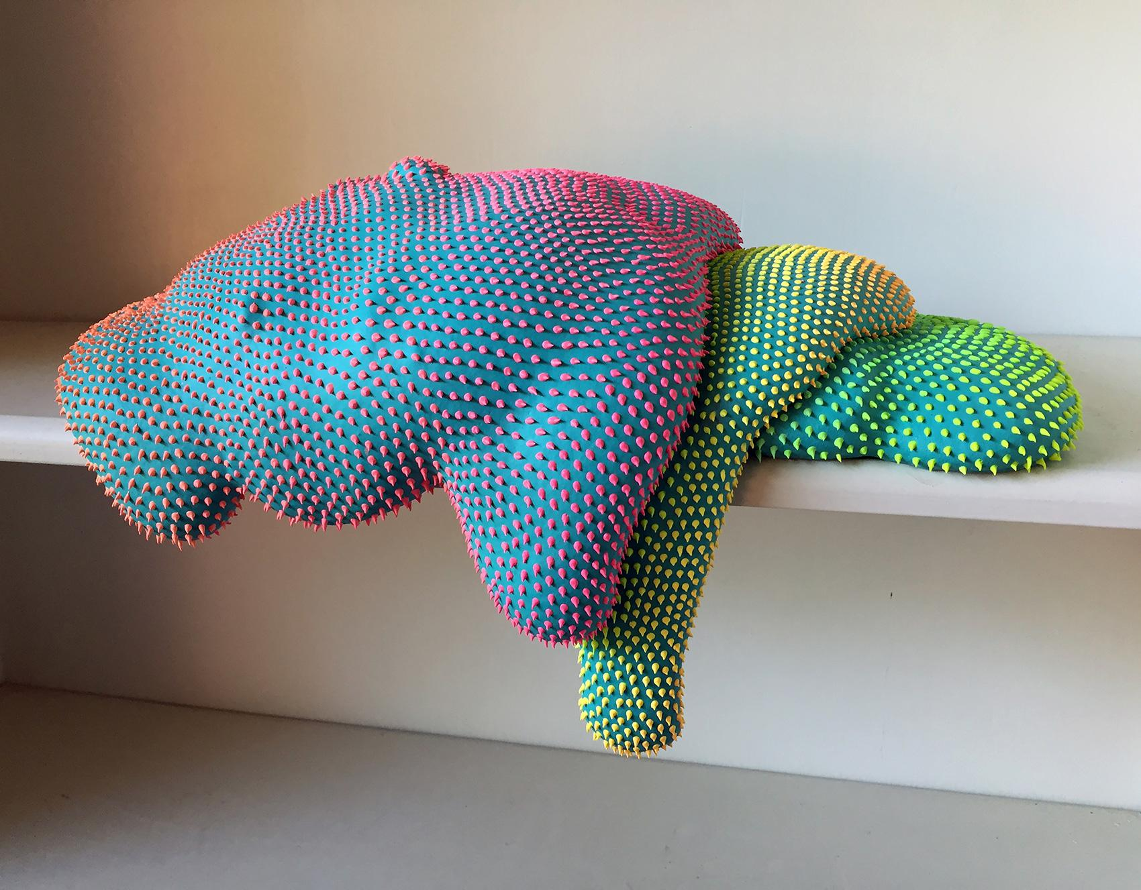

Slide 10
“I’m interested in creating these bright, attractive things that begged to be held, but either can’t be touched because of the setting, or you can actually touch them, but they’re hard and spiky – making them not so inviting.’’

Slide 11
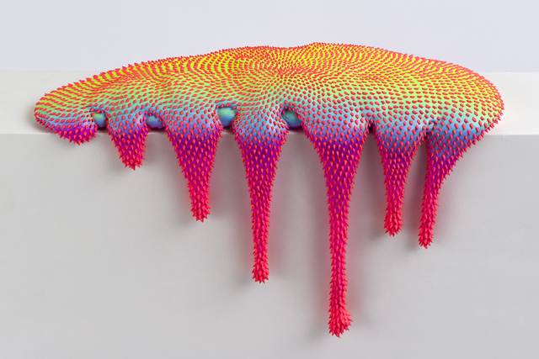

Slide 12
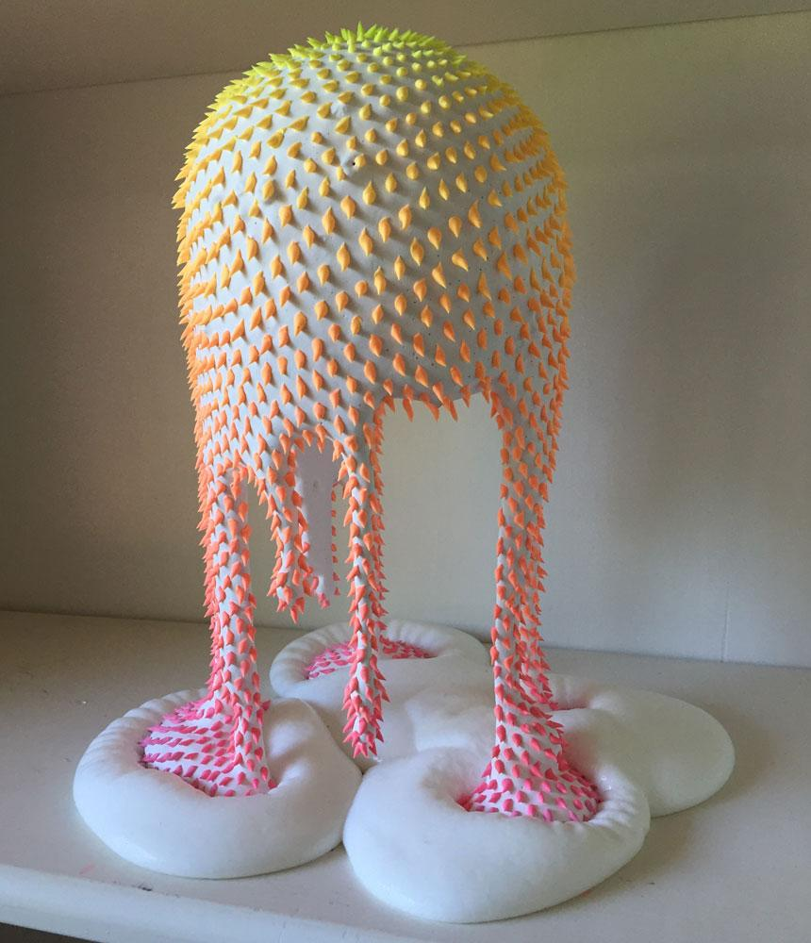

Slide 13
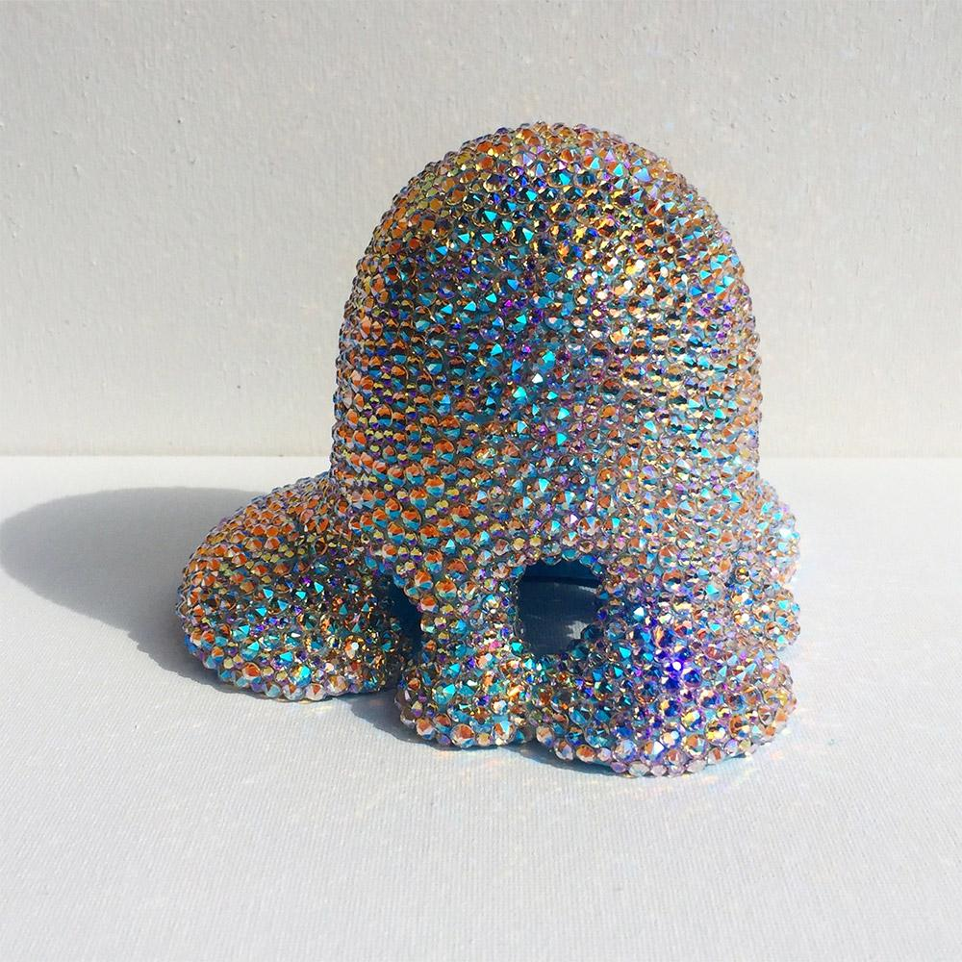

Slide 14
https://www.youtube.com/watch?v=NeuUk46oR-o

