Slide 1
Oh! Susanna (1993)
Ellen Gallagher

Slide 2
Oh! Susanna (Detail) (1993

Slide 3
Ellen Gallagher
Mixed Media Collage American Artist
Often explores issues of race in her work
Walks the line between minimalist abstraction and image based narratives

Slide 5
Host (1996) consists of sheets of penmanship paper adhered to the surface of the canvas and then covered by fields of hand-drawn eyes and lips, taken from the highly charged imagery of American minstrelsy.

Slide 6
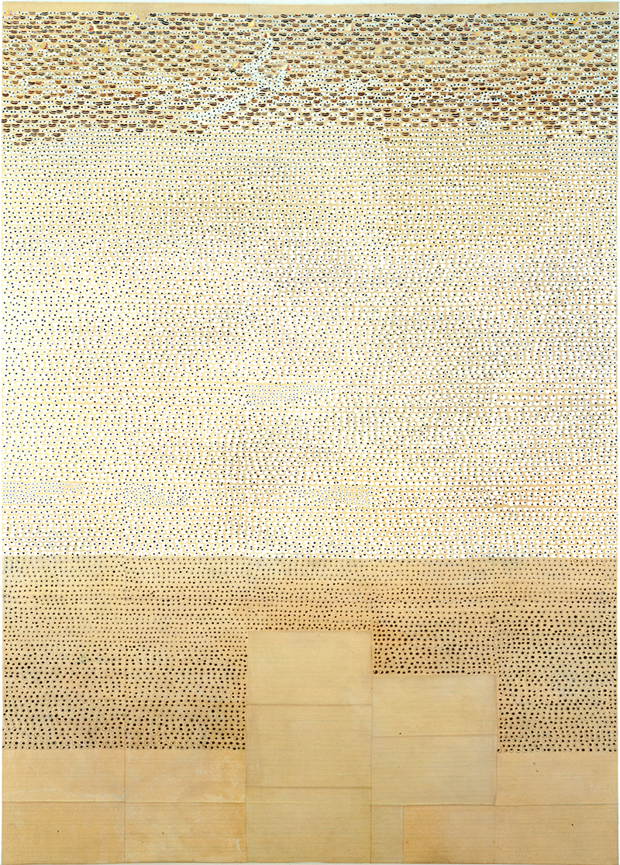
Host (1996) consists of sheets of penmanship paper adhered to the surface of the canvas and then covered by fields of hand-drawn eyes and lips, taken from the highly charged imagery of American minstrelsy.

Slide 8
DeLuxe (2004)

Slide 9
Detail from DeLuxe (2004)

Slide 13
Bird in Hand (2006)

Slide 14
Detail from Morphia (2008-12)

Slide 15
PRESERVE, DETAIL 2001

Slide 16
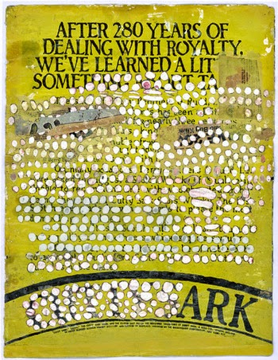
ARK ( Front and Back) 2014

Slide 17
UNTITLED 2013 Oil, Ink, and Paper on Canvas

Slide 18
Dew Breaker, 2015

