Slide 1
Freezer Paper Printing

Slide 2
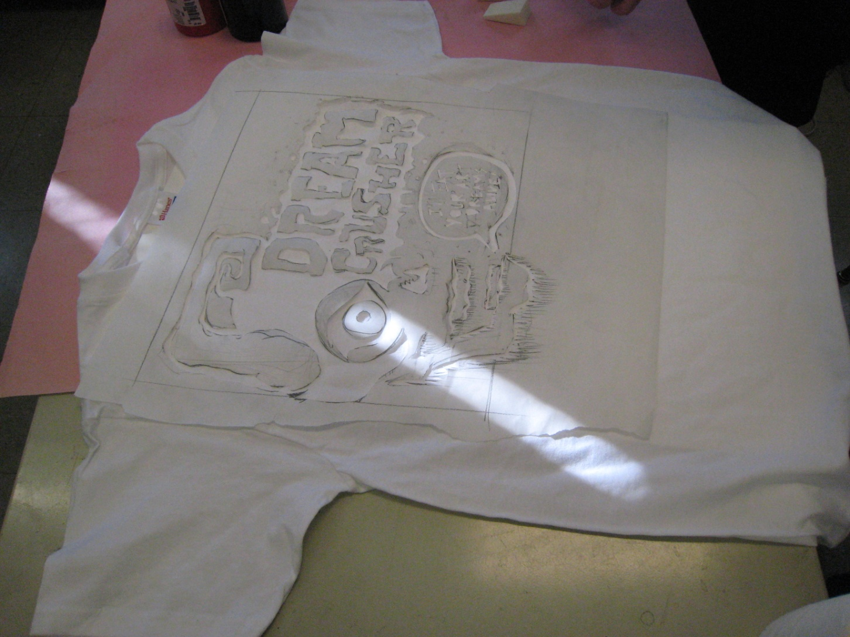
Put your cut out stencil on your t-shirt (make sure you have a board inside your shirt)

Slide 3
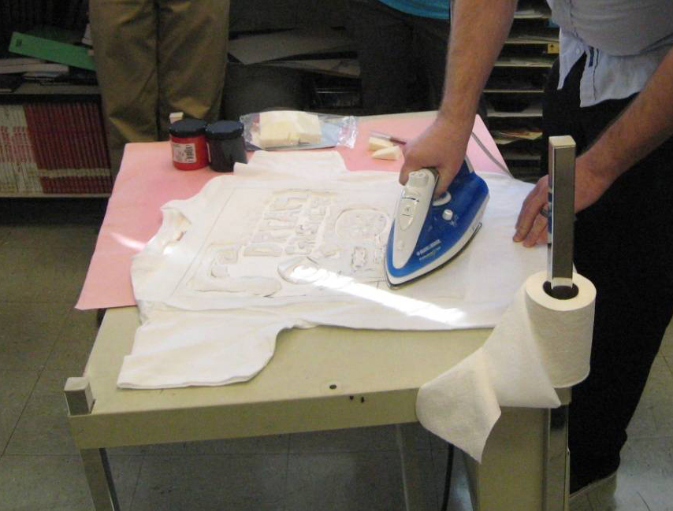
Iron on your cut out stencil (make sure shiny side is down)

Slide 4
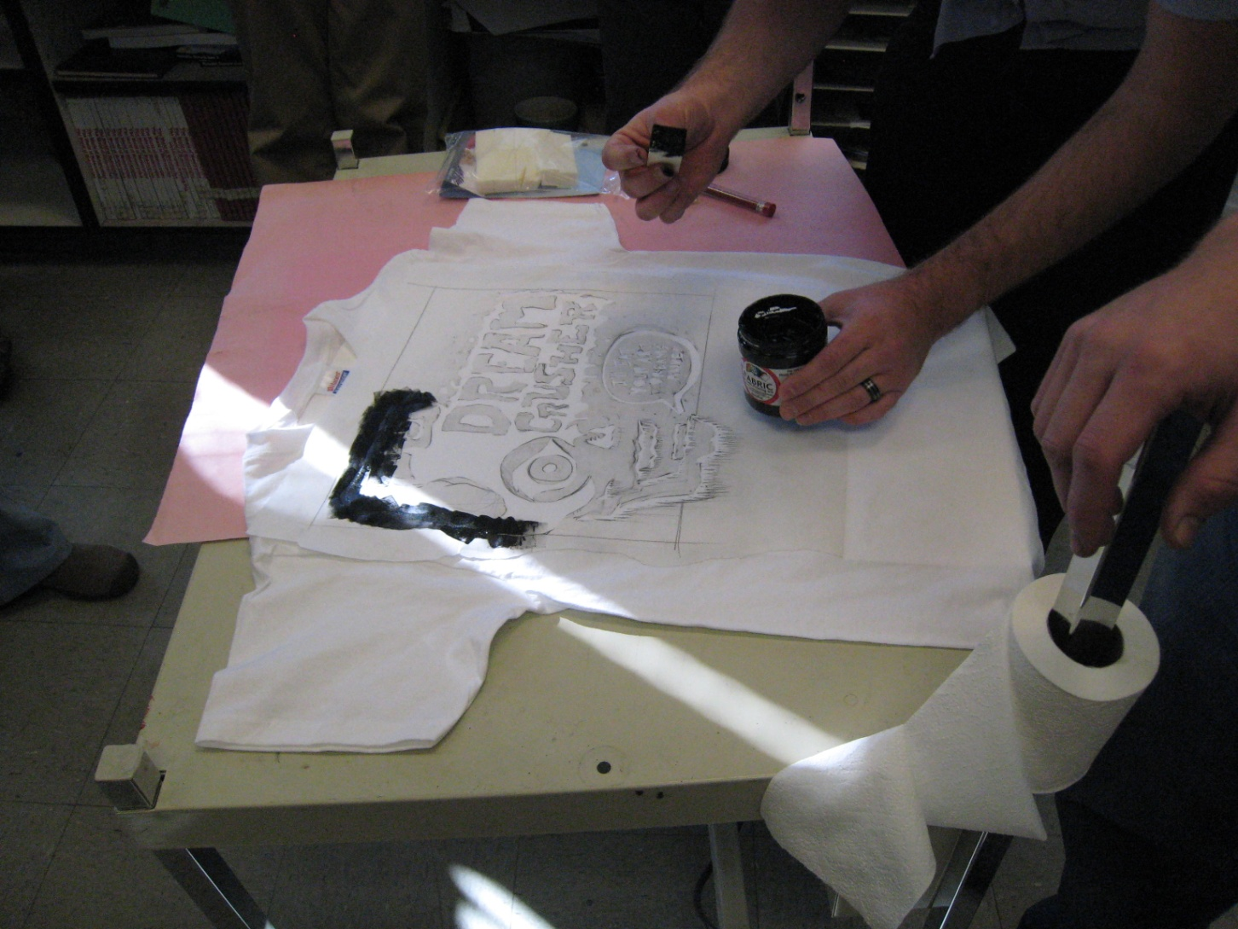
Ink it -Using a makeup sponge or paint brush

Slide 5
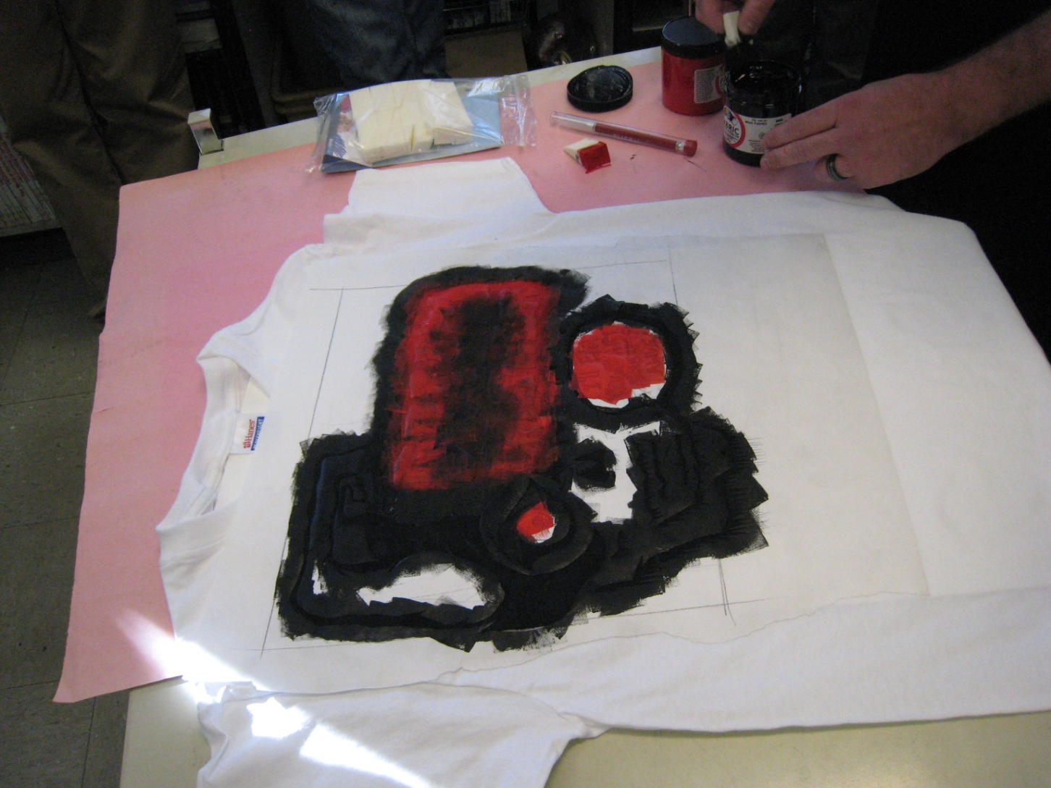
Make sure you don’t miss any areas

Slide 6
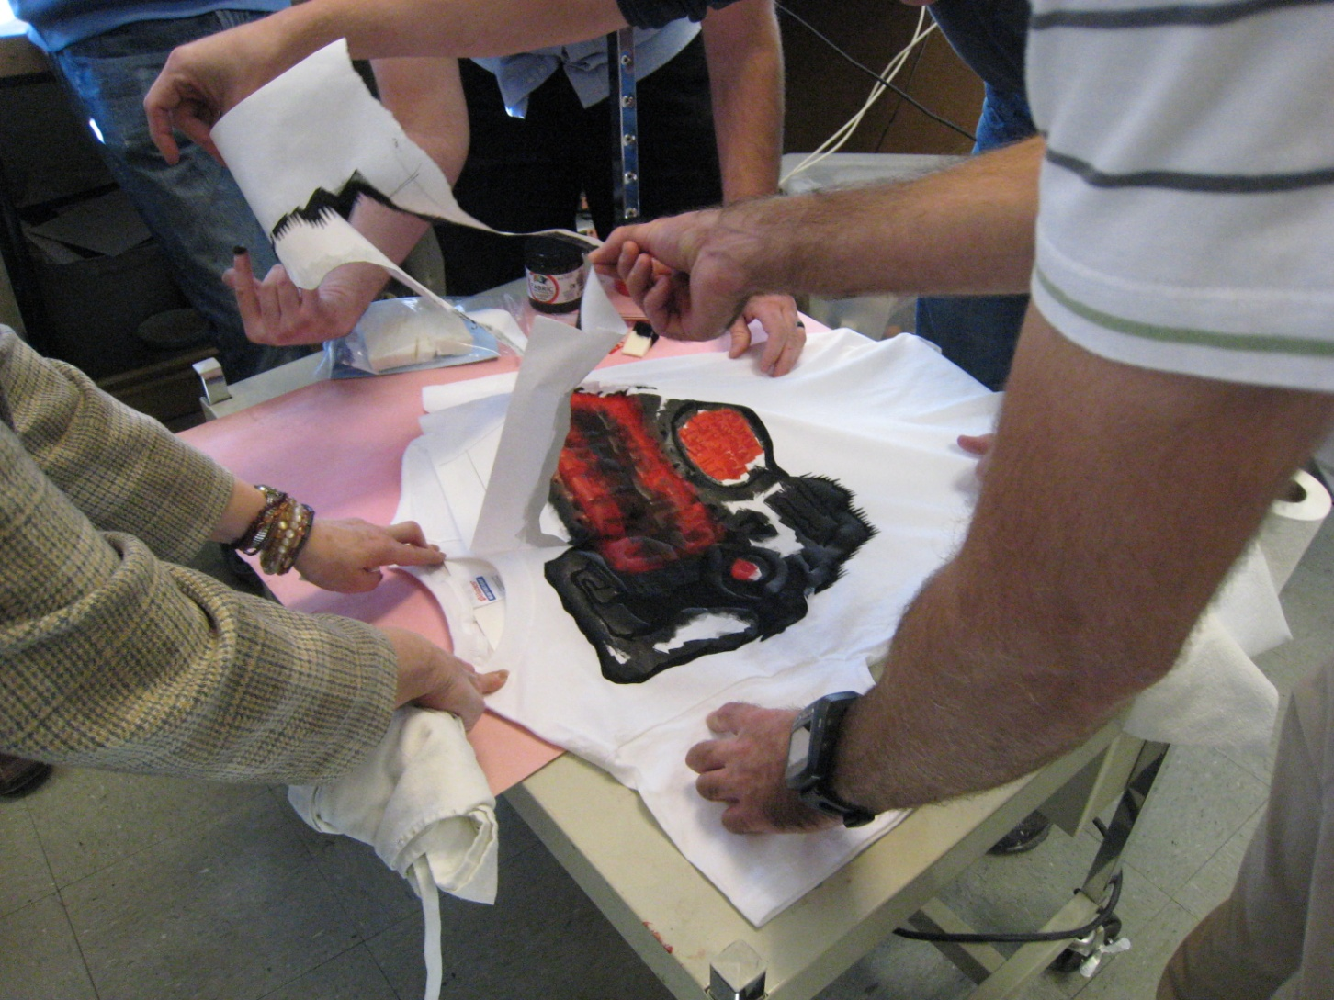
Once ink is dry, carefully peel off the freezer paper

Slide 7
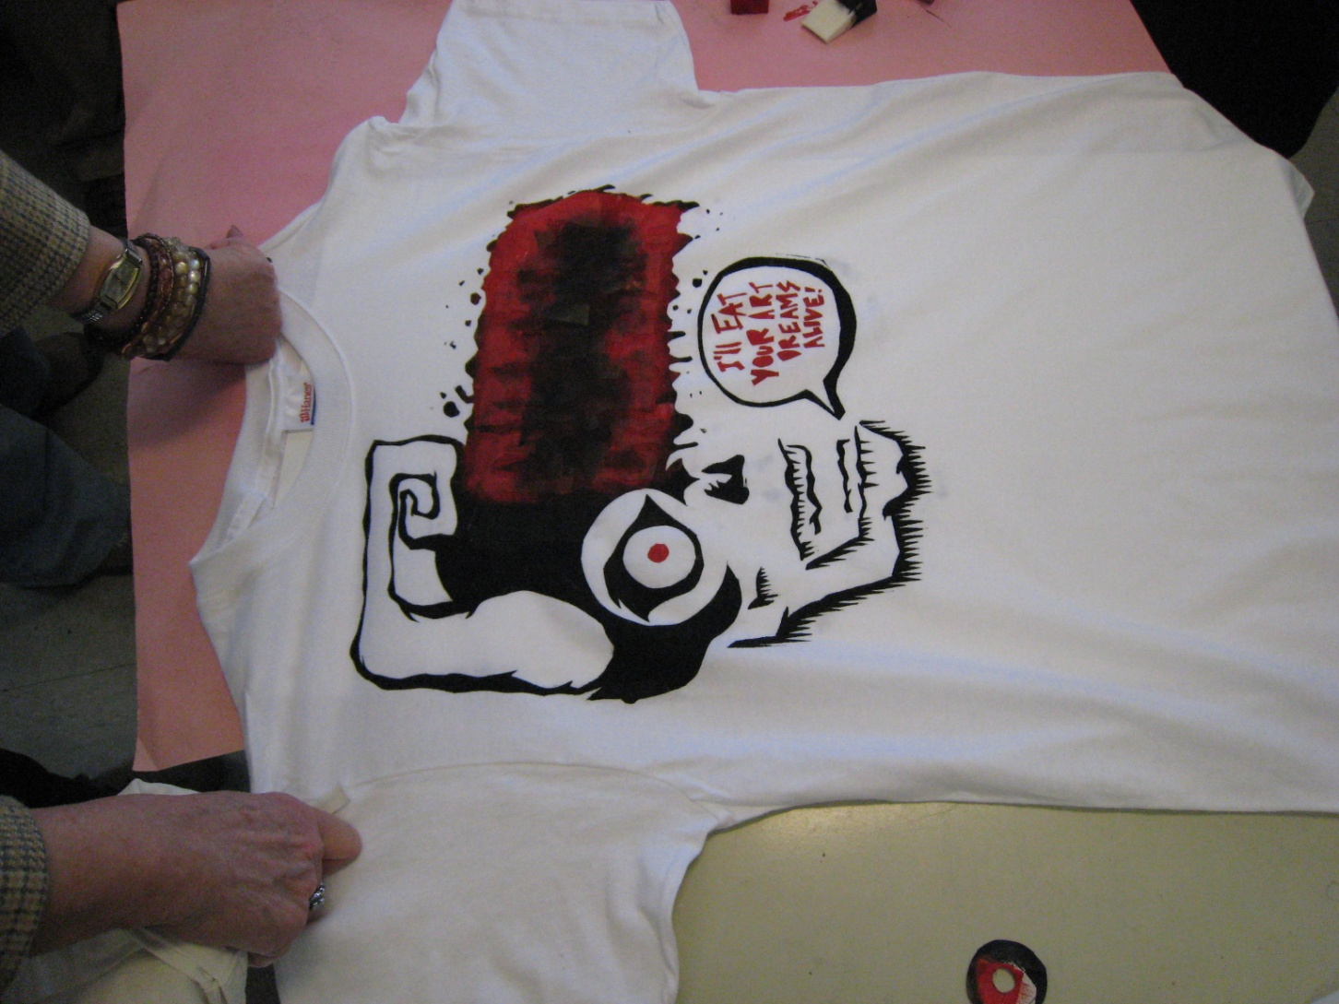

Slide 8
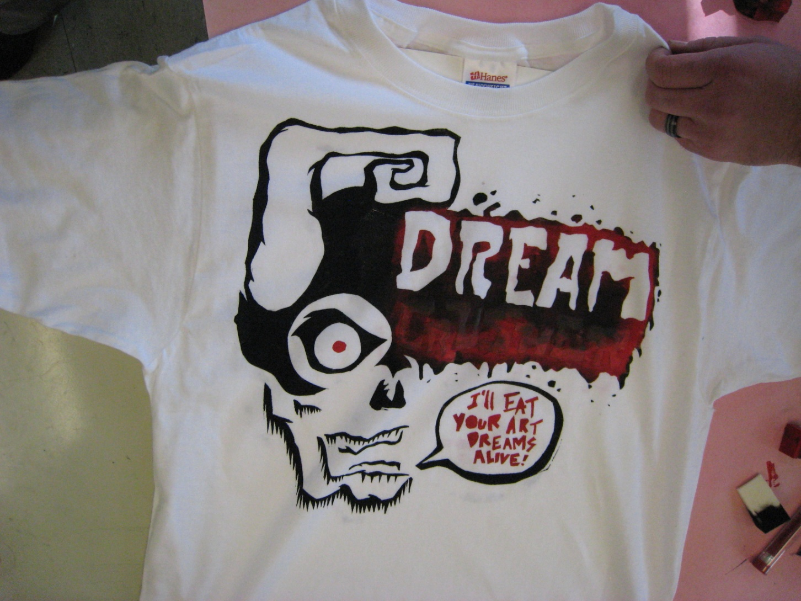

Slide 9
Your Assignment
Draw out your design on Freezer paper – make sure it is the size you want – draw it in shapes
Cut it out with an x-acto knife and cutting matt
Iron on freezer paper to shirt
Carefully ink it up
Once its dry carefully peel off paper
Cover with paper and iron on high for 3-5 mins to set ink

Slide 10
Student Examples

Slide 11
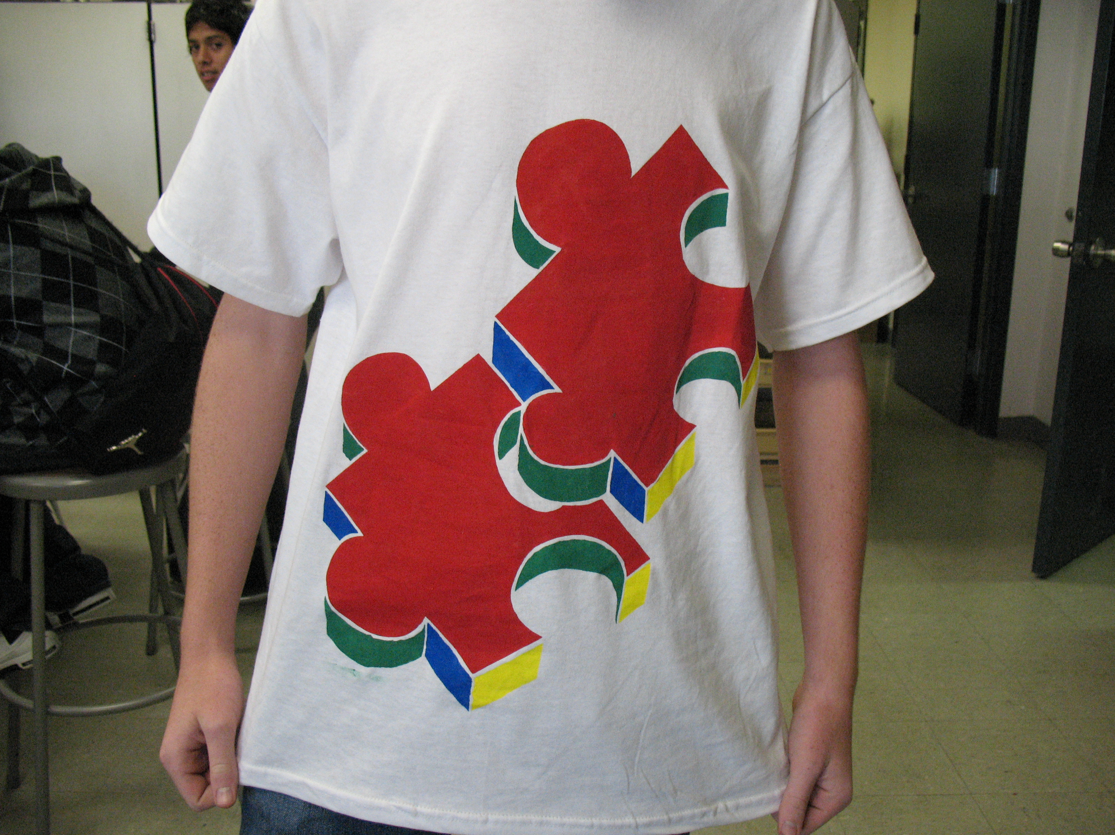

Slide 12
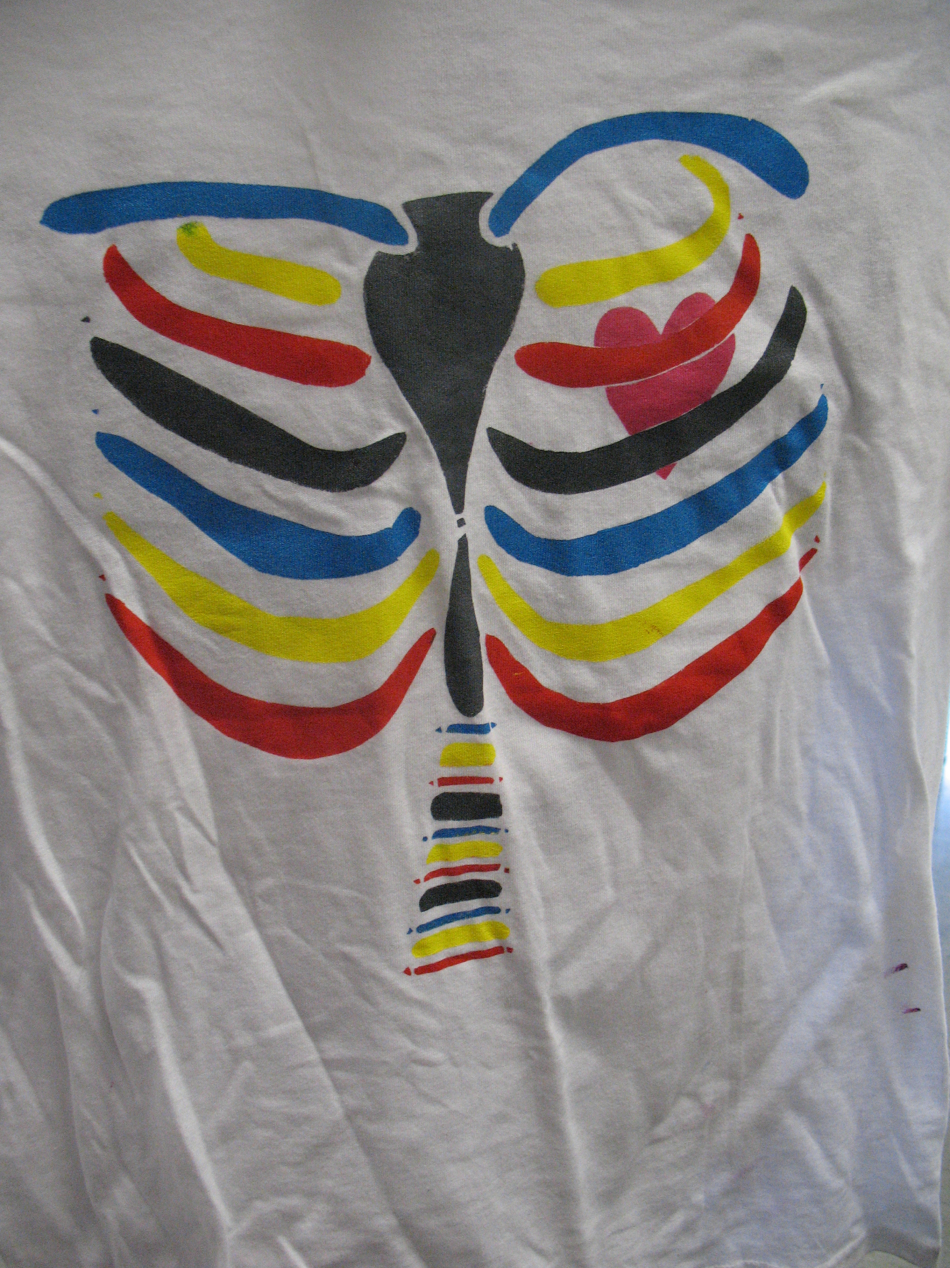

Slide 13
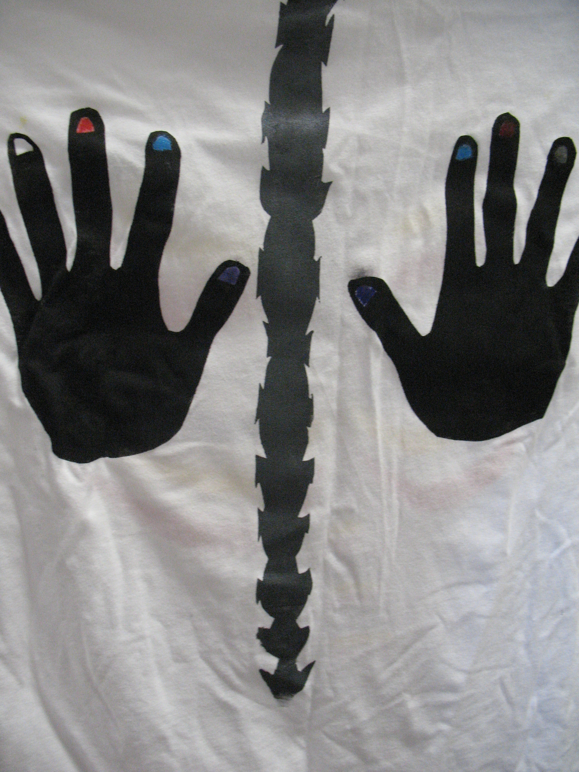

Slide 14


Slide 15
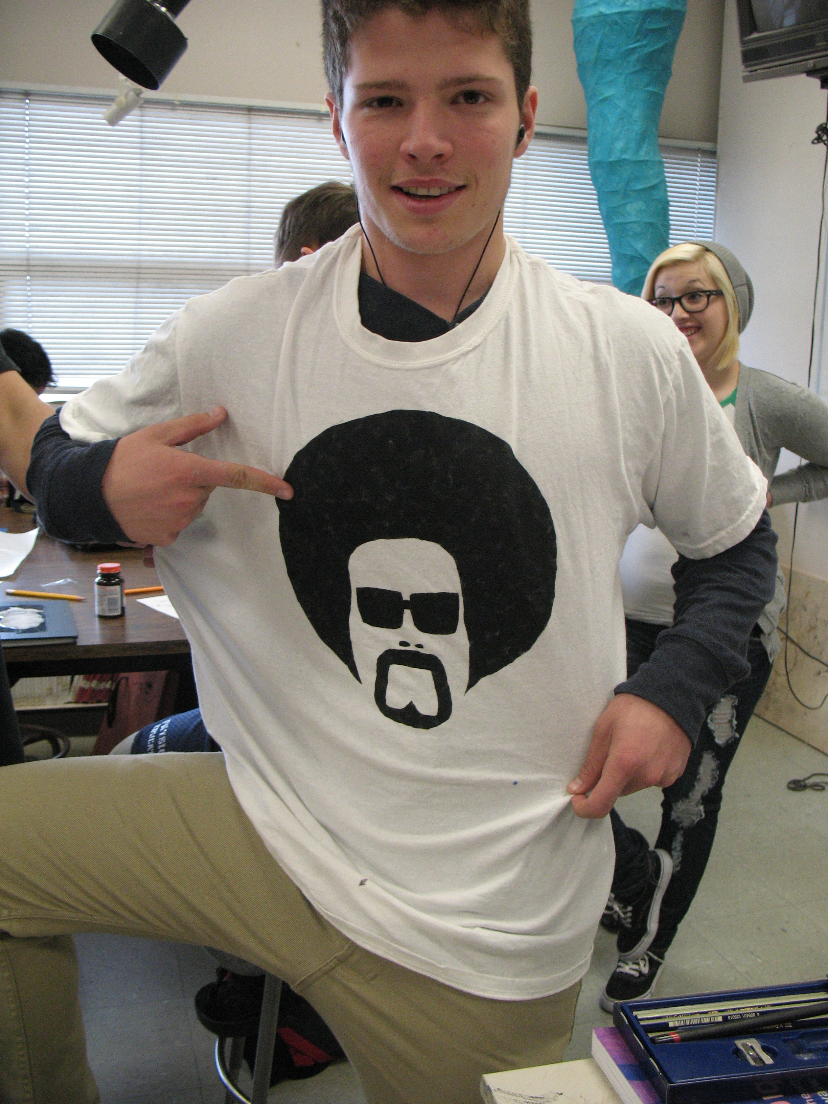

Slide 16
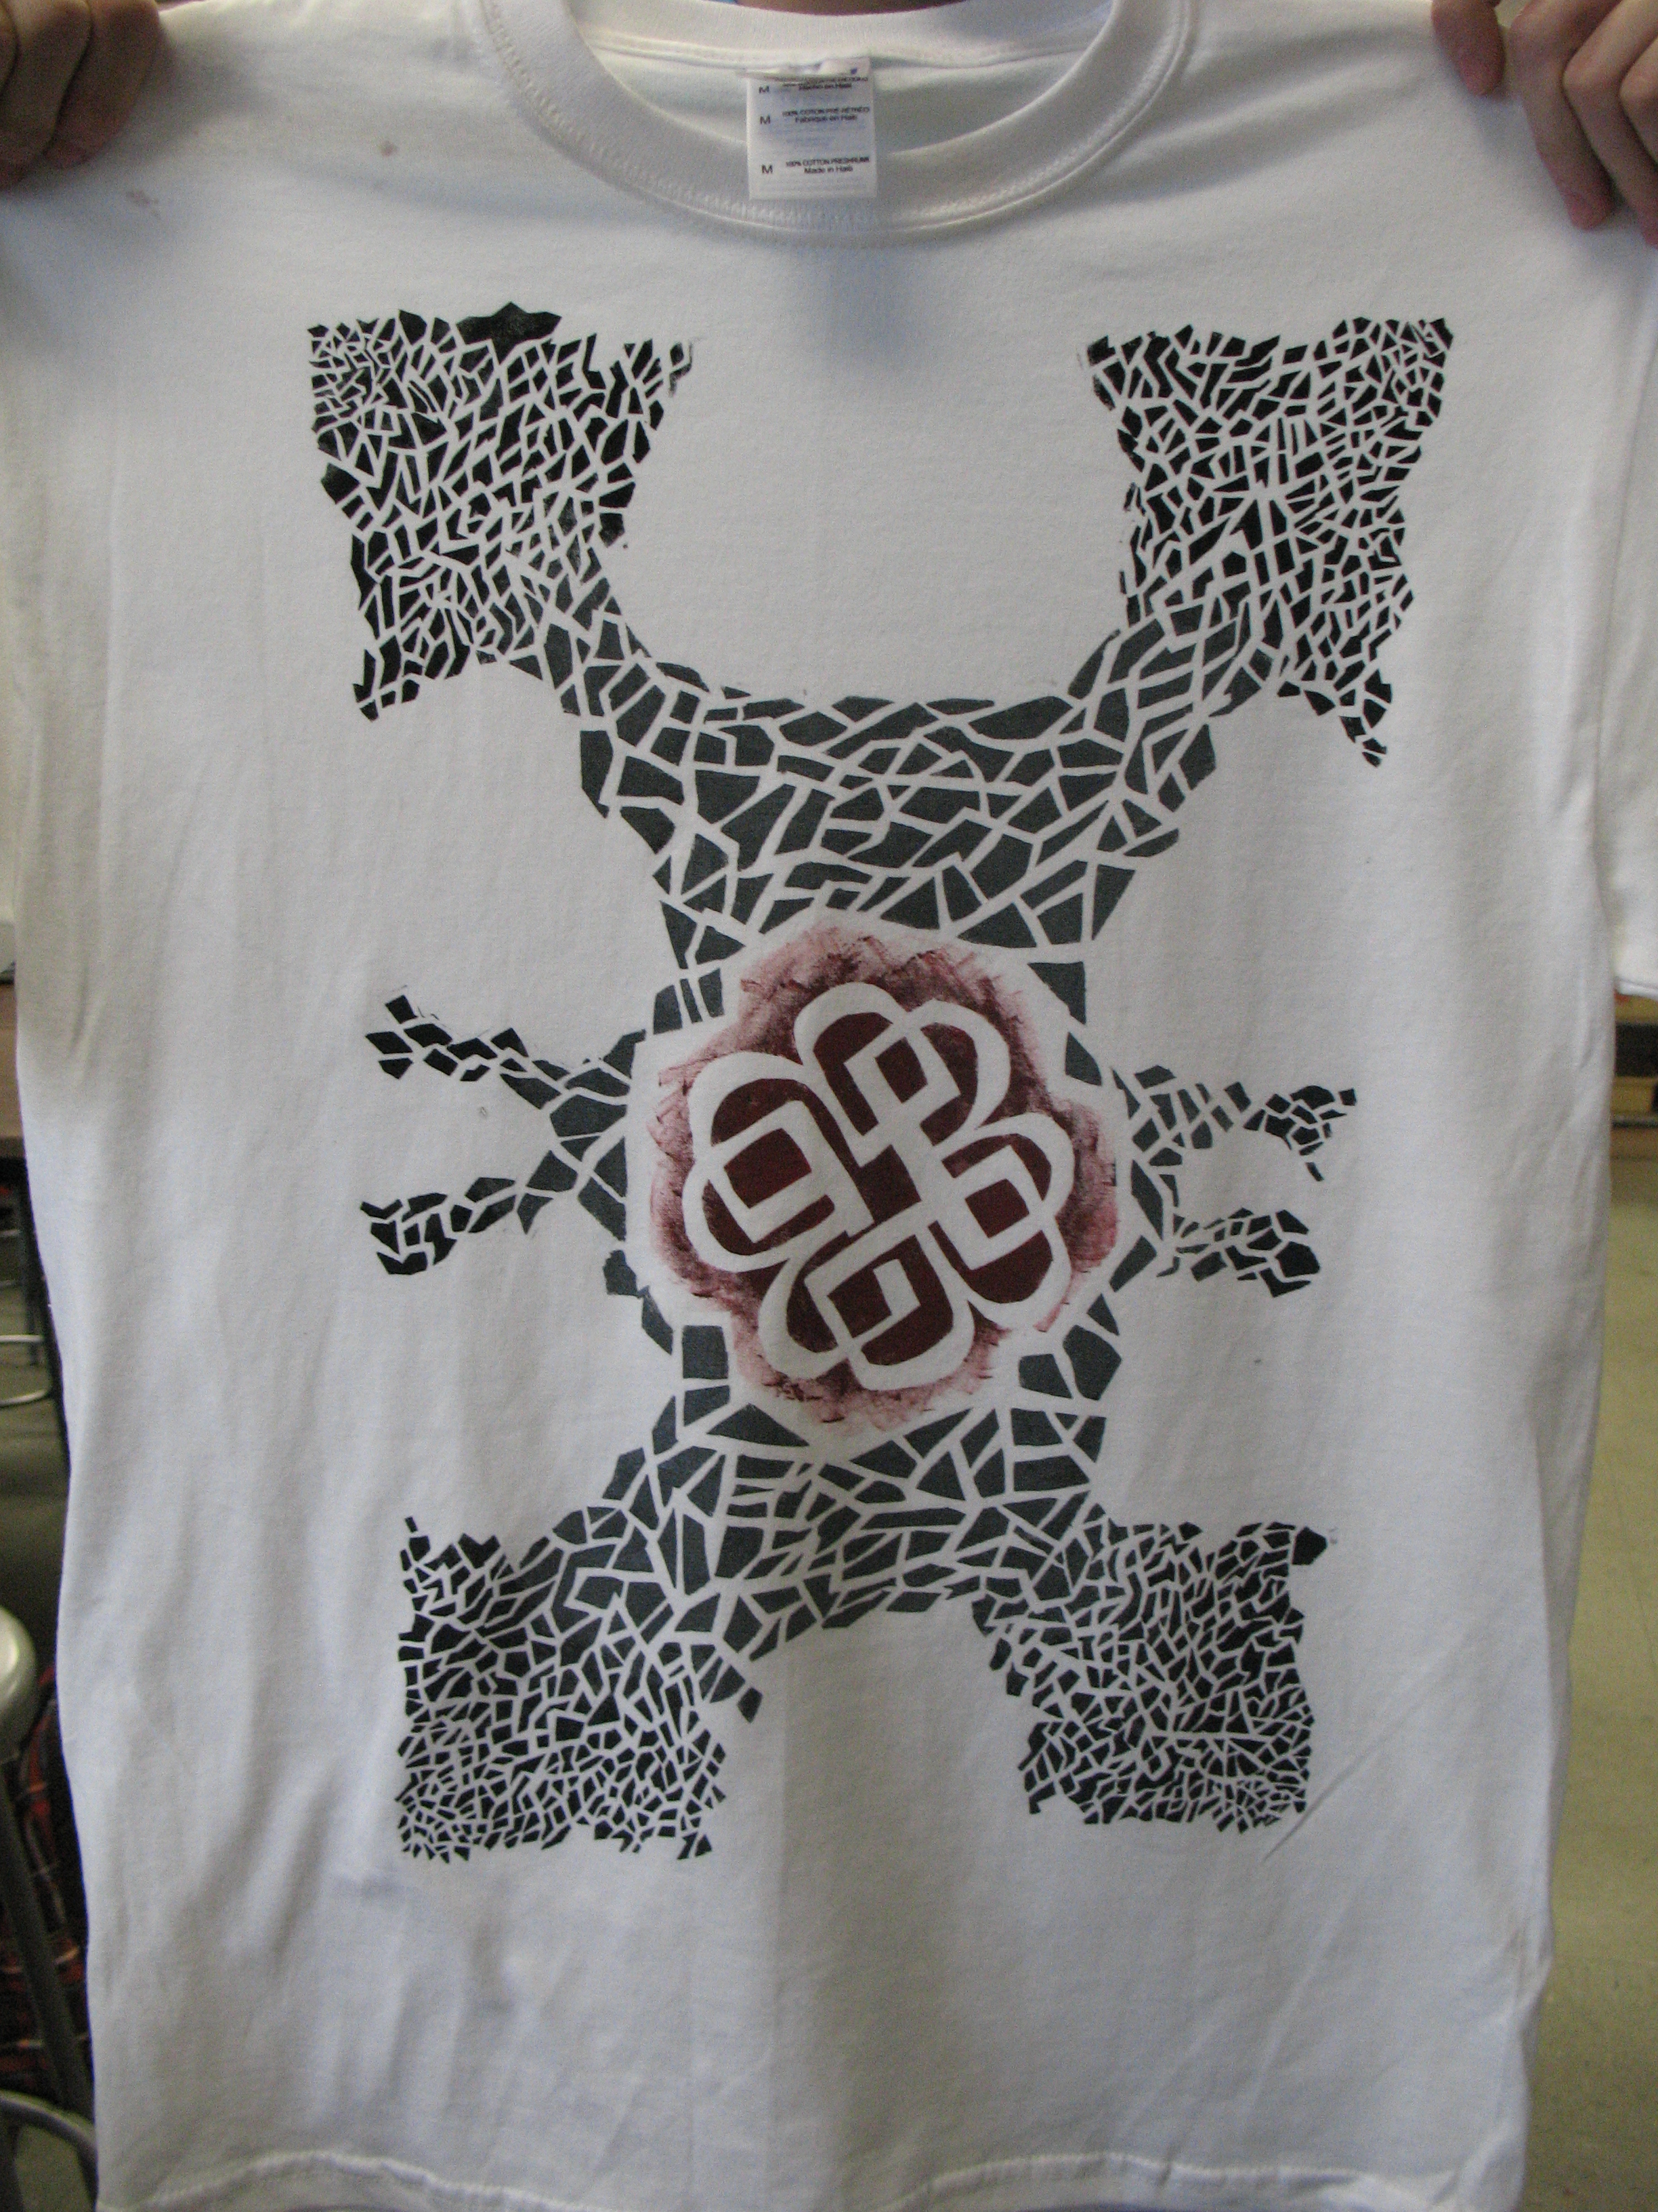

Slide 17
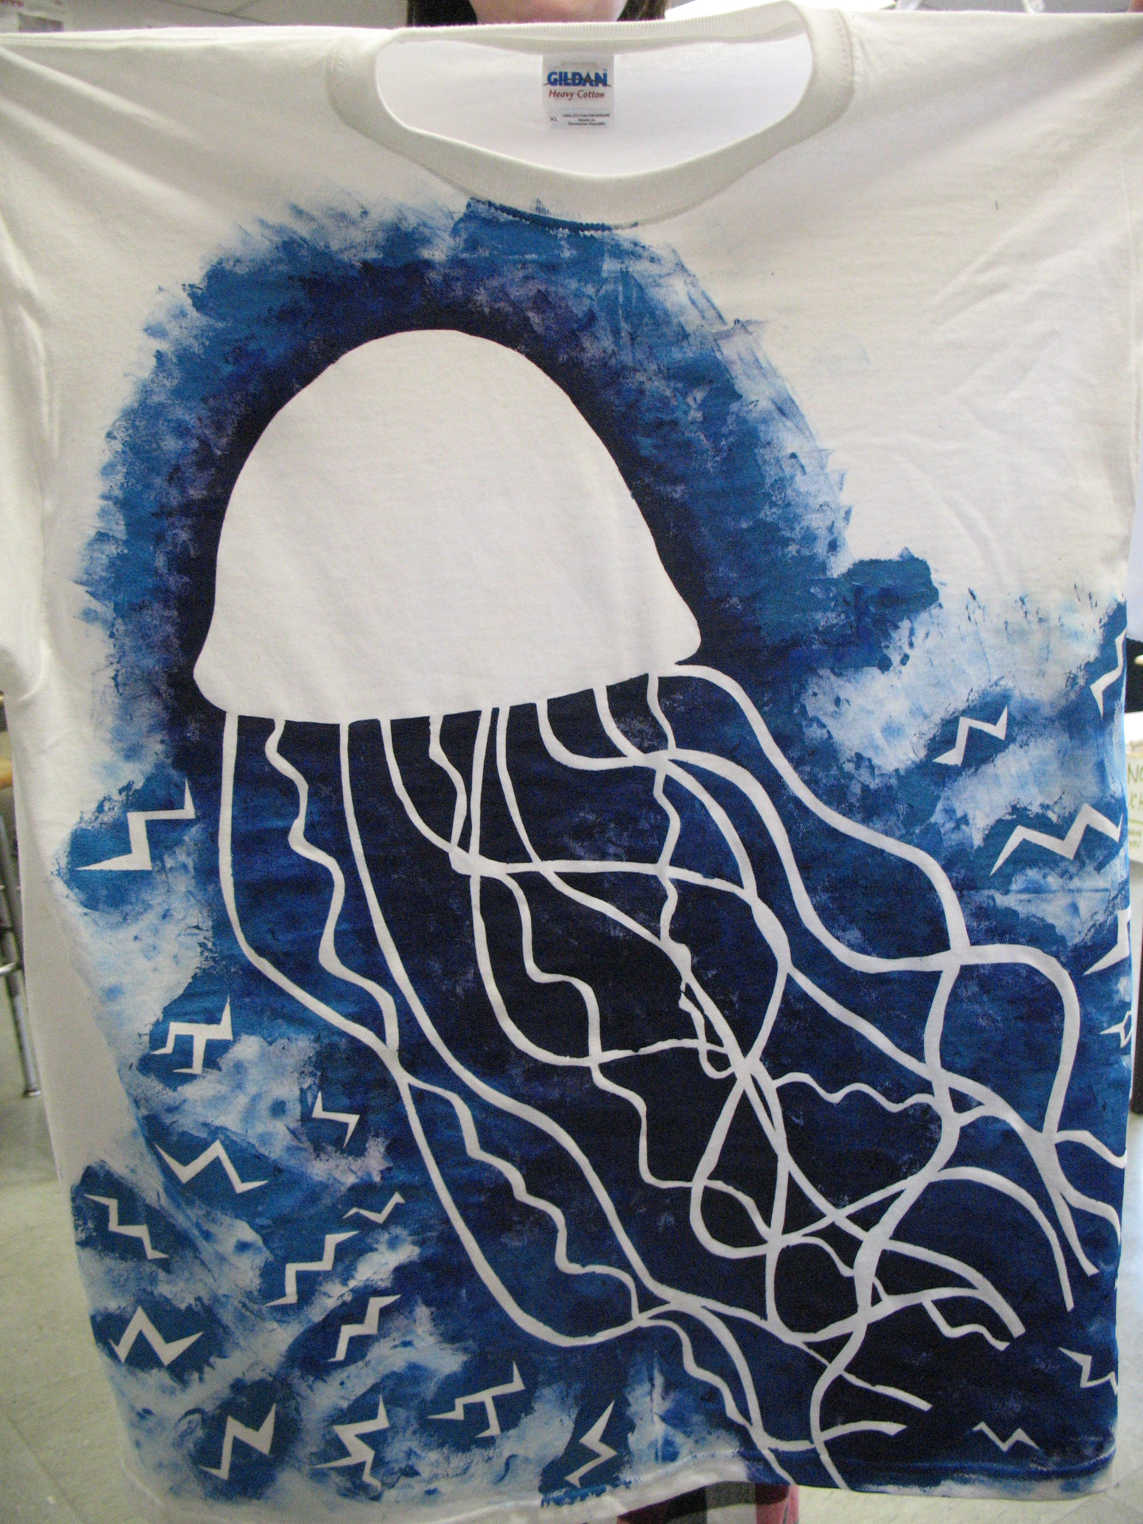

Slide 18
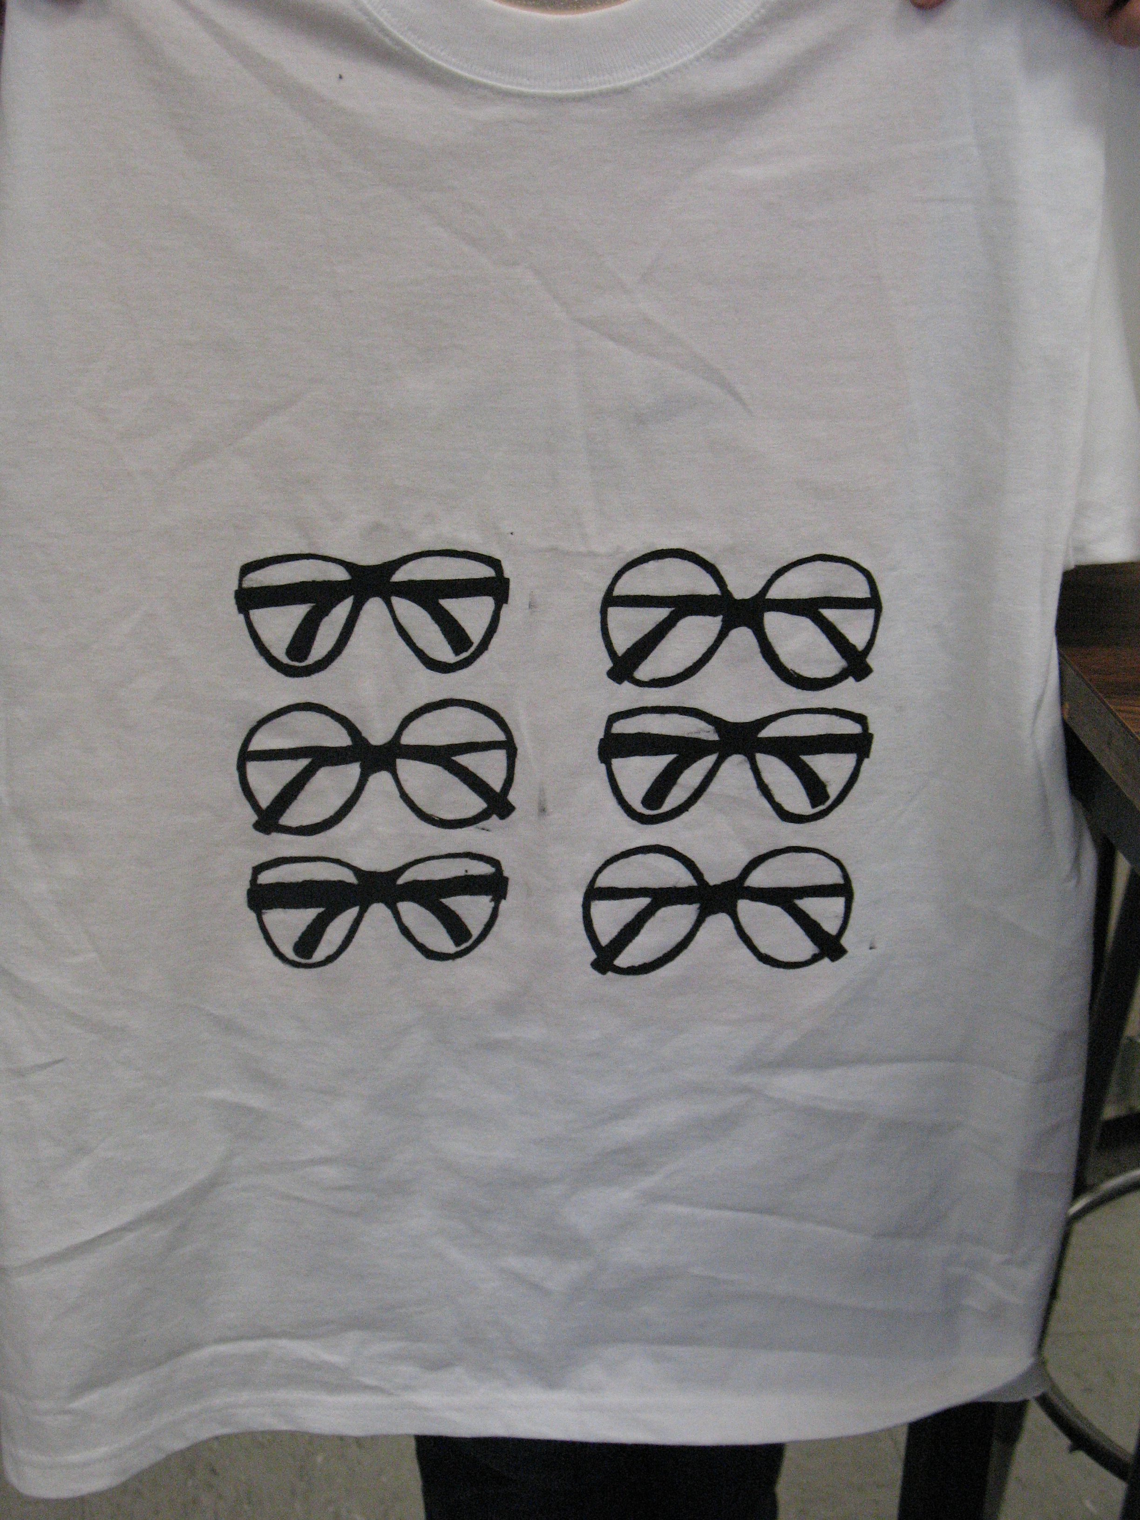

Slide 19
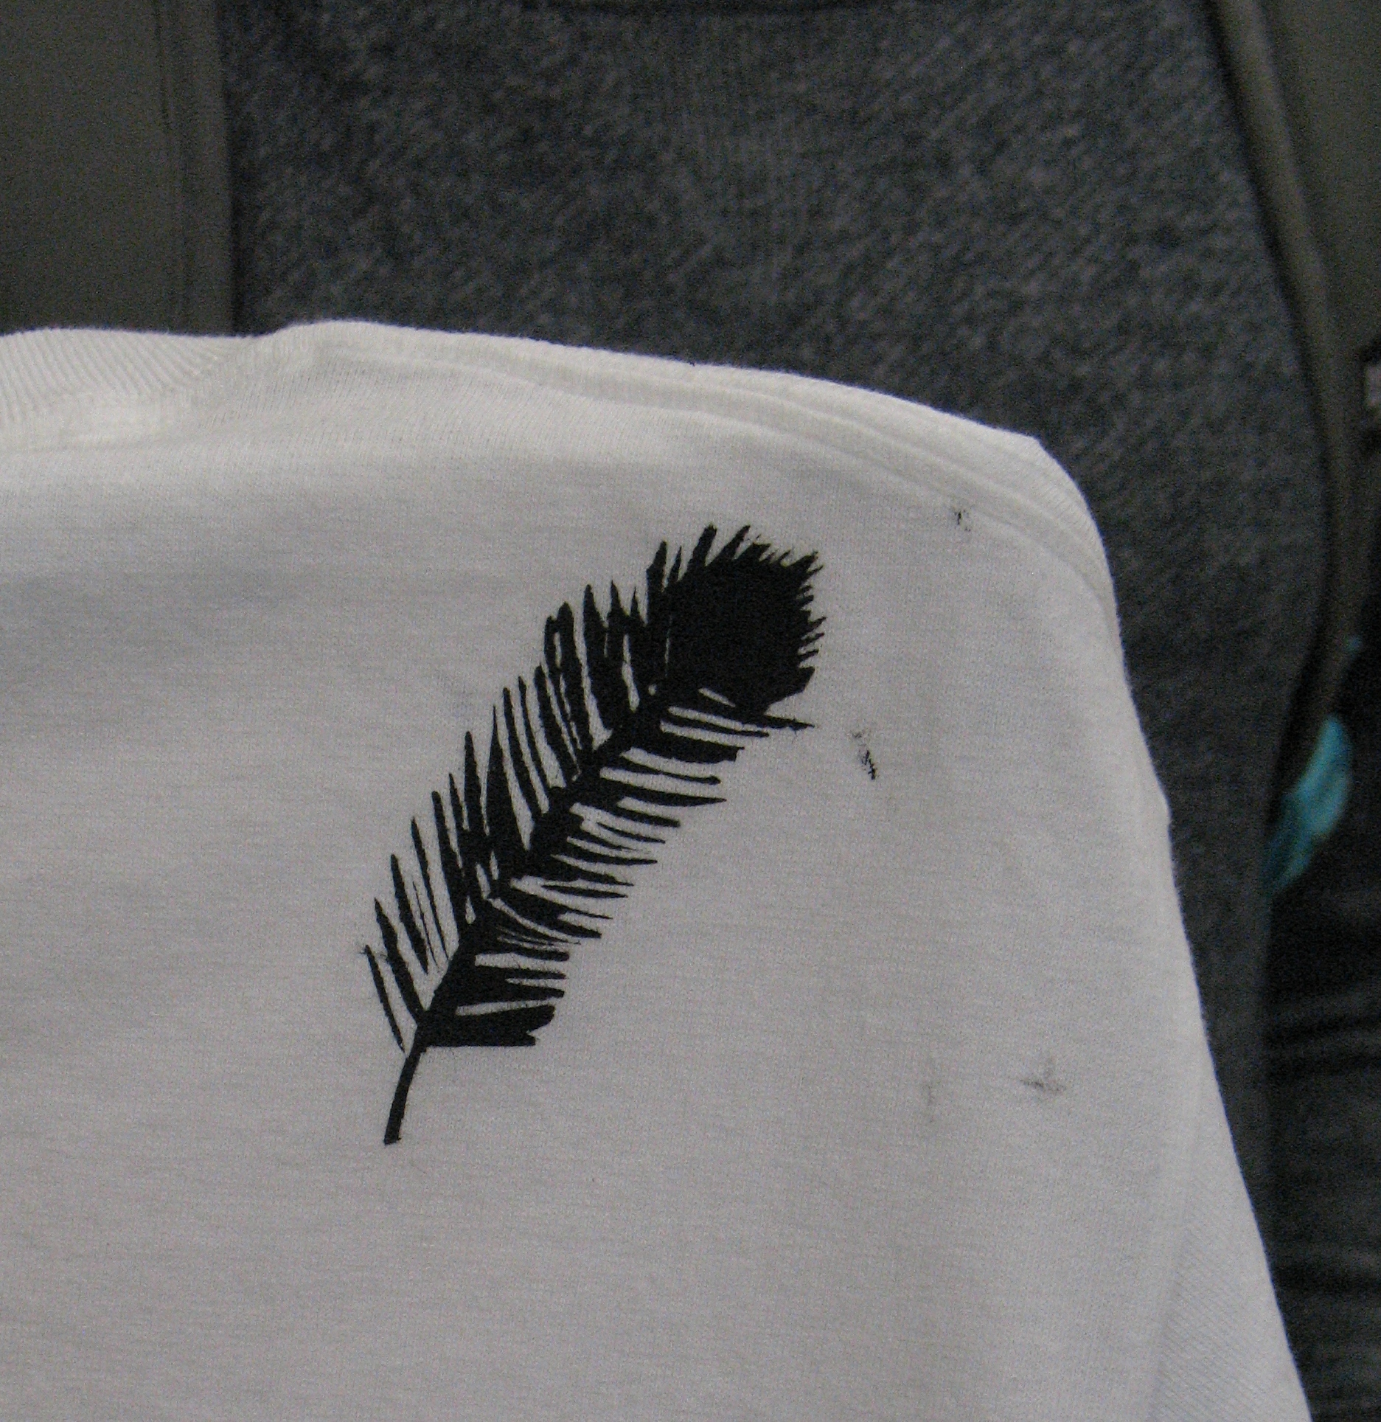

Slide 20


Slide 21
