Slide 1
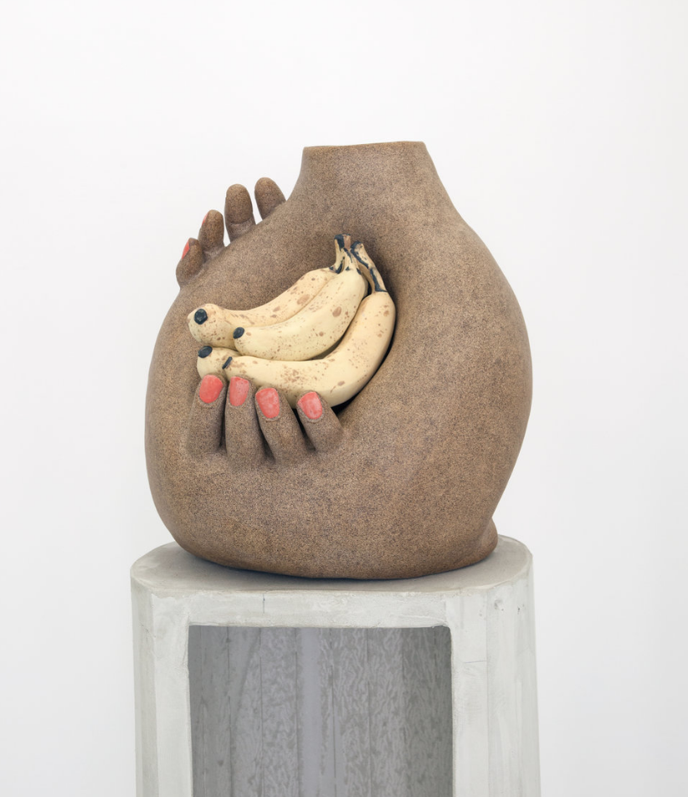
Genesis Belanger
Contemporary ceramic artist
Of the show “Cheap Cookie and a Tall Drink of Water”
Genesis Belanger
2017

Slide 2
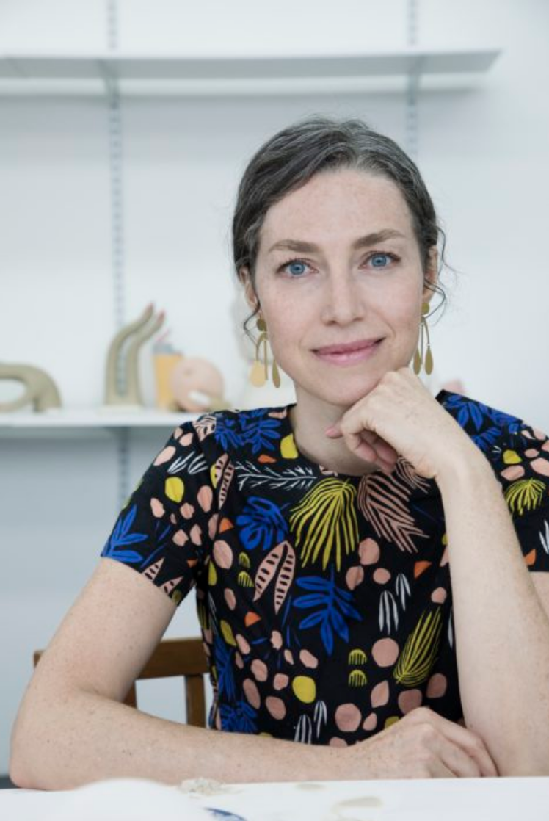
Brooklyn-based ceramicist
Degree in fashion design, worked as a prop-maker for advertising campaigns
GENESIS BELANGER

Slide 3
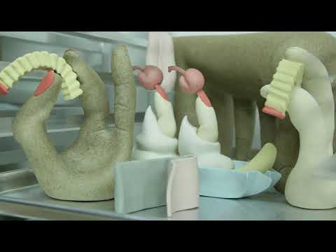

Slide 4
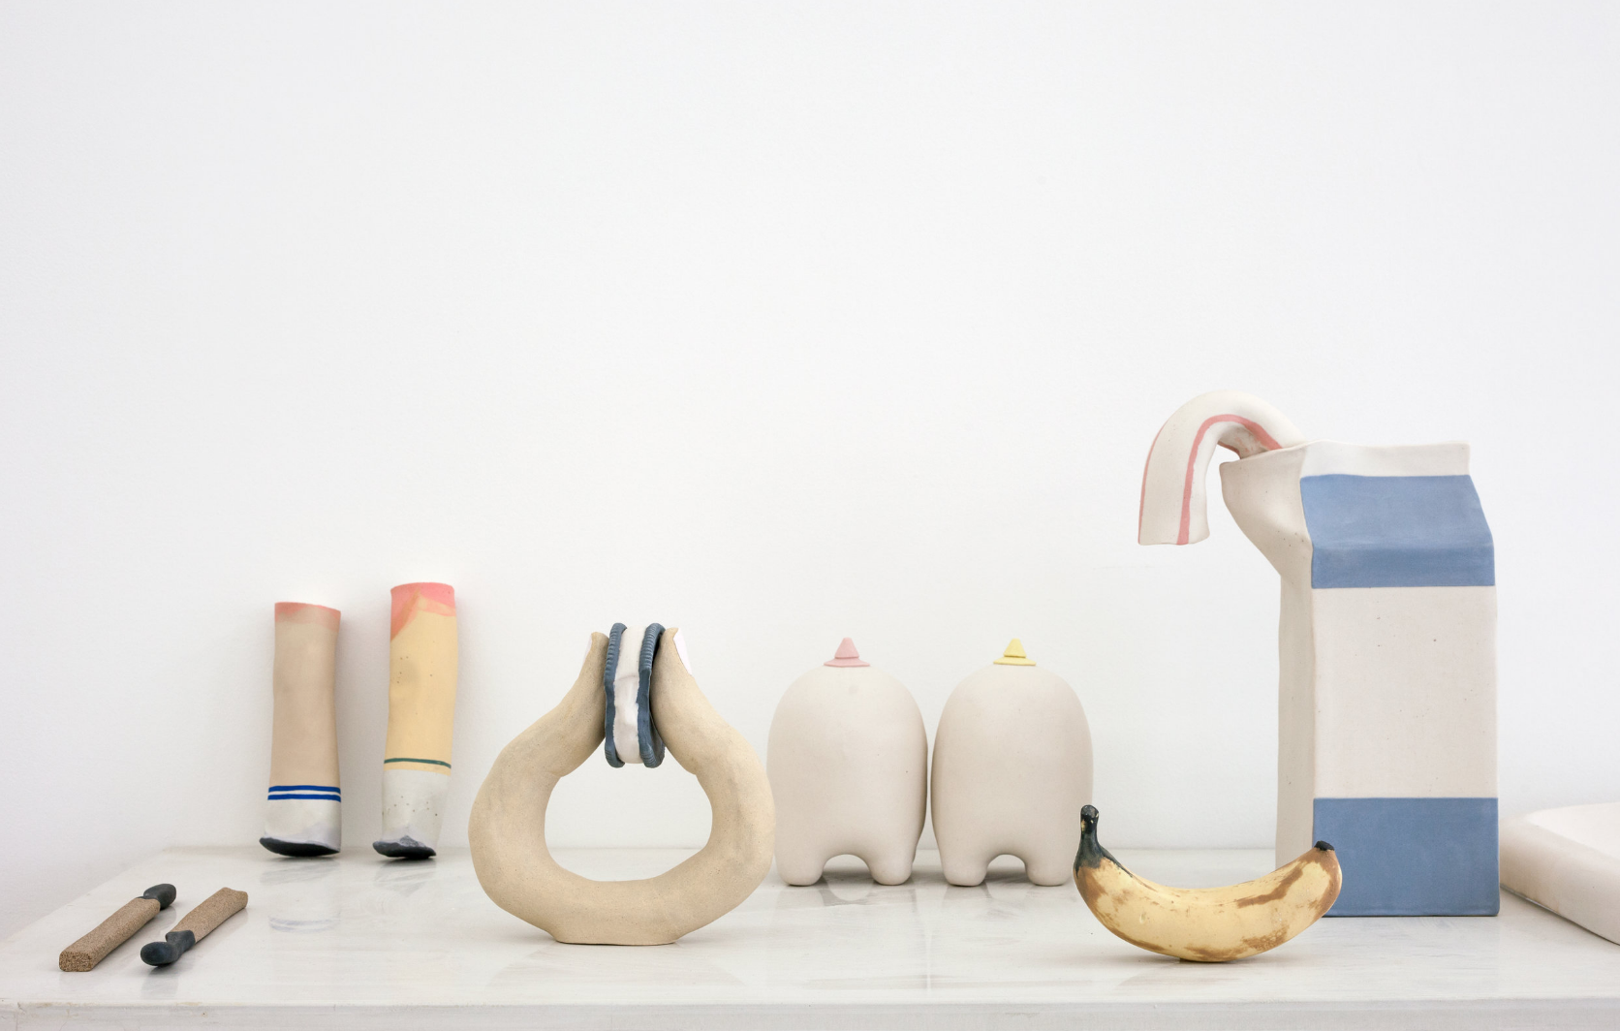
Cheap Cookie and a Tall Drink of Water, 2017

Slide 5
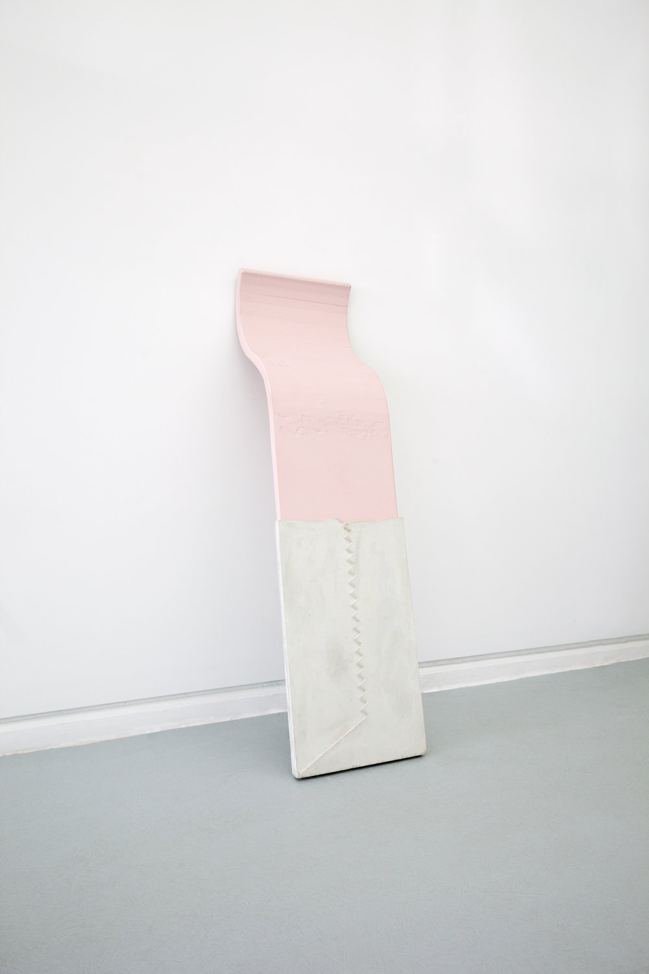
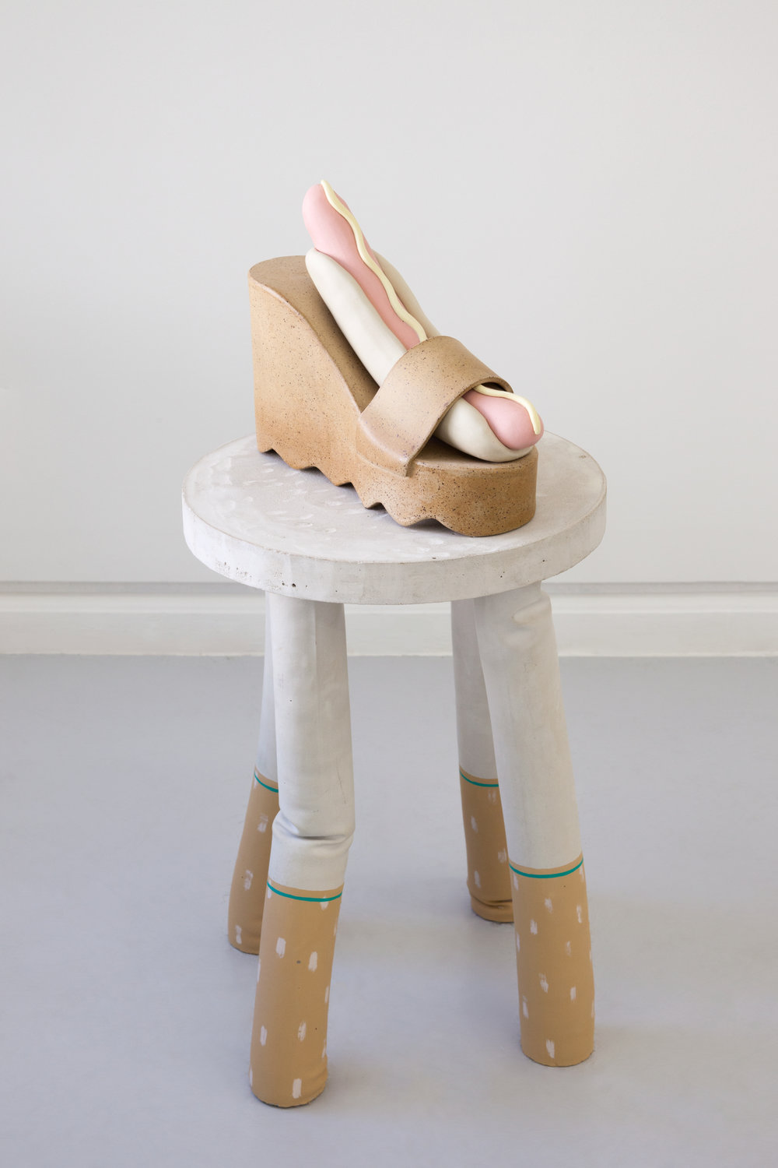
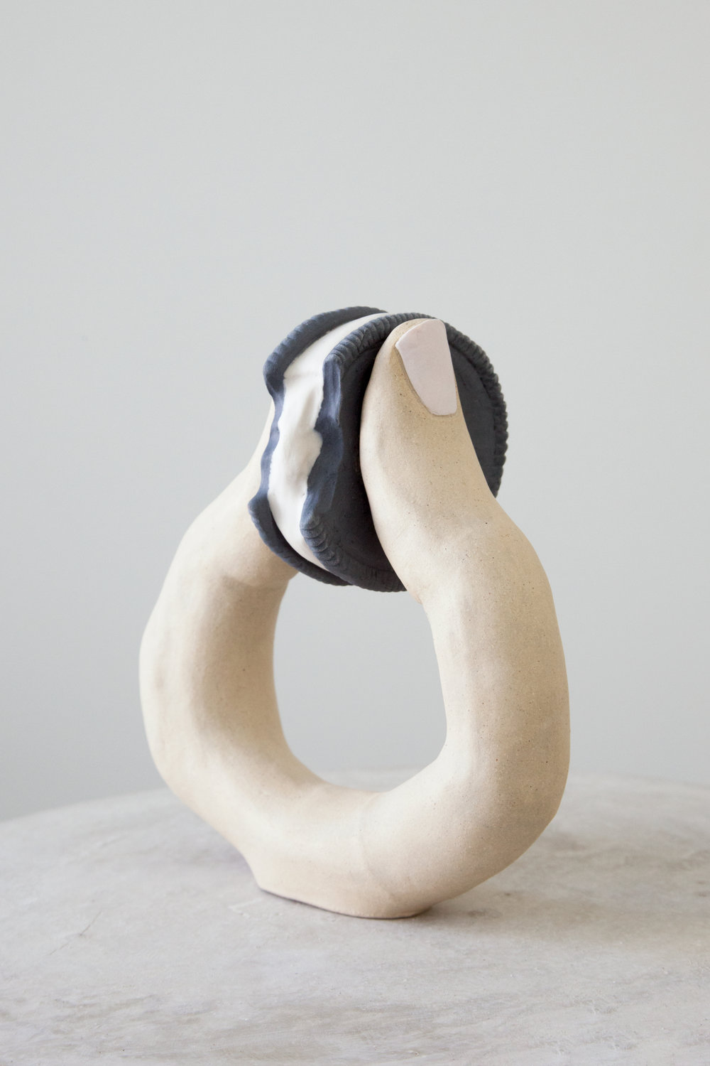
Cheap Cookie and a Tall Drink of Water, 2017

Slide 6
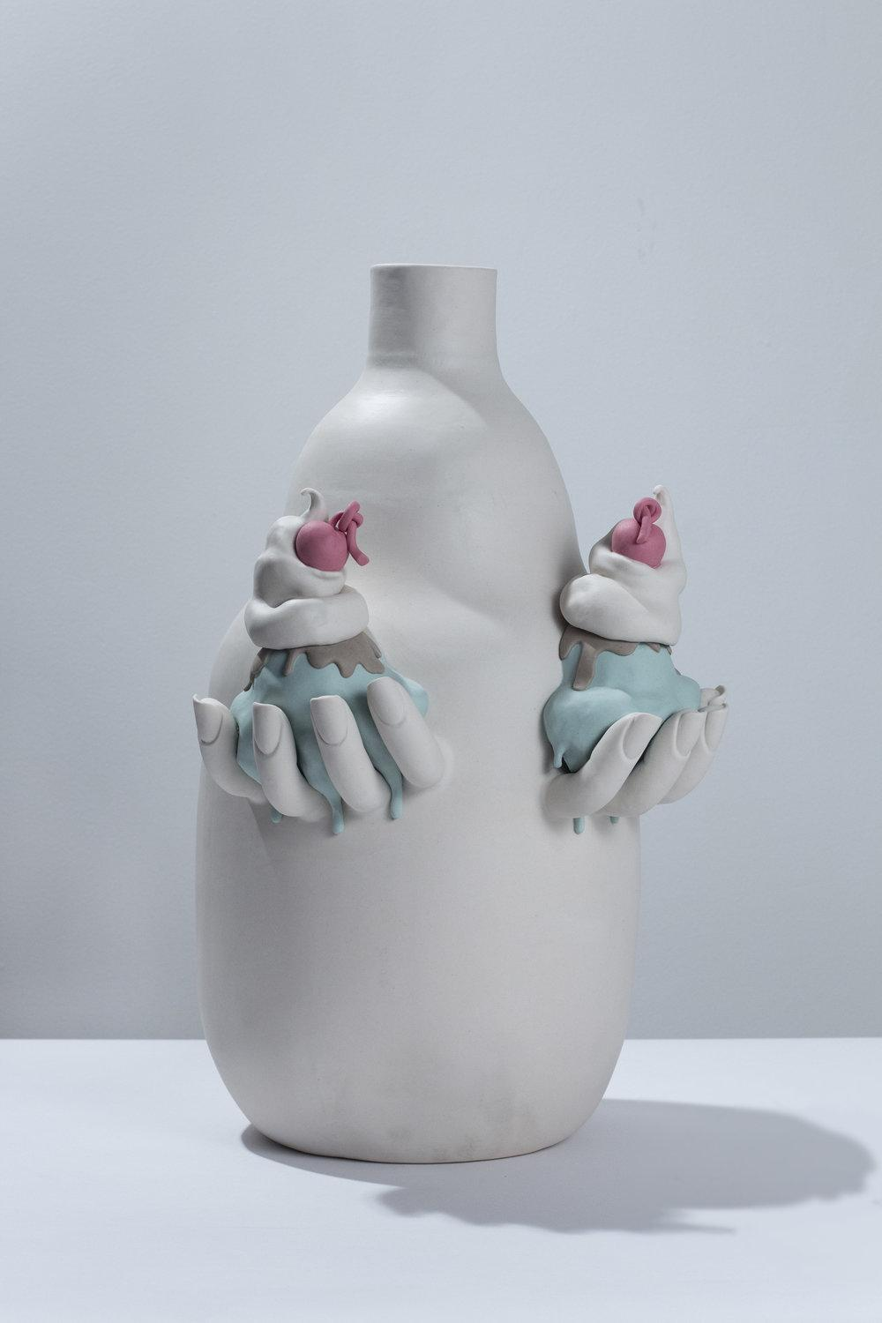
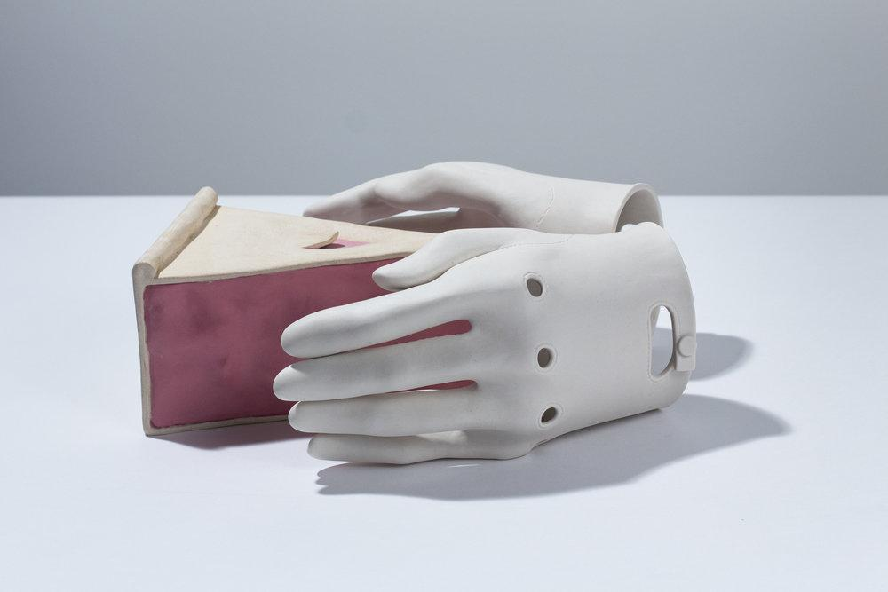
Body So Delicious, 2018

Slide 7
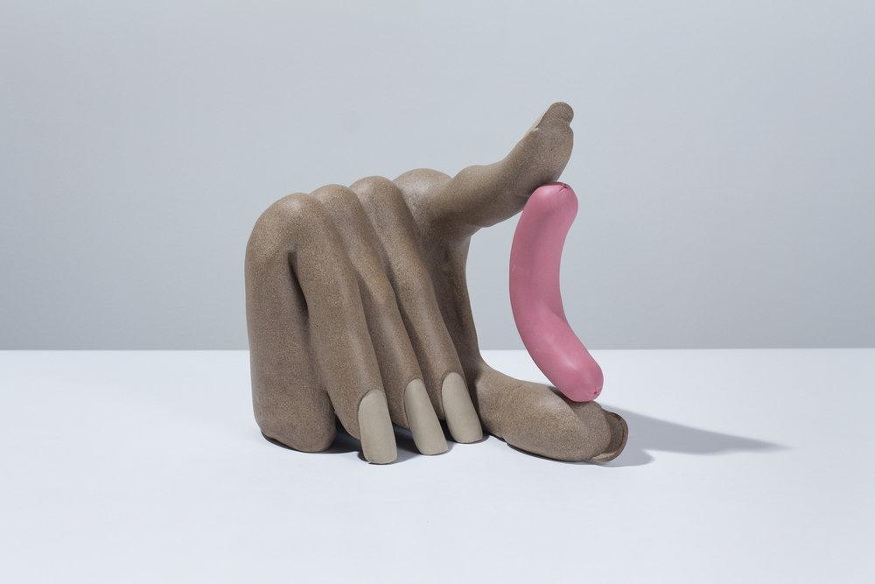
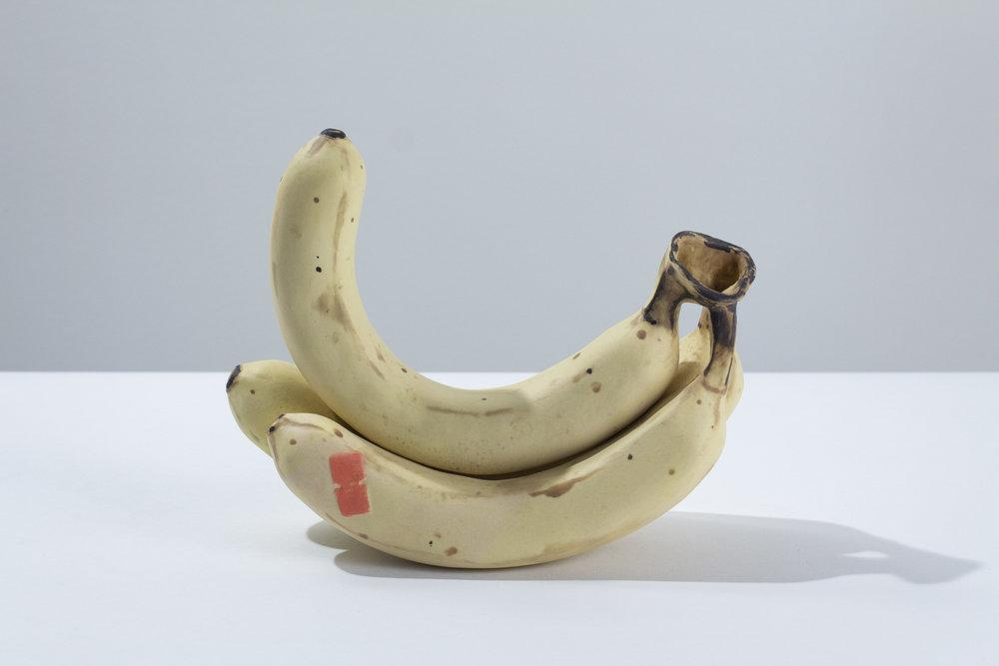
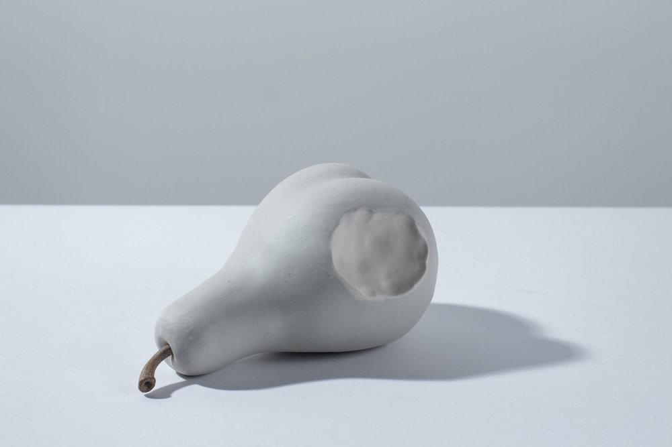
Body So Delicious, 2018

Slide 8
Yummy, 2017, stoneware, porcelain

Slide 9
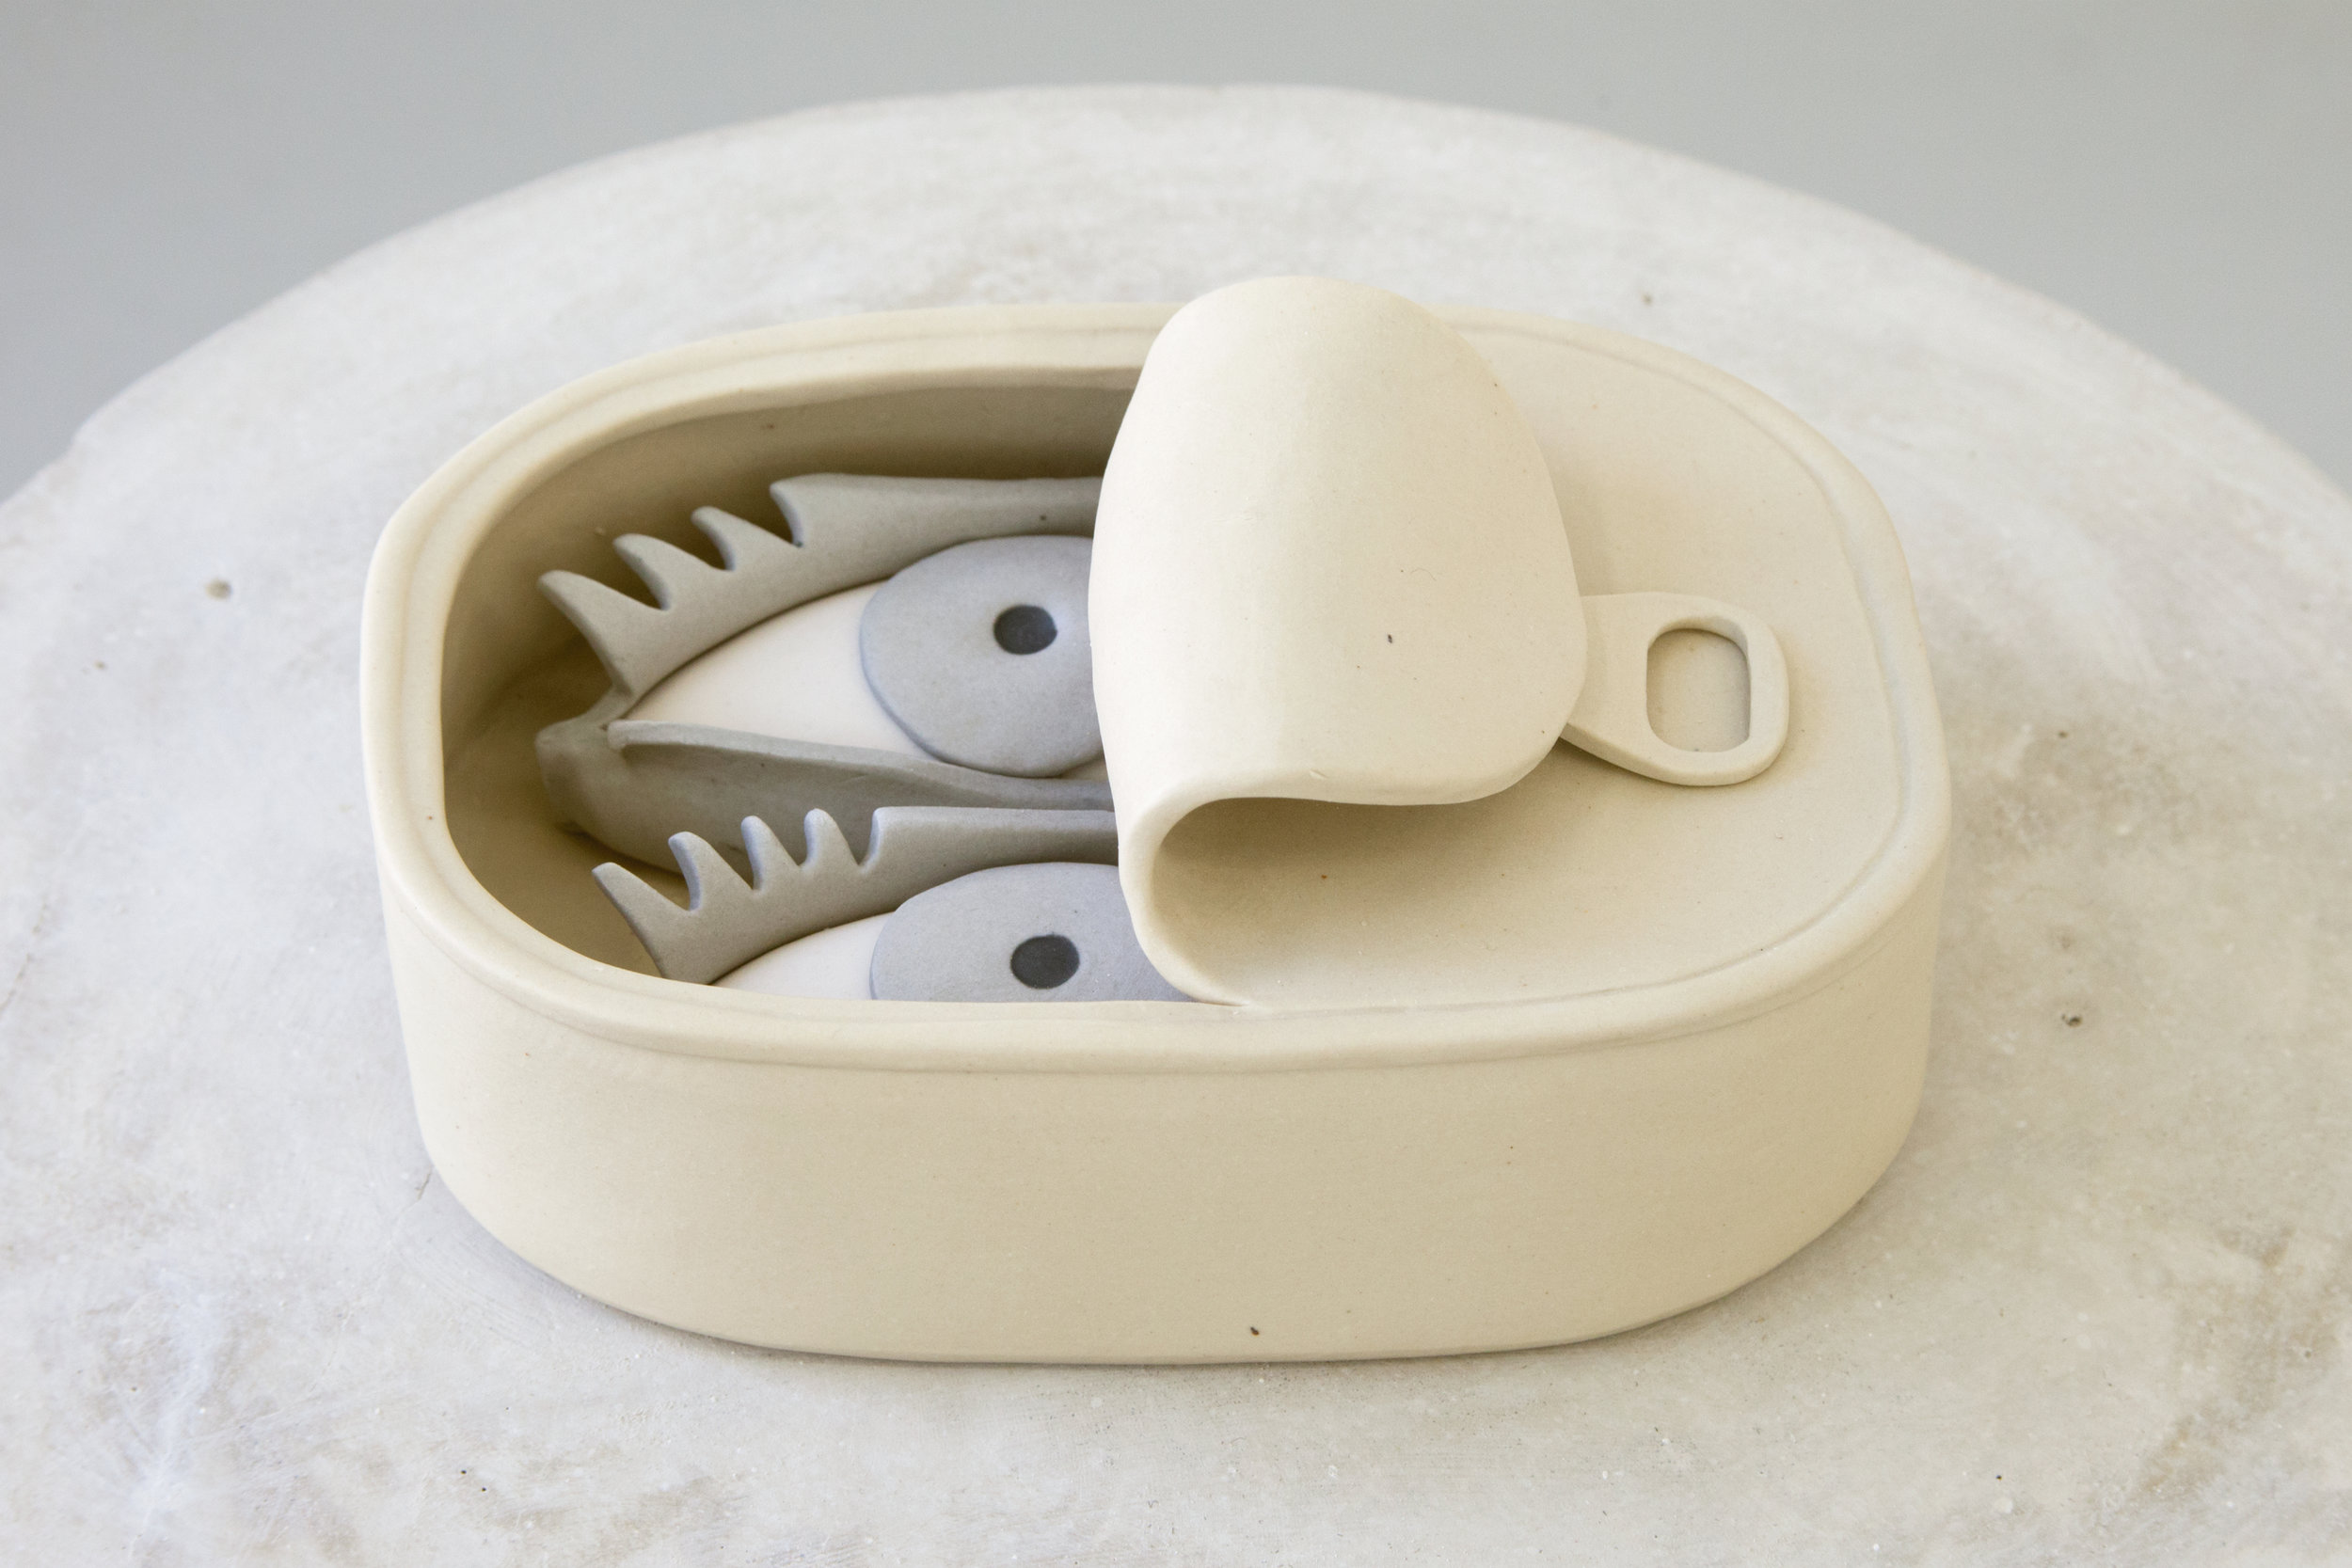
Something Fishy, 2017, porcelain

Slide 10
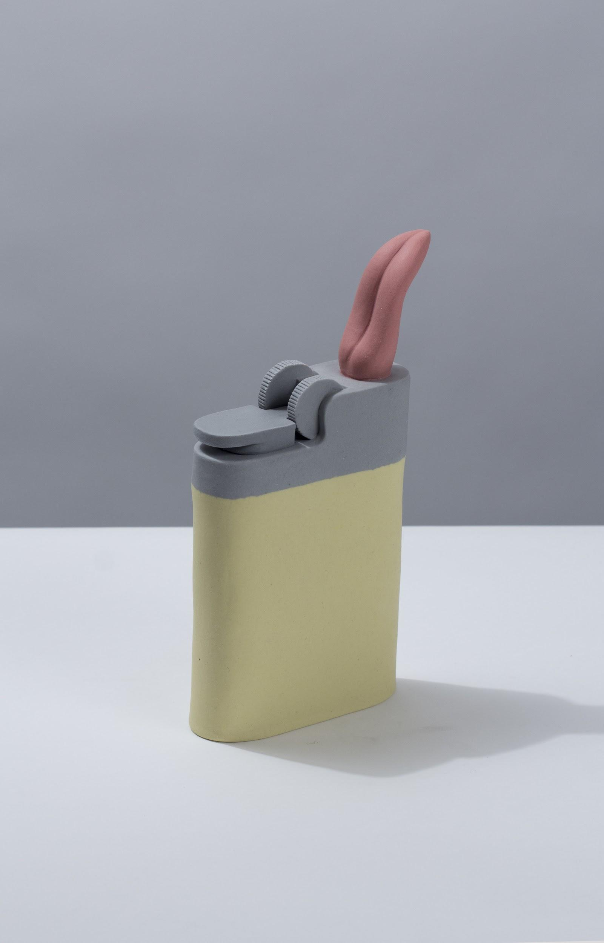
Flick, 2018, porcelain

Slide 11
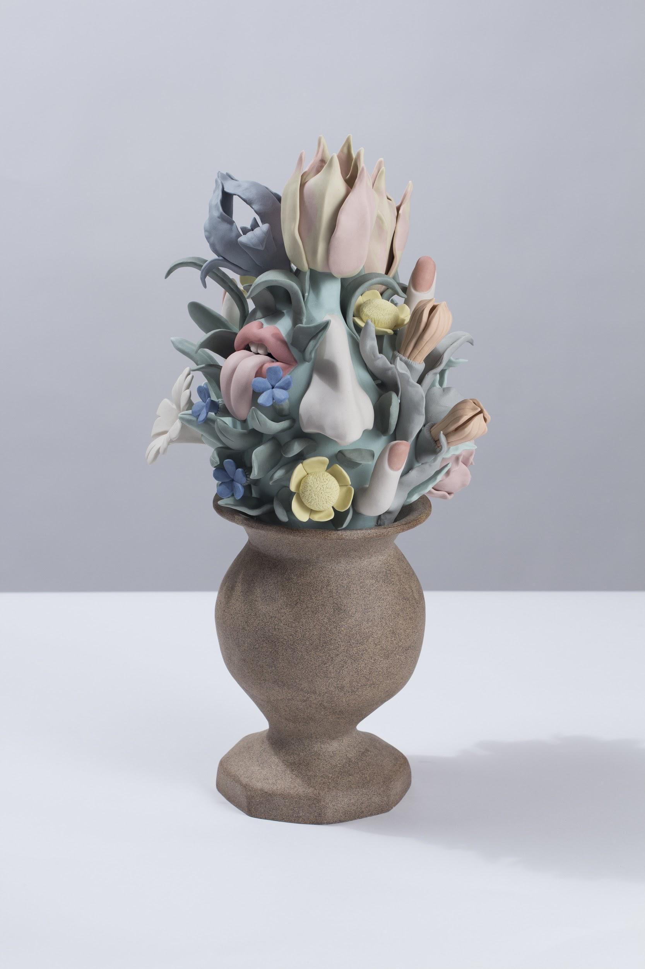
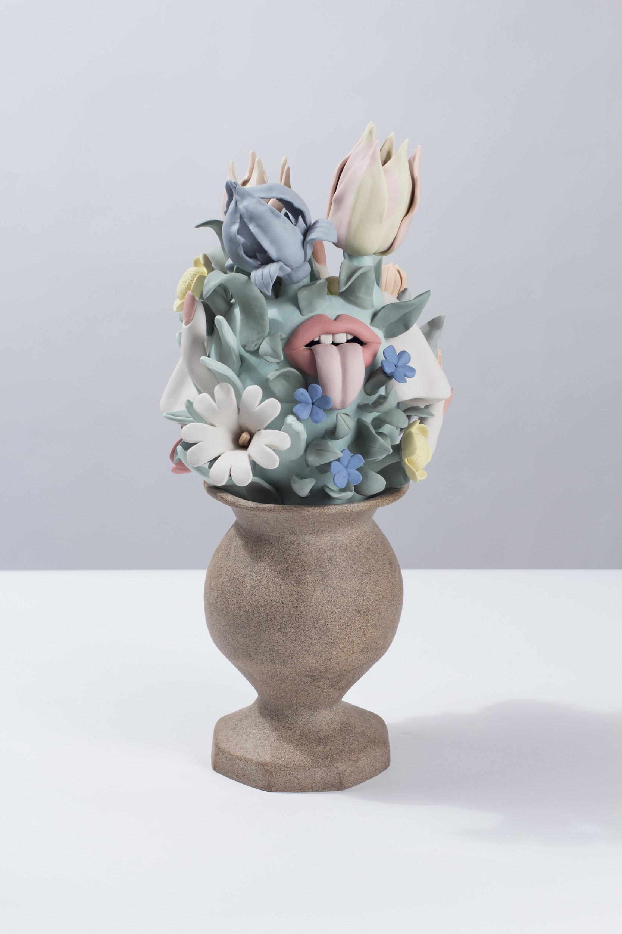
Center Piece, 2018, stoneware and porcelain, 20x10x11”

