Slide 1
Dini’s Surface: A surface of constant Negative curvature obtained by twisting a pseudosphere
Hiroshi Sugimoto
2004

Slide 2
Hiroshi Sugimoto
Japanese Photographer

Slide 3
World Trade Center
1997

Slide 4
Church of Light
1997

Slide 5
PPTRD 028
2008

Slide 6
Union Drive-In
1993

Slide 7
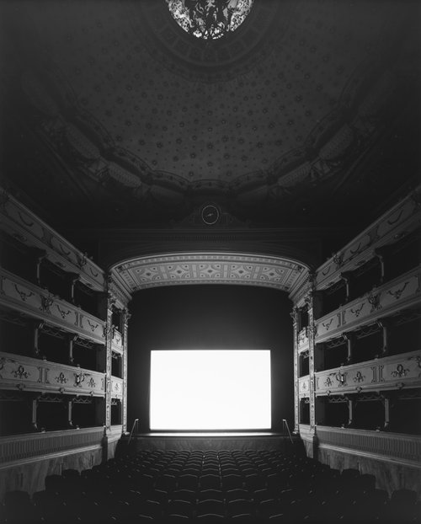
Teatro dei Rozzi “Summer Time”
2014

