Slide 1
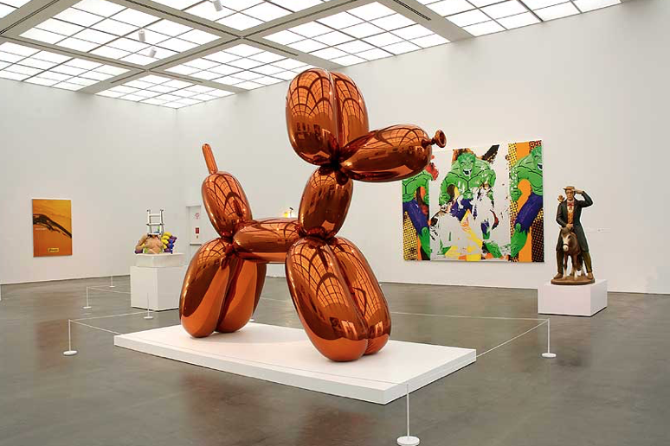
Jeff Koons
Balloon Dog (Orange)
Stainless Steel

Slide 2
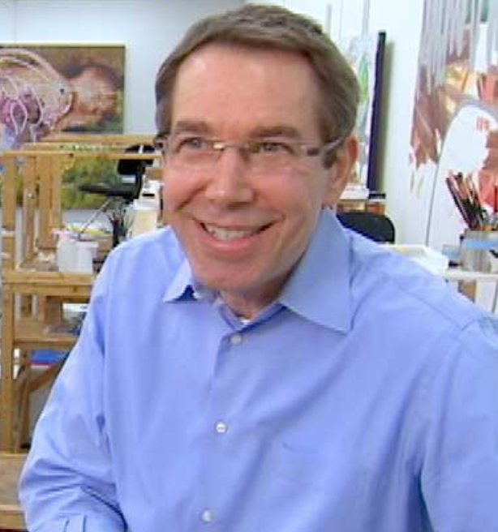
Jeff Koons
Inspired by items not typically considered fine art
Controversial and polarizing artist
Sold Balloon Dog (Orange) for 58.4$ million
“The Evil Genius”
-Brian Christensen

Slide 3
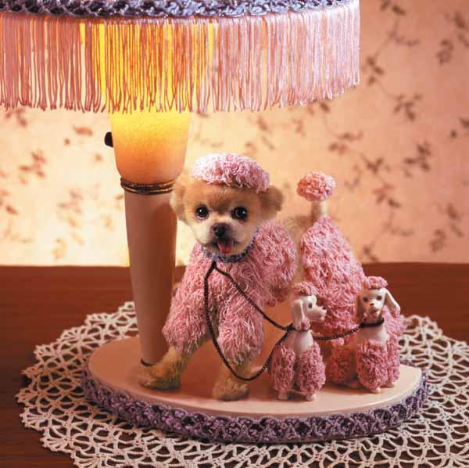
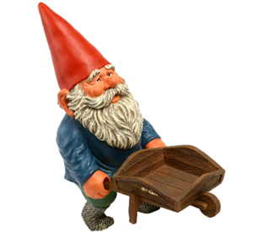
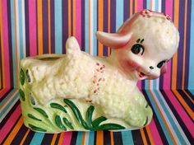
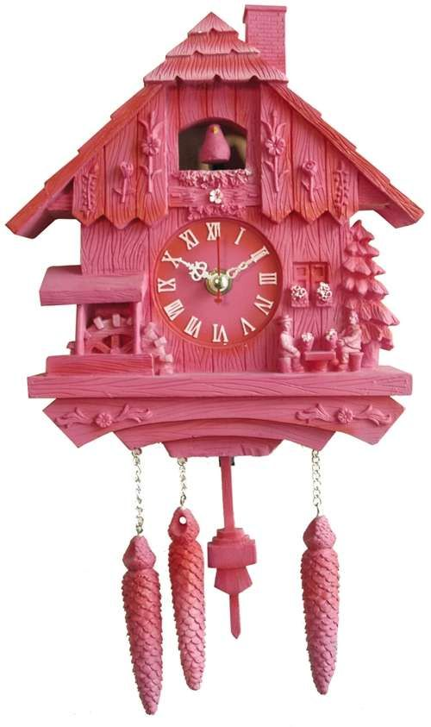
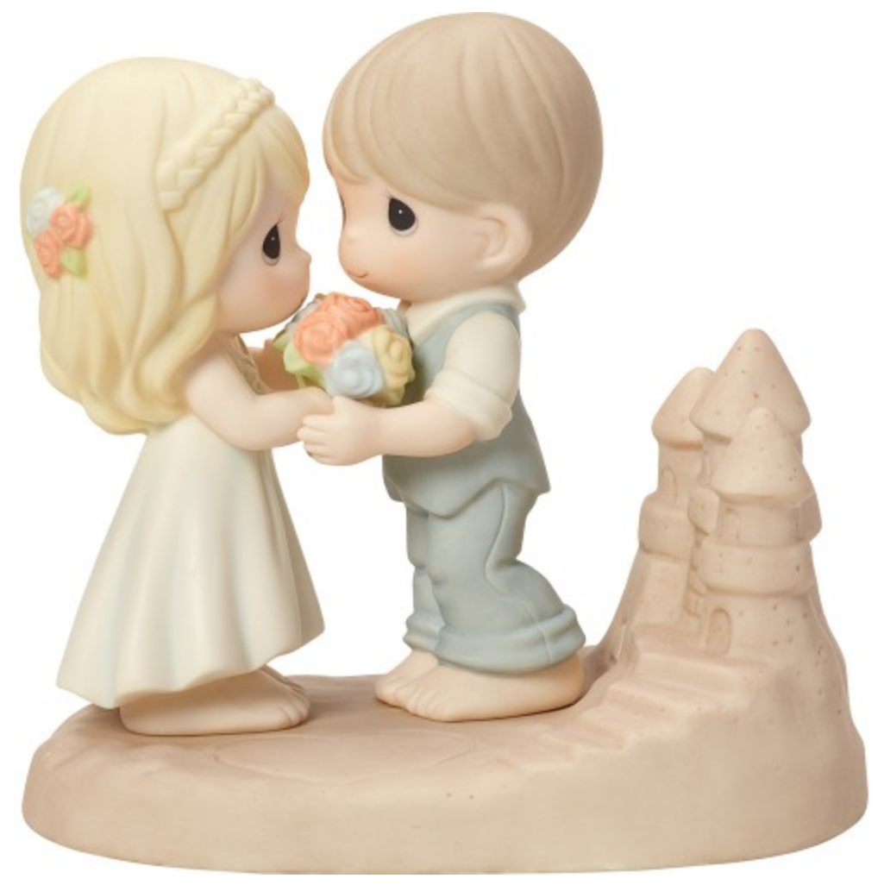
Kitsch (/kɪtʃ/ KITCH; loanword from German), also called cheesiness or tackiness, is art or other objects that, generally speaking, appeal to popular rather than "high art" tastes.
Kitschy things

Slide 4
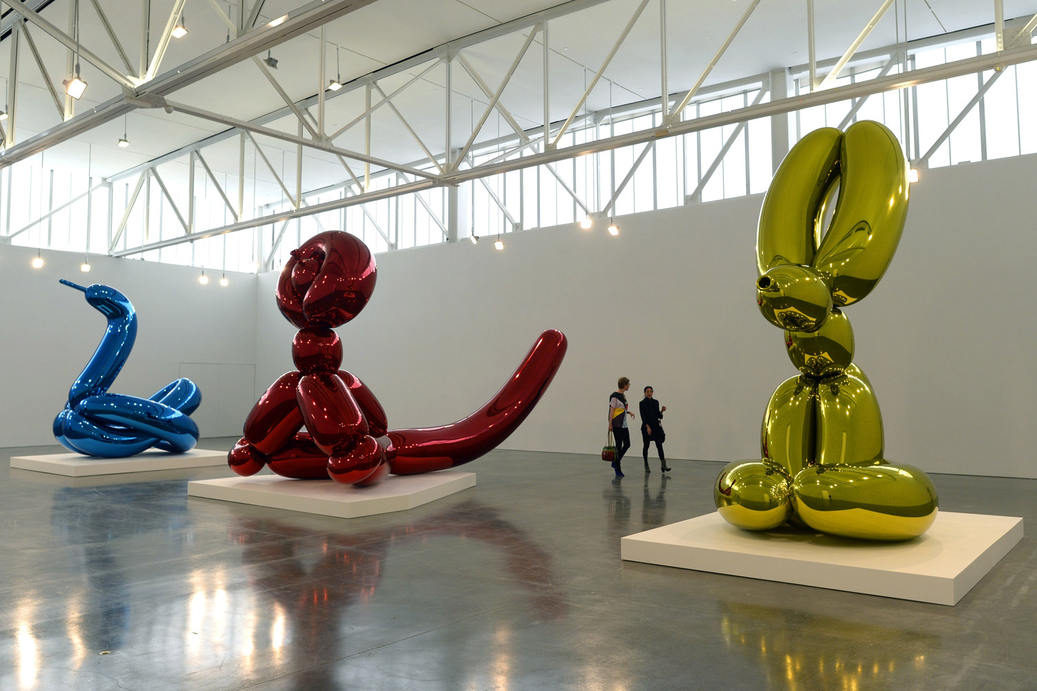

Slide 5
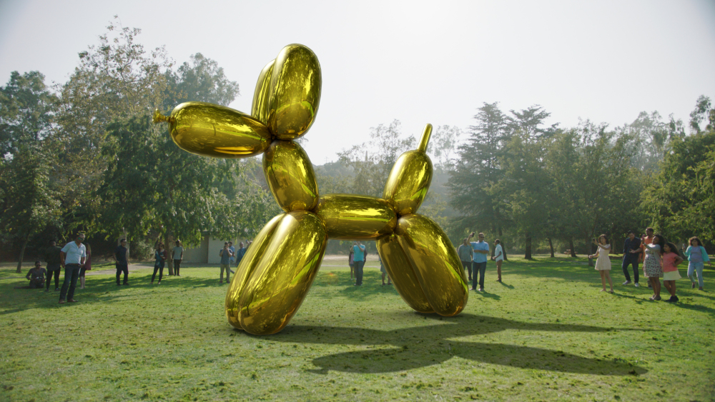

Slide 6
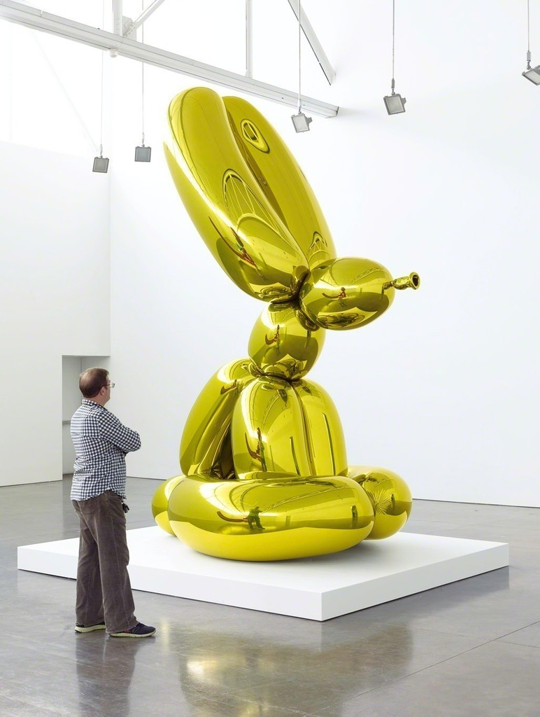

Slide 7
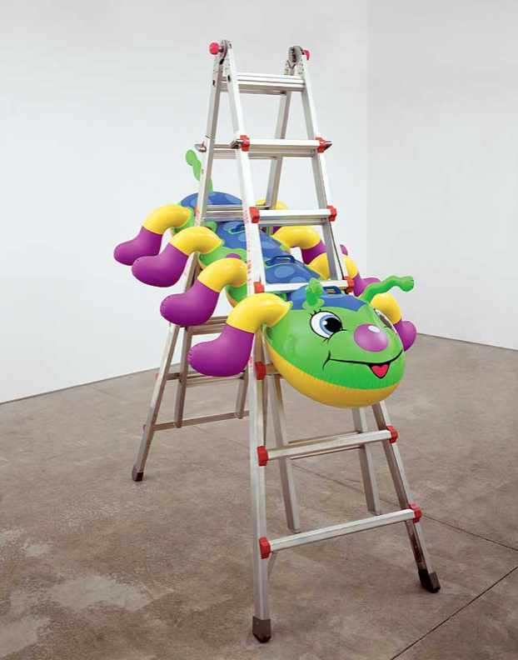
Caterpillar Ladder (2003)

Slide 8
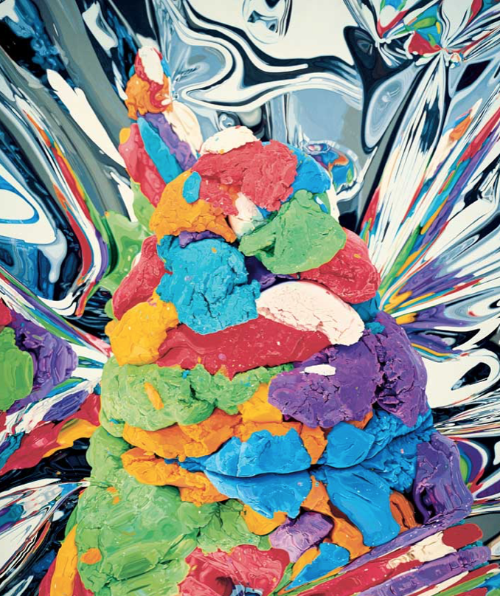
Play Doh
Oil on Canvas

Slide 9
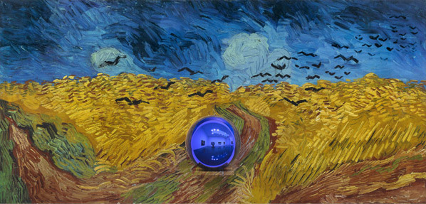
Gazing Ball Series
Notes:
In his current show at Gagosian Gallery, Koons invites the viewer to engage with the Masters of the past: reproductions of Titian, Van Gogh, Manet and others. Each painting has a blue glass gazing ball in front of it, sitting on a painted aluminum shelf. For centuries, gazing balls have been used to decorate gardens. Mystical powers have been attributed to them. In this show, the gazing ball allows the viewer to interact with the paintings, and vice versa: forming the connection between the past and the present.

Slide 10
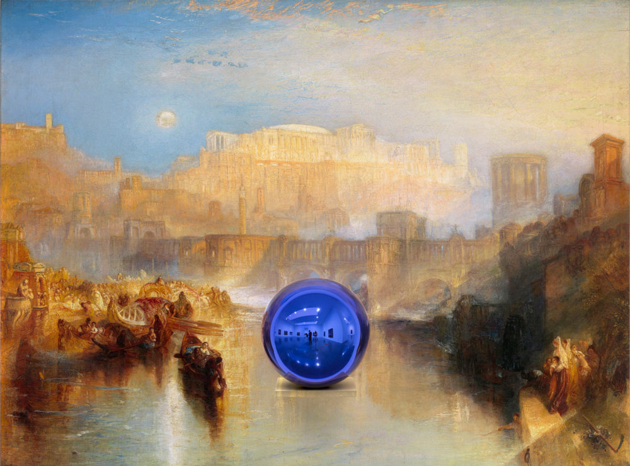

Slide 11
9:45
https://art21.org/watch/art-in-the-twenty-first-century/s5/jeff-koons-in-fantasy-segment/

Slide 12
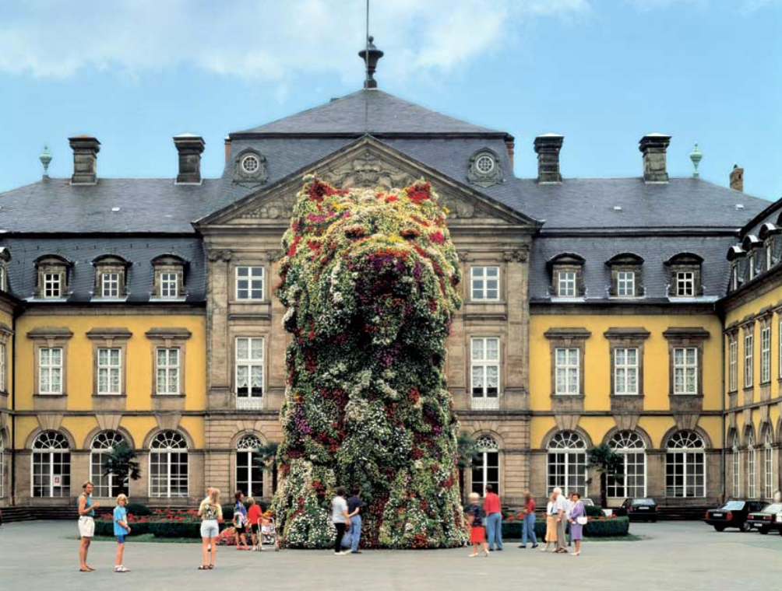
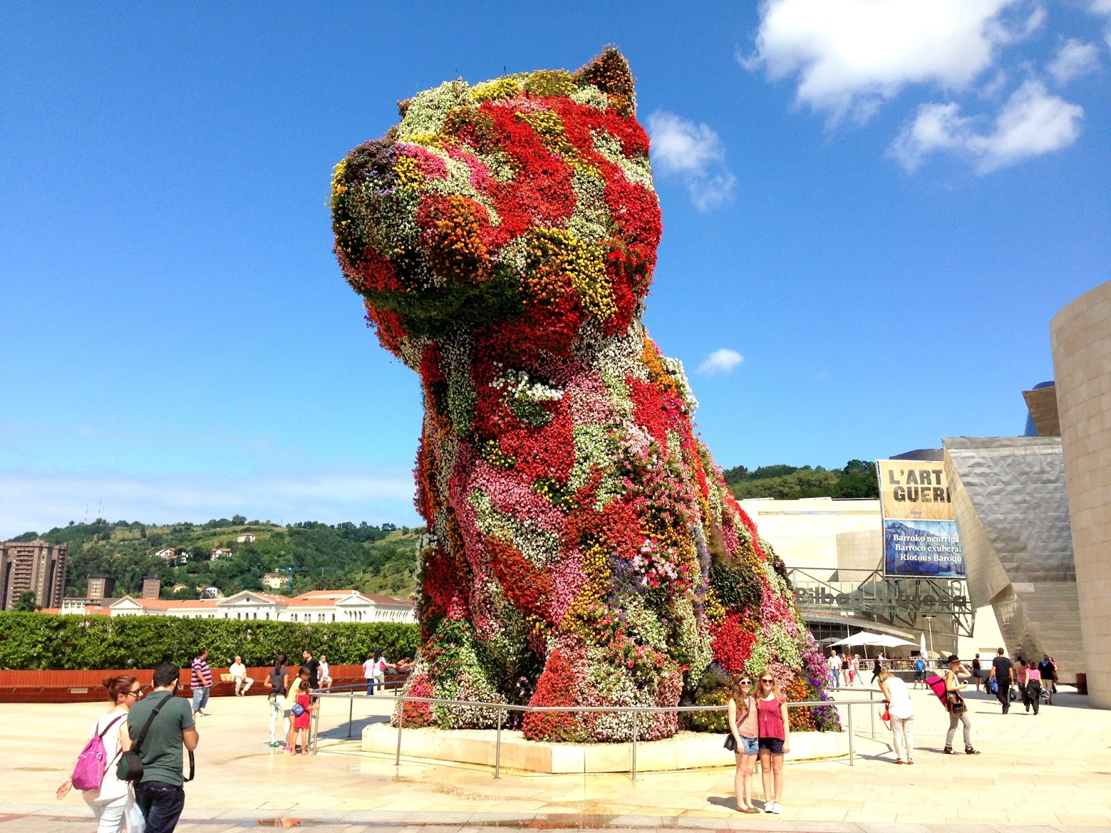
Puppy
1992

Slide 13
Lifeboat 1985
Bronze

Slide 14
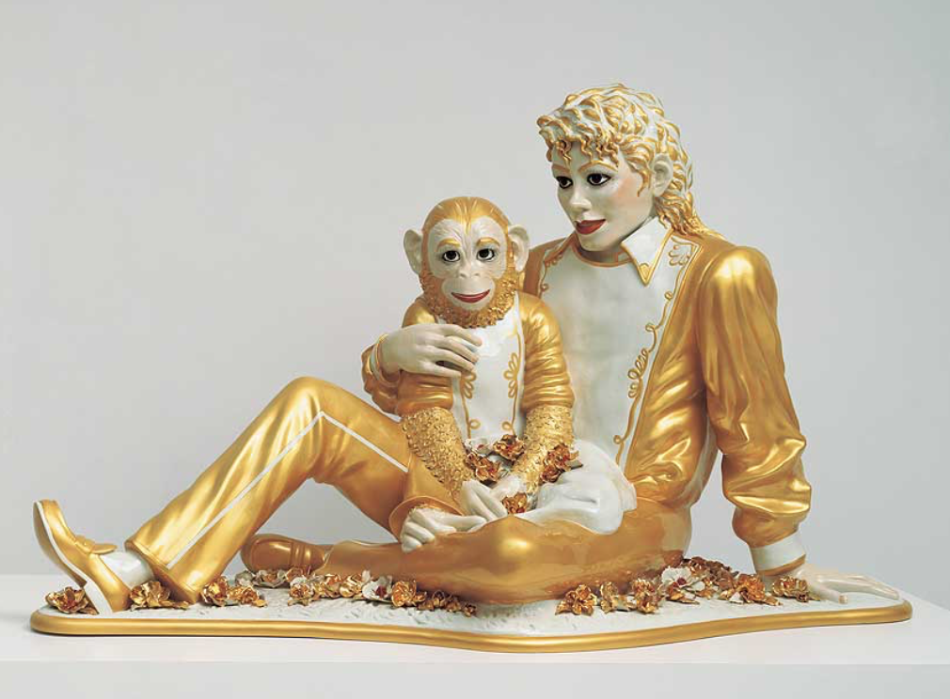
Michael Jackson and Bubbles
1988

