Slide 1
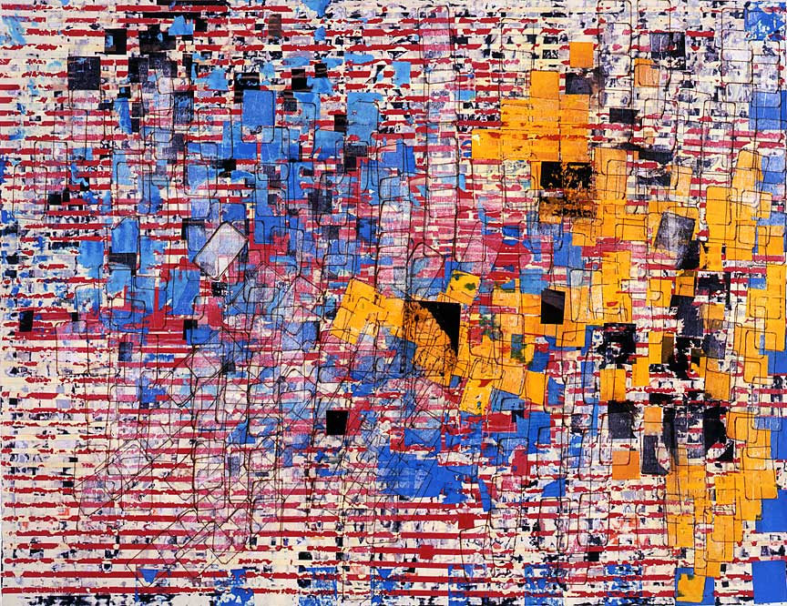
"Disappear Like a Dope Fiend"
2006 Mixed media collage on canvas, 47 3/8 x 61 1/8 inches

Slide 2
Mark Bradford
By: Valerie Ouimet

Slide 3
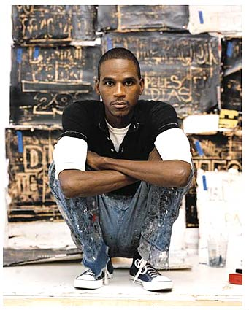
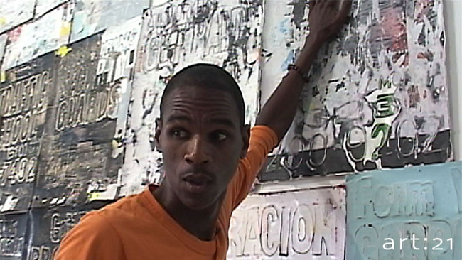
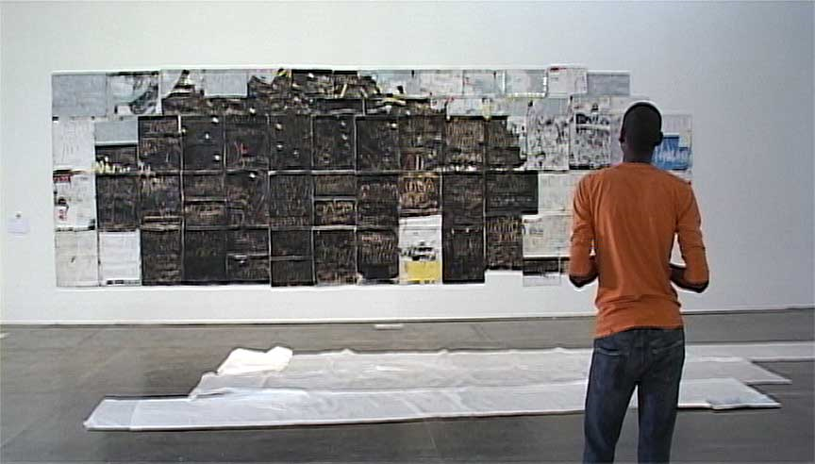
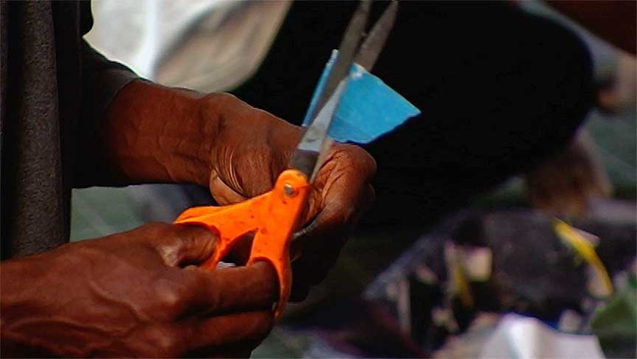
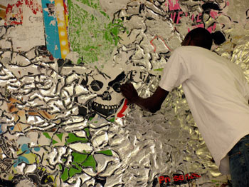
What does he do?

Slide 4
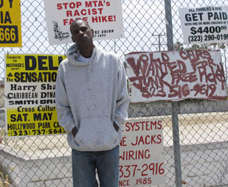
Mark’s videos and map-like, multilayered paper collages refer not only to the organization of streets and buildings in downtown Los Angeles, but also to images of crowds, ranging from civil rights demonstrations of the 1960s to contemporary protests concerning immigration issues.

Slide 5
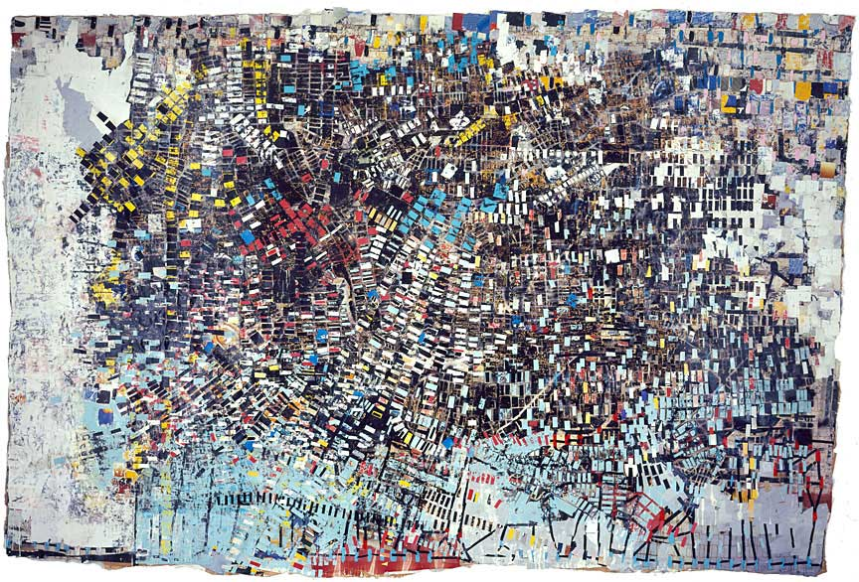
“Black Venus”
2005 Mixed media collage, 130 x 196 inches

Slide 6
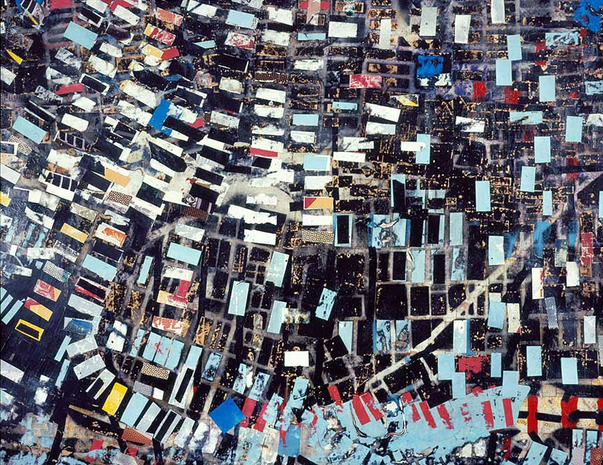
“Black Venus” Detail

Slide 7
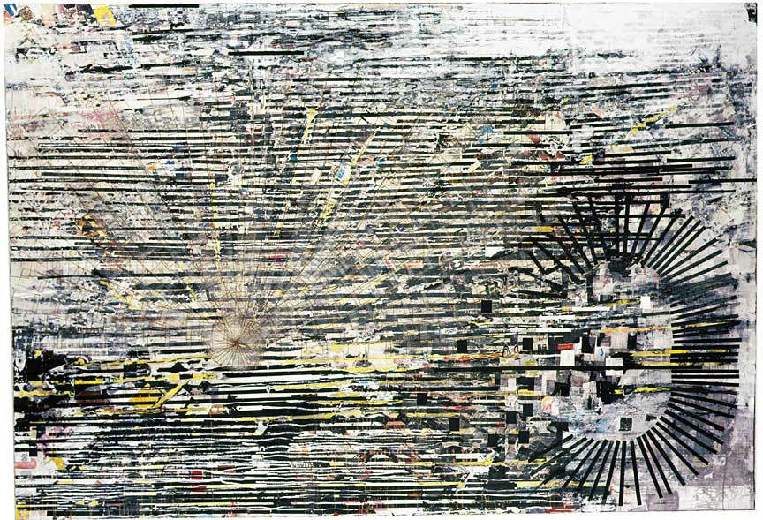
"Backward C"
2005 Mixed media collage on canvas, 84 x 120 inches

Slide 8
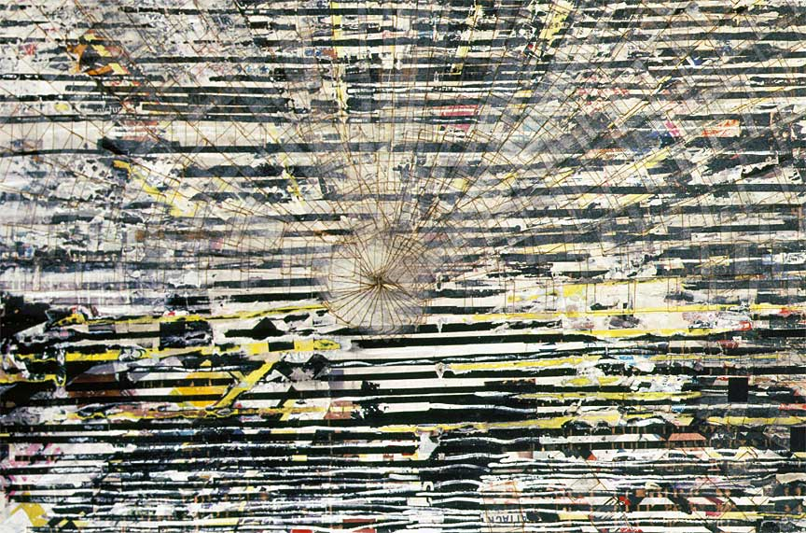
"Backward C” Detail

Slide 9
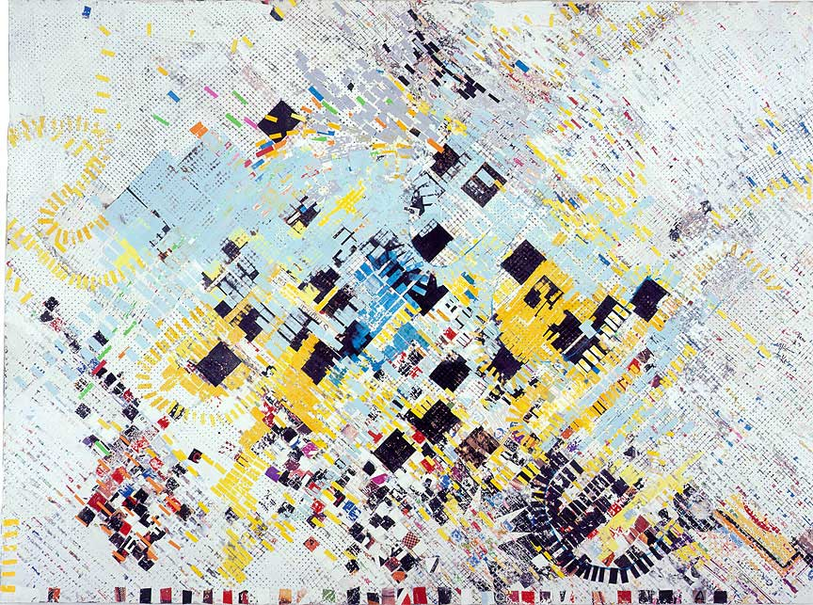
“Grace & Measure”
2005 Mixed media collage on canvas, 90 x 120 inches

Slide 10
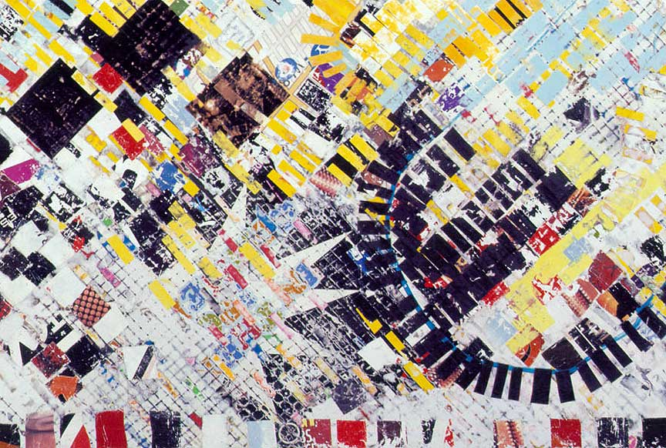
“Grace & Measure” Detail

Slide 11
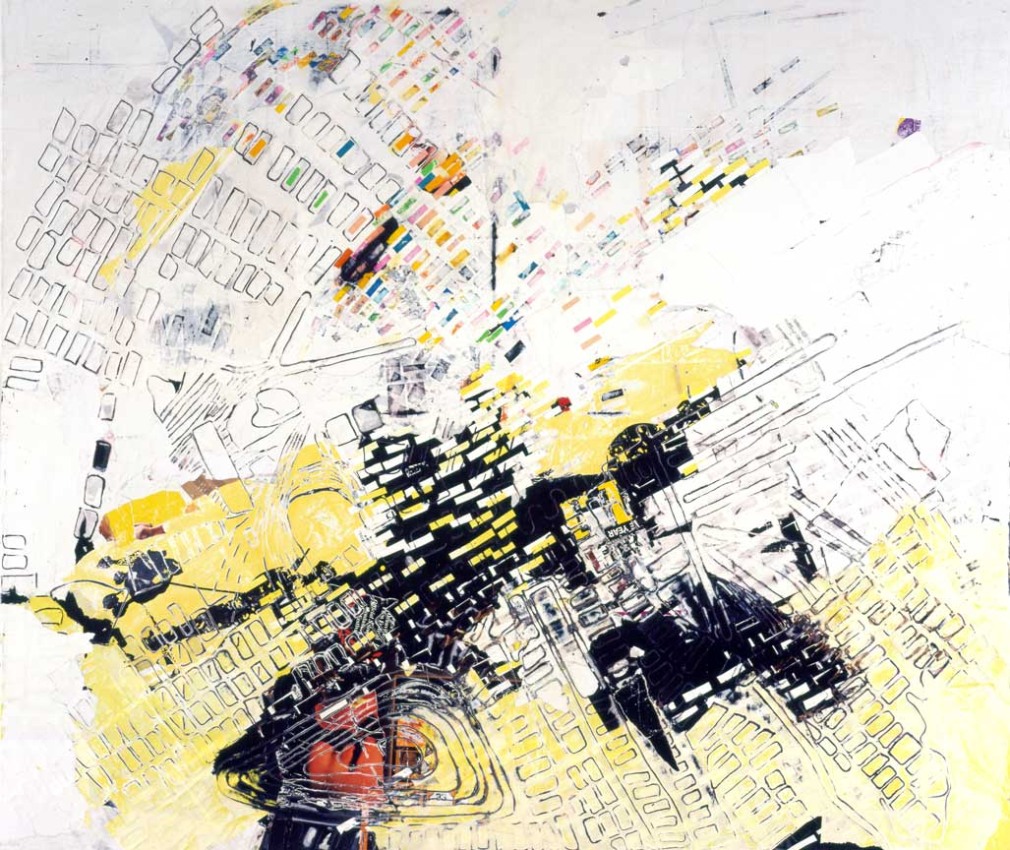
“Civil Brand”
2005 Mixed media collage on canvas, 72 x 85 inches

Slide 13
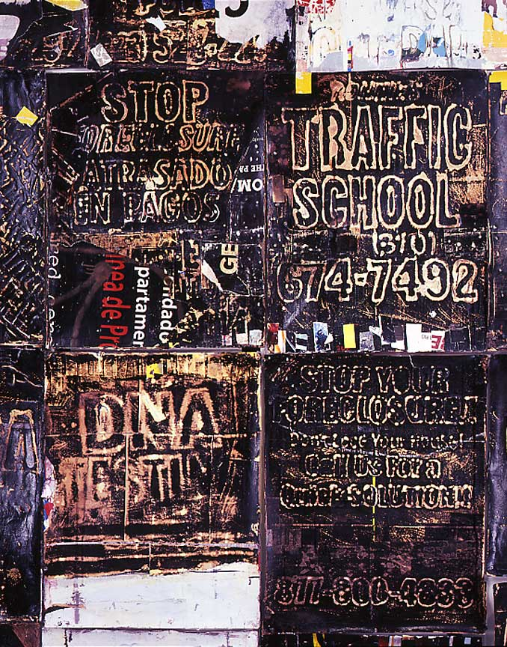
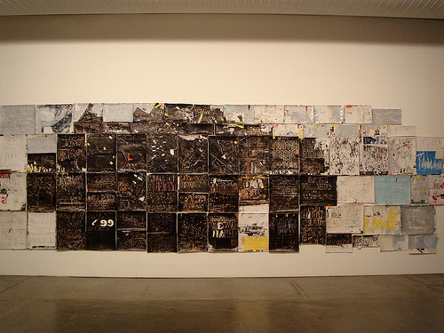
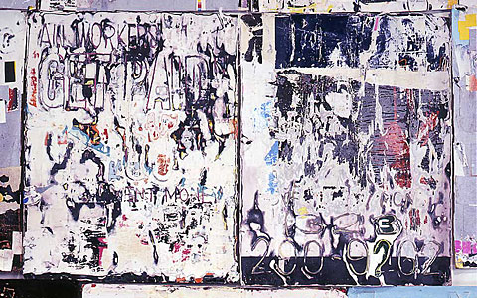
“Ridin’ Dirty”

Slide 14
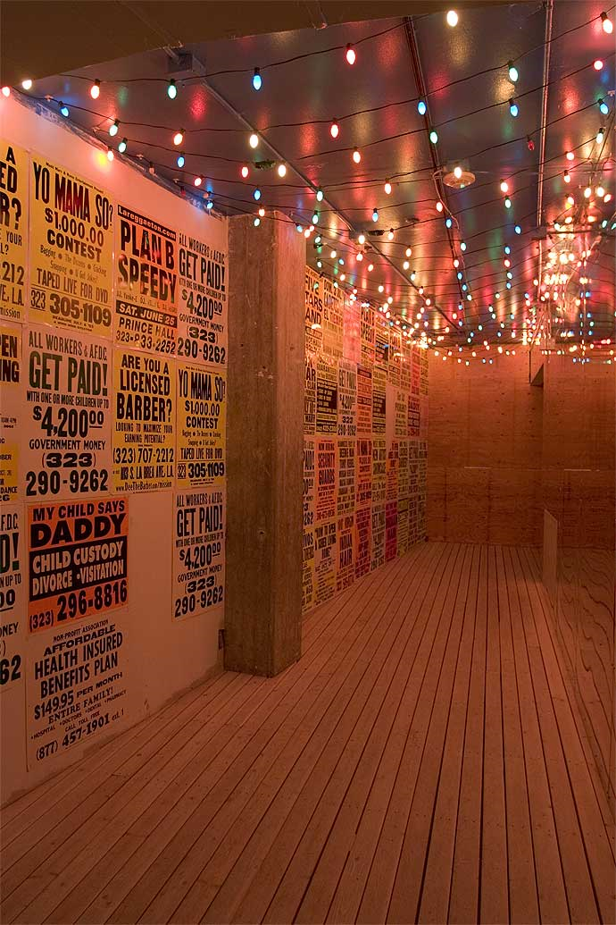
“Market>Place”
"I wanted to create an environment that had something to do with trade, with public space, and the way people use it for pleasure, for business, for meetings, for secrets. I like that. And this was the amalgamation of all that put together. I wanted to create the feeling of being outdoors and indoors at the same time- those little passageways, alleyways, or narrow spaces between buildings that people turn into private places to talk and gather in."

Slide 15
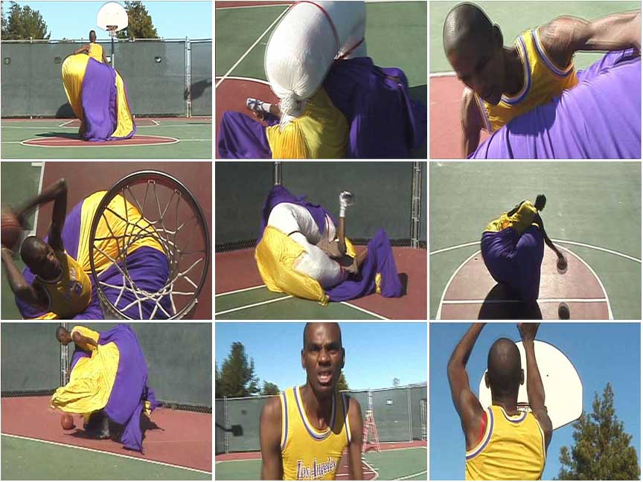

Slide 16
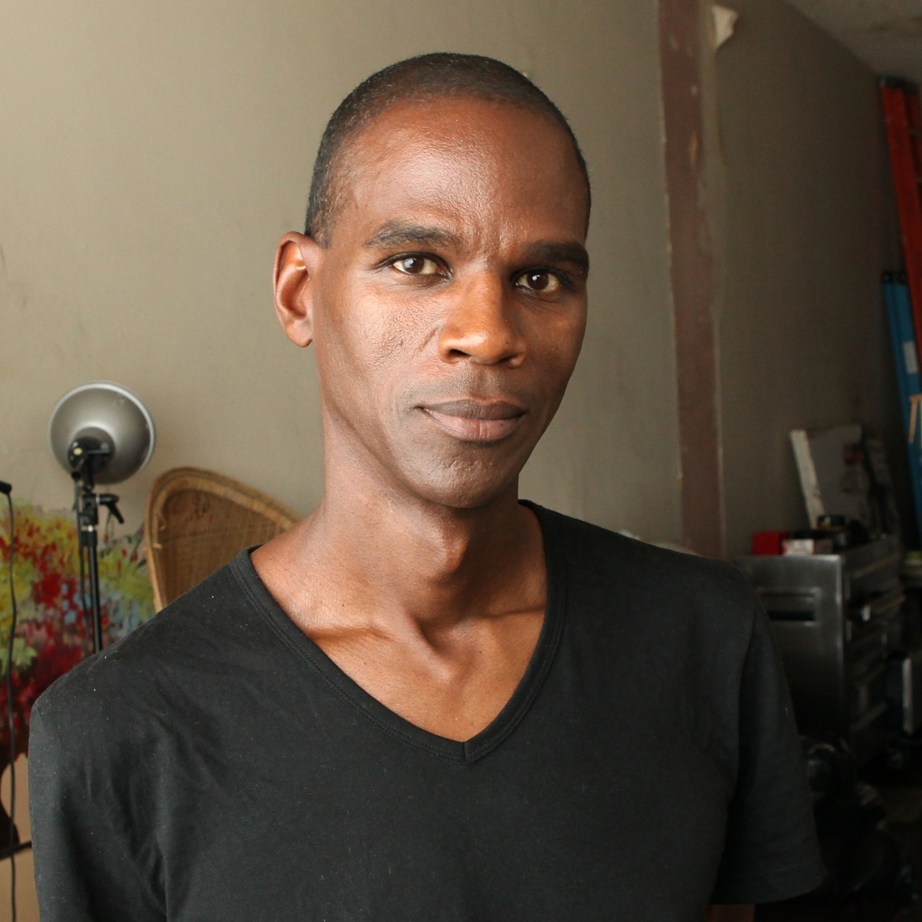
The End

