Slide 1
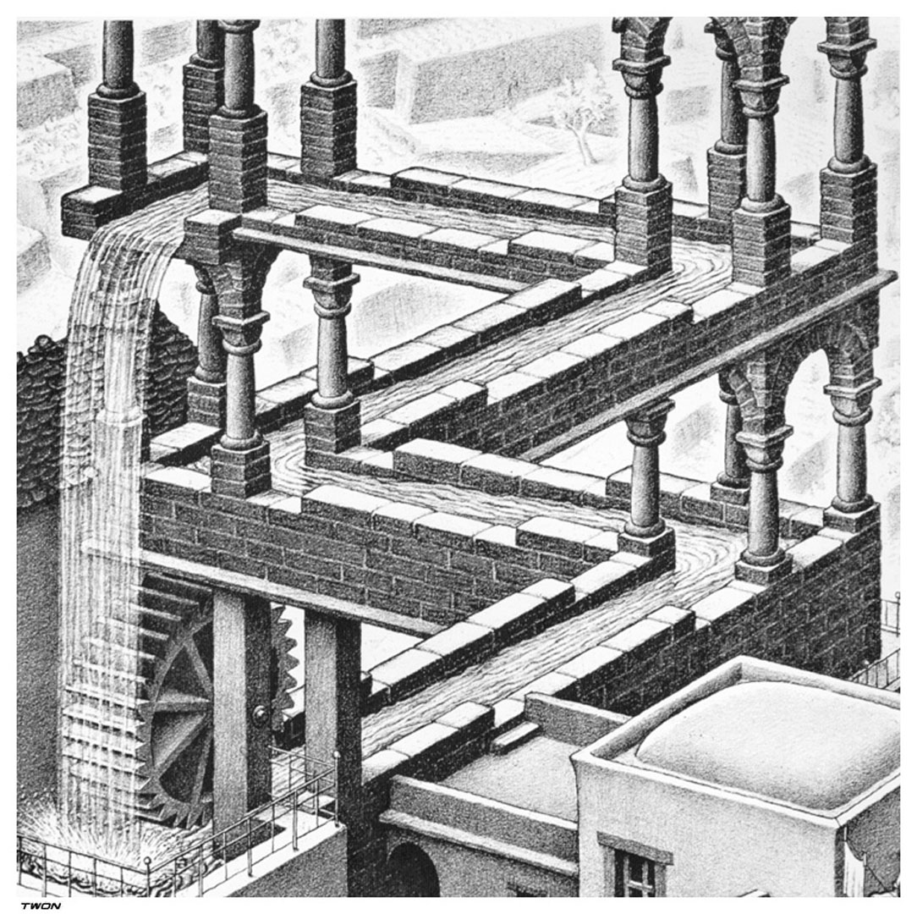
M.C. ESCHER
“Waterfall”
1961
Lithograph

Slide 2
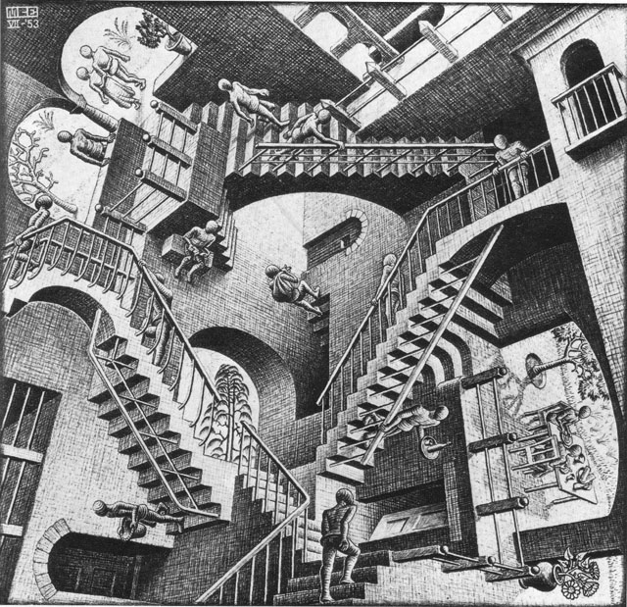
M.C. ESCHER
“Relativity”
1953
Lithograph
Impossible Constructions

Slide 3
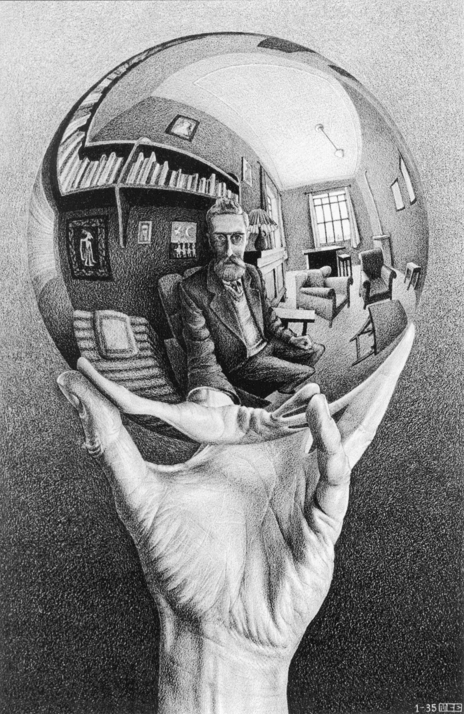
Self Portrait
“Hand with Reflecting Sphere”
1935
Lithograph

Slide 4
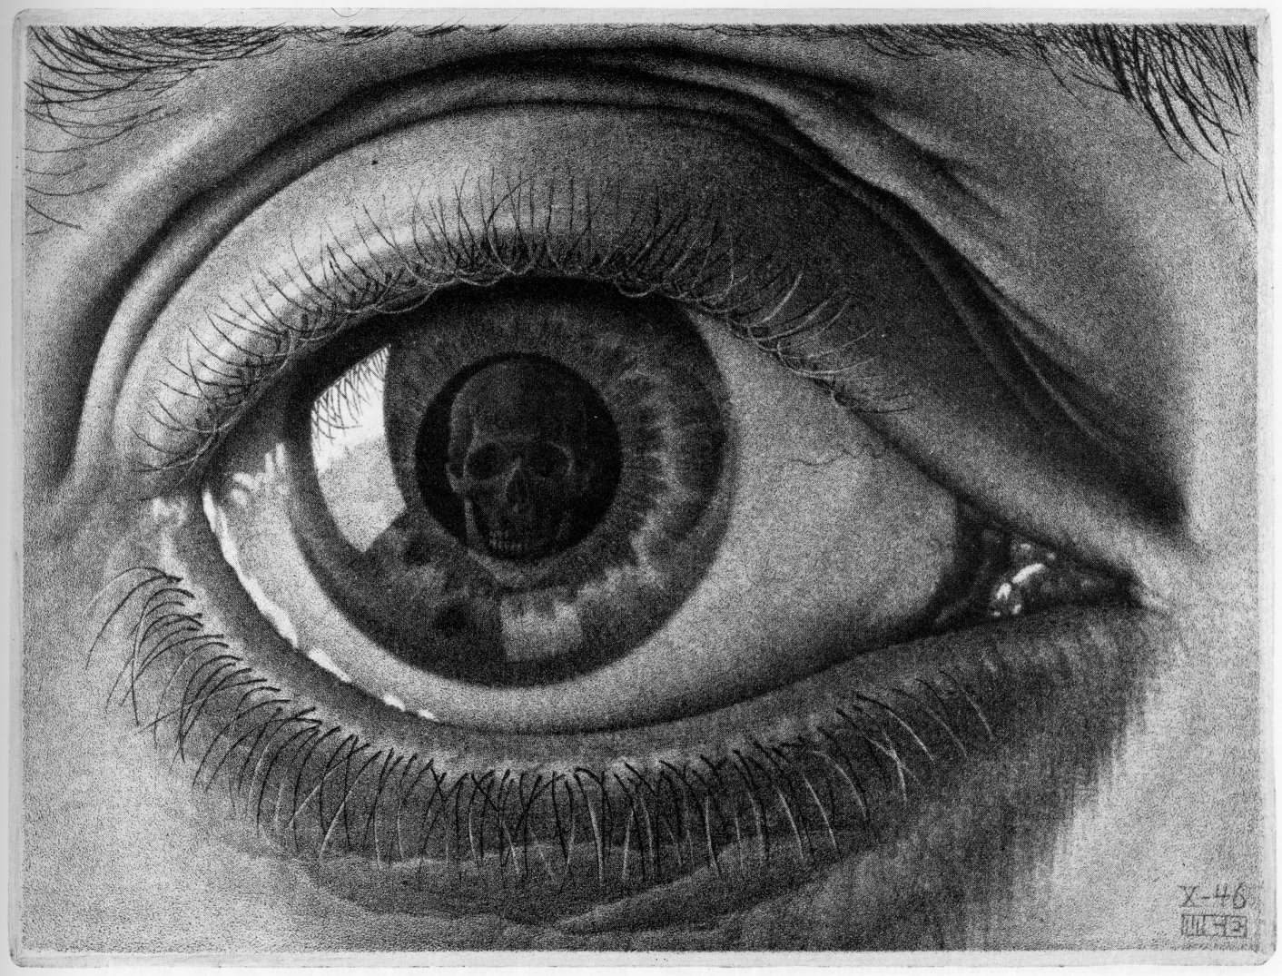
“Eye”
1946
Mezzotint

Slide 5
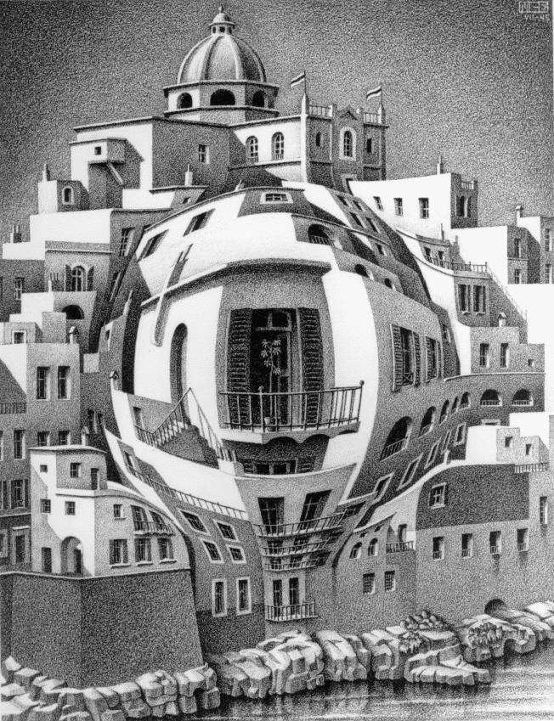
“Balcony”
1945
Lithograph
Mathematics

Slide 6
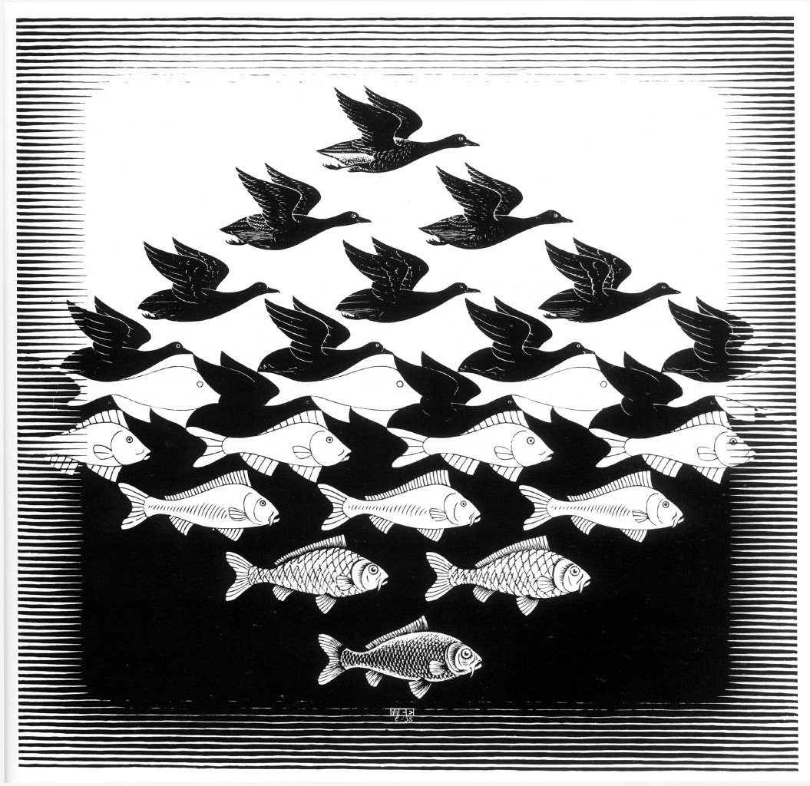
“Sky and Water I”
1936
Woodcut
Transformation

Slide 7
“Metamorphosis I”
1937
Woodcut
Transformation

Slide 8
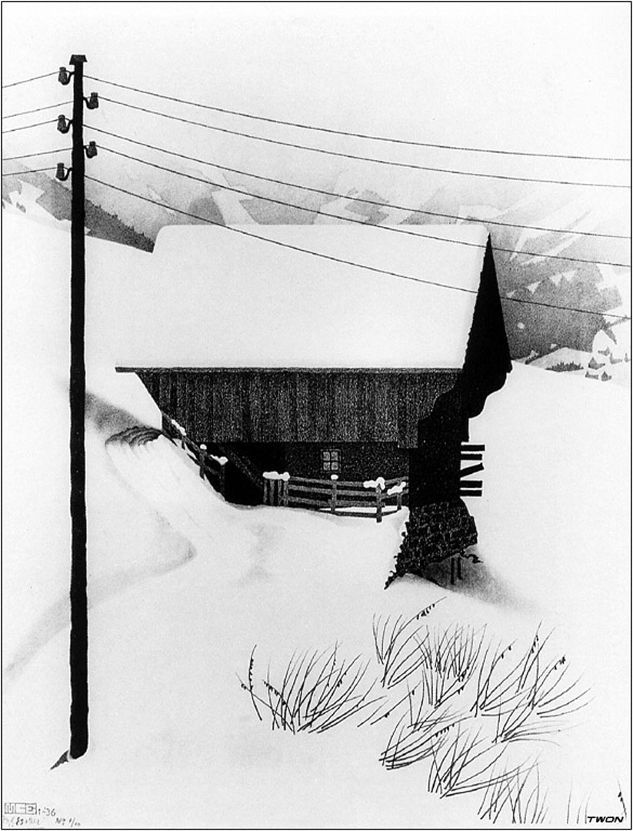
“Snow”
1936
Lithograph
Life

