Slide 1
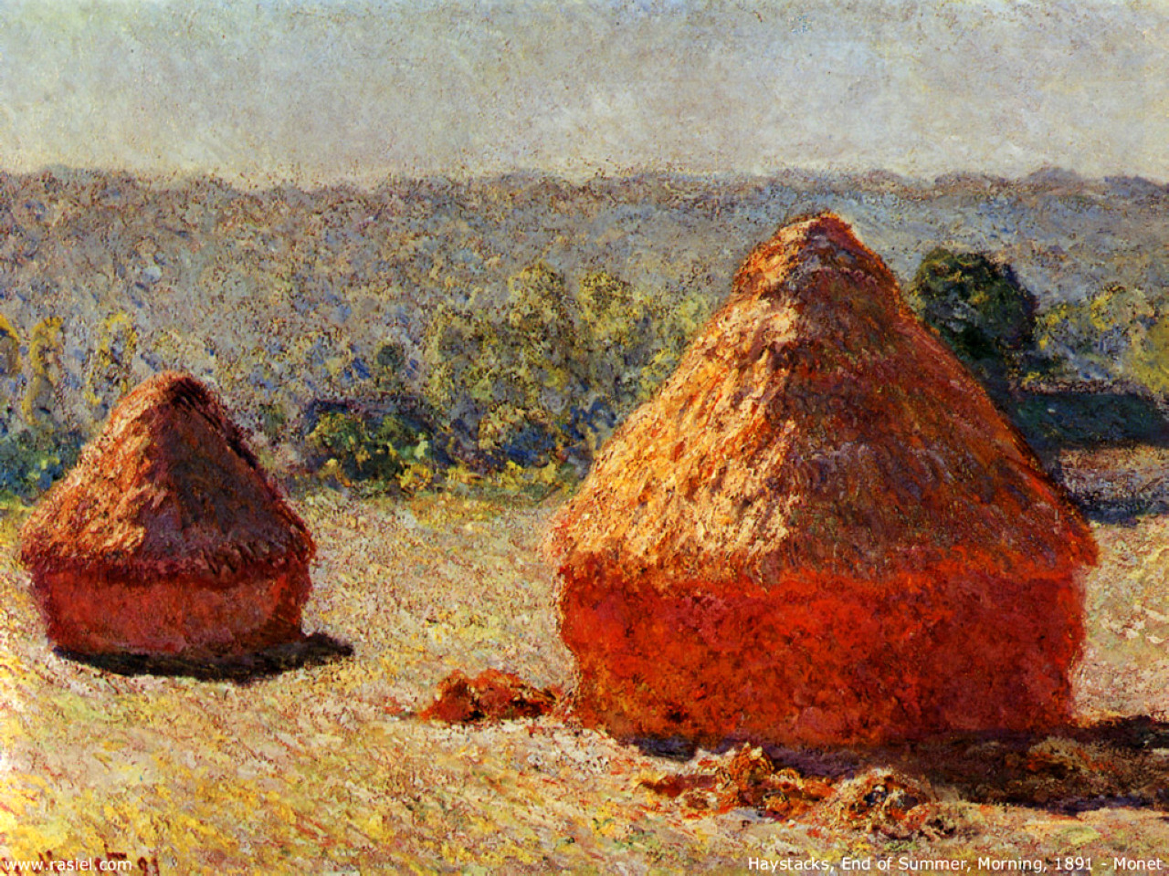
Claude Monet
Haystack. End of the Summer
Oil on canvas, 1890-1891

Slide 2
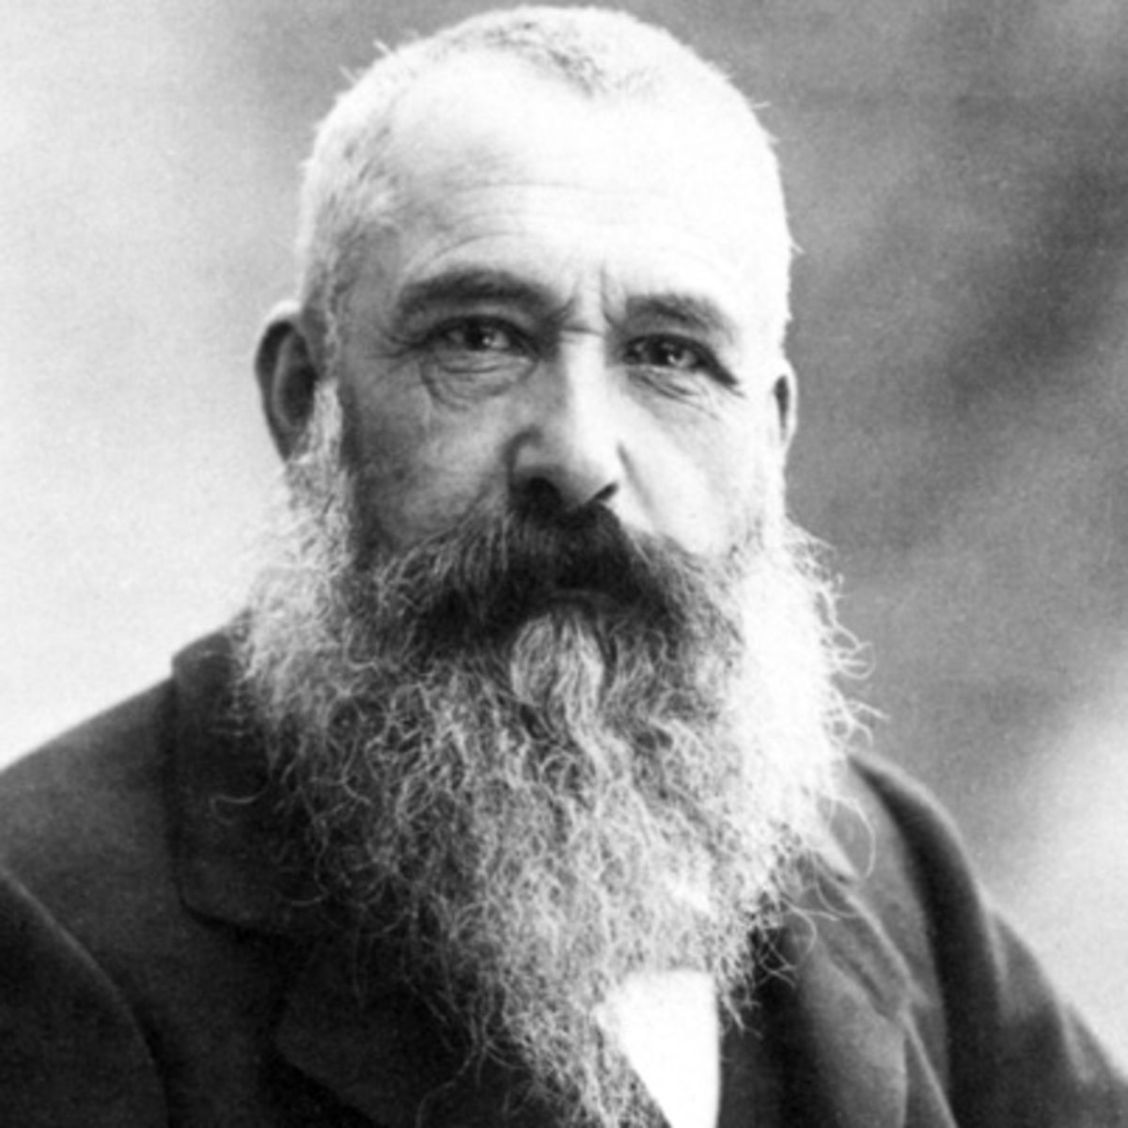
Claude Monet 1840-1926
Founder of the Impressionist Movement.
Captured perceptions instead of realism
Painted several series of the same objects (water lilies, haystacks, etc.

Slide 3
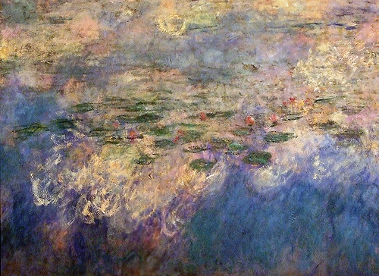
Claude Monet.
Reflections of Clouds on the Water-Lily Pond, c. 1920, (78.74 × 502.36 in), oil on canvas, Museum of Modern Art, New York City

Slide 4
Claude Monet.
Reflections of Clouds on the Water-Lily Pond, c. 1920, (78.74 × 502.36 in), oil on canvas, Museum of Modern Art, New York City

Slide 5
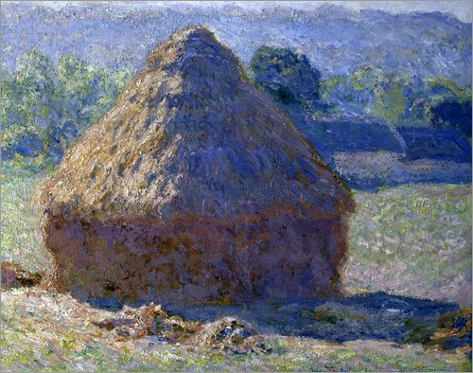

Slide 7
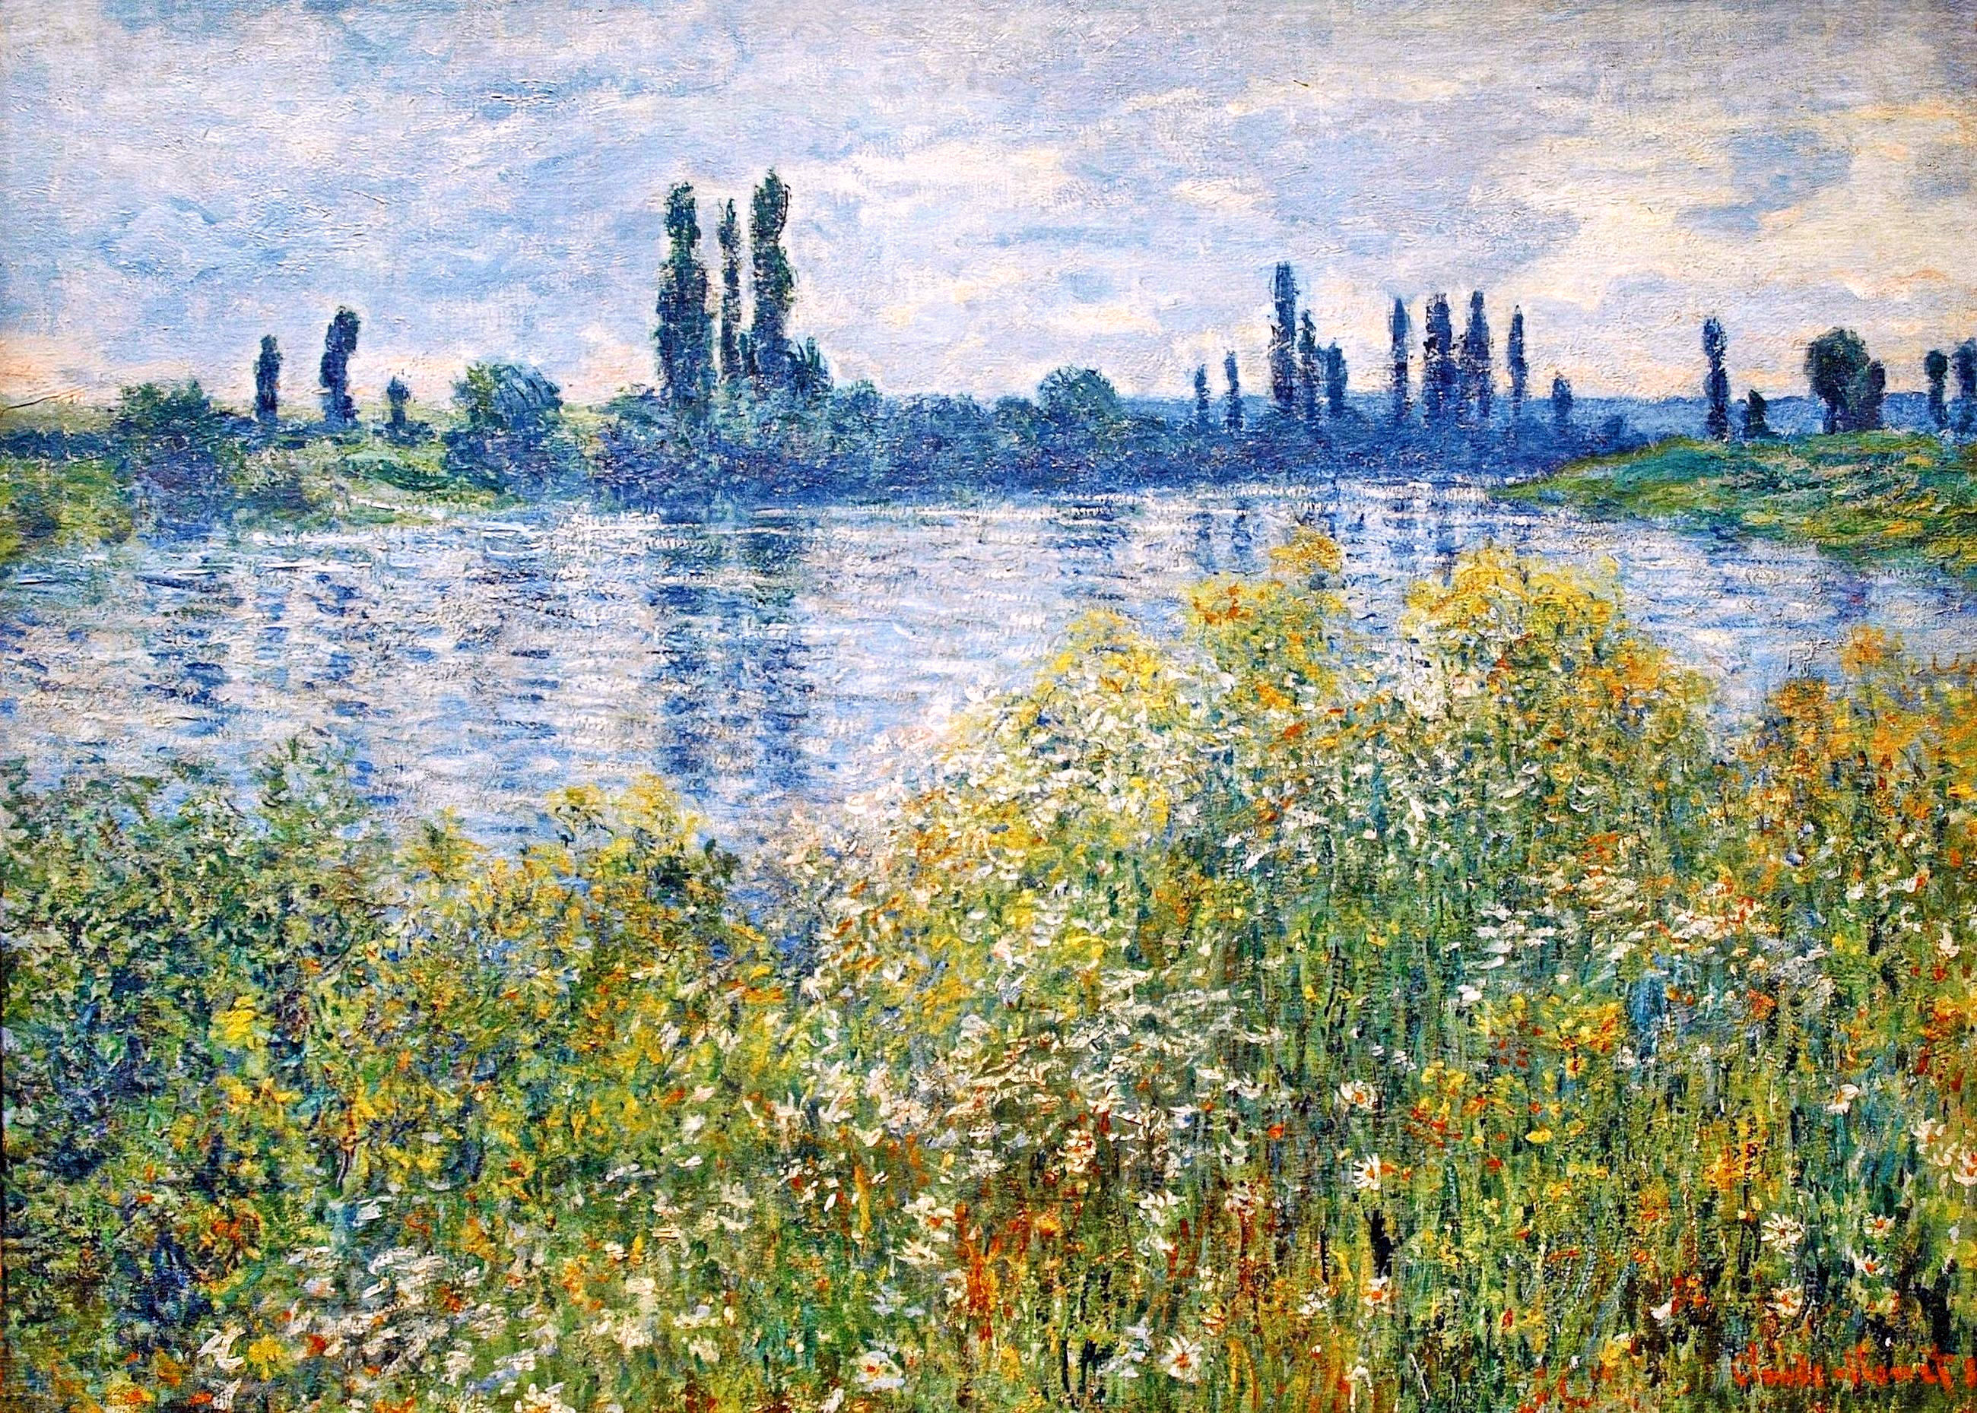

Slide 8
