Slide 1
Nina Katchadourian
“Lavatory Self Portraits in the Flemish Style”

Slide 2
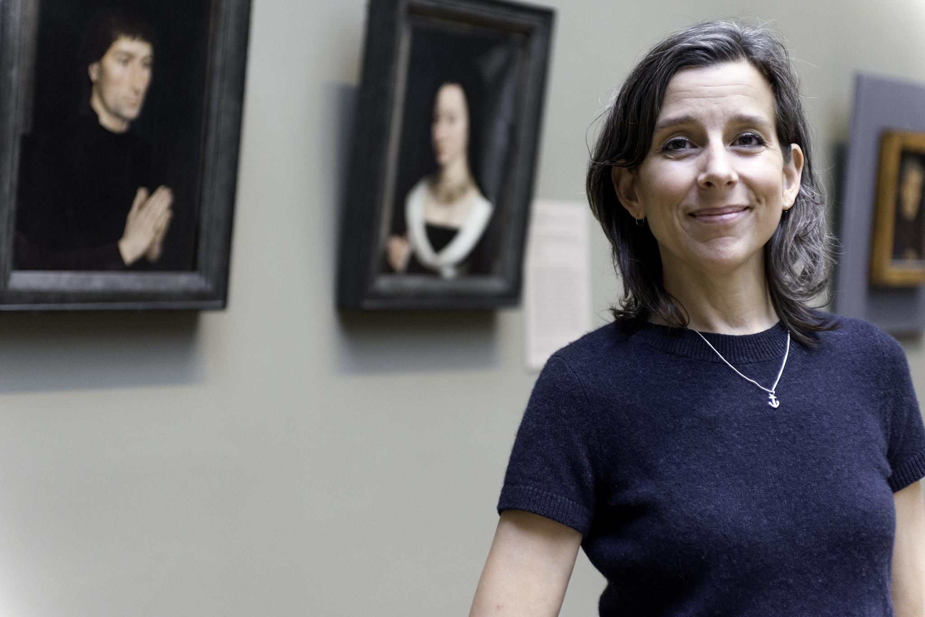
American interdisciplinary artist
Based in Brooklyn, NY
Themes: Humor, irony, re-ordering, appropriation, constraints, found objects

Slide 3
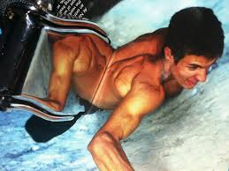
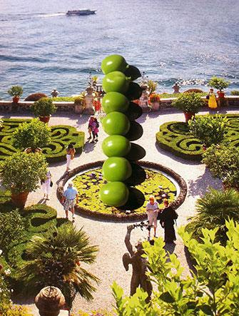
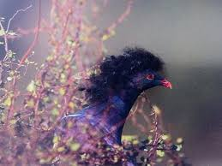

Slide 4
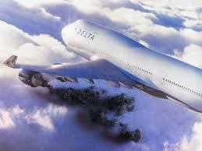
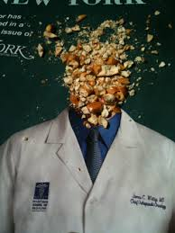
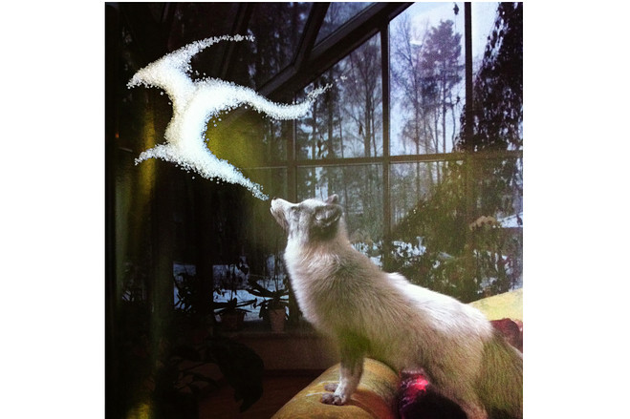

Slide 5
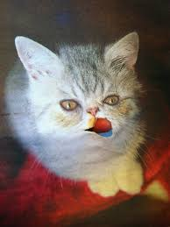
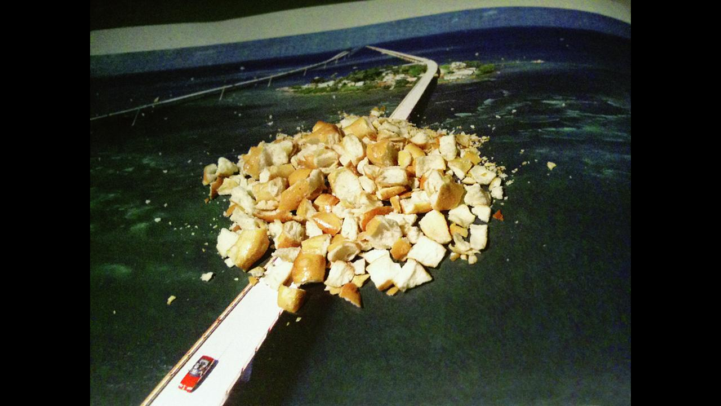

Slide 6
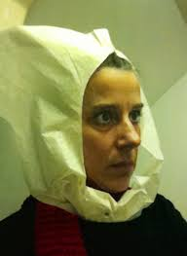
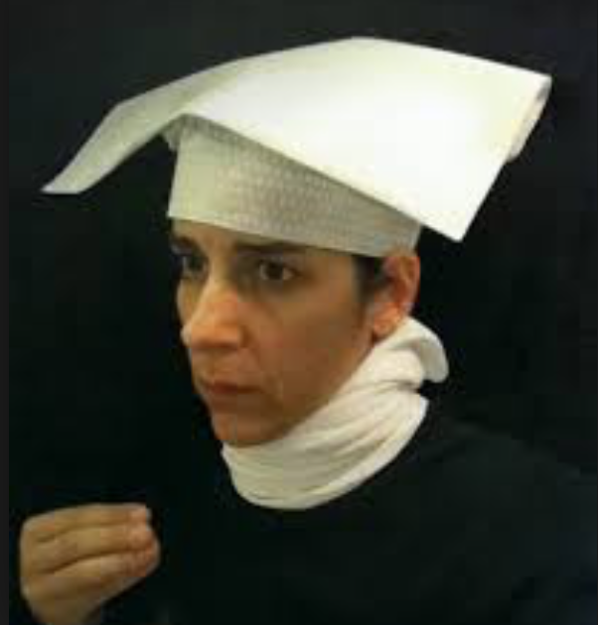
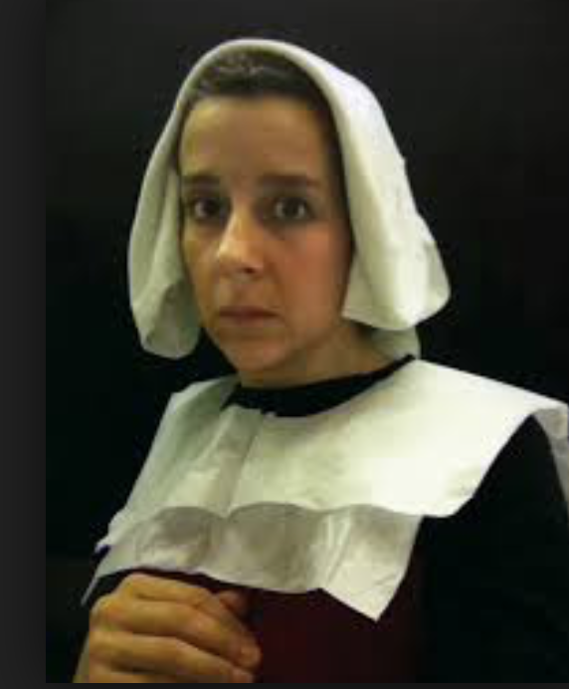
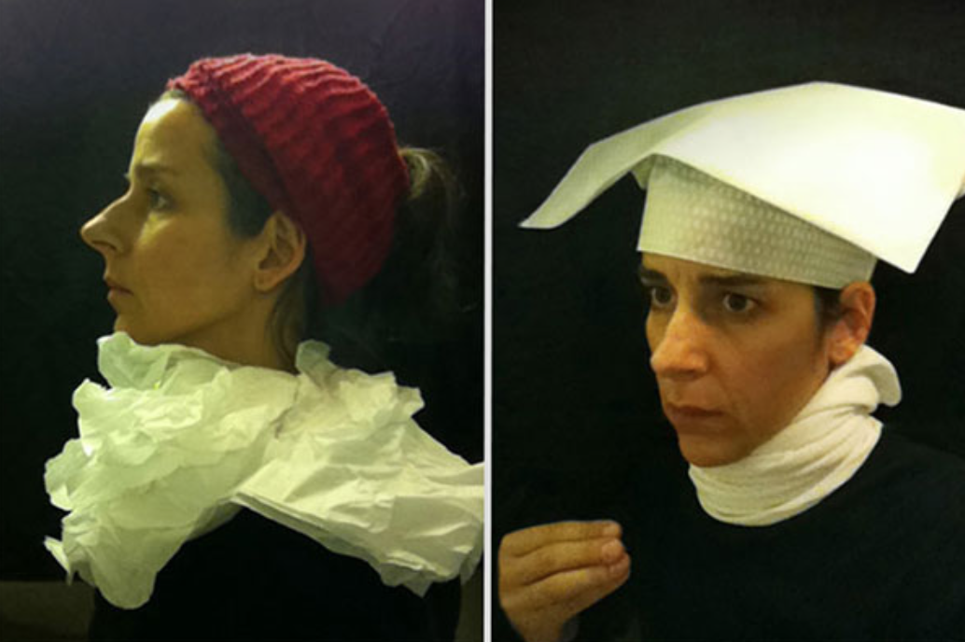

Slide 7
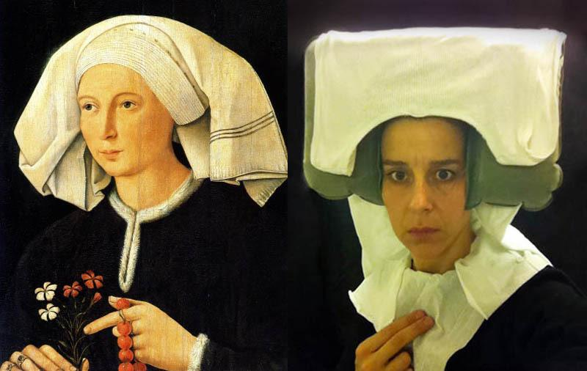

Slide 8
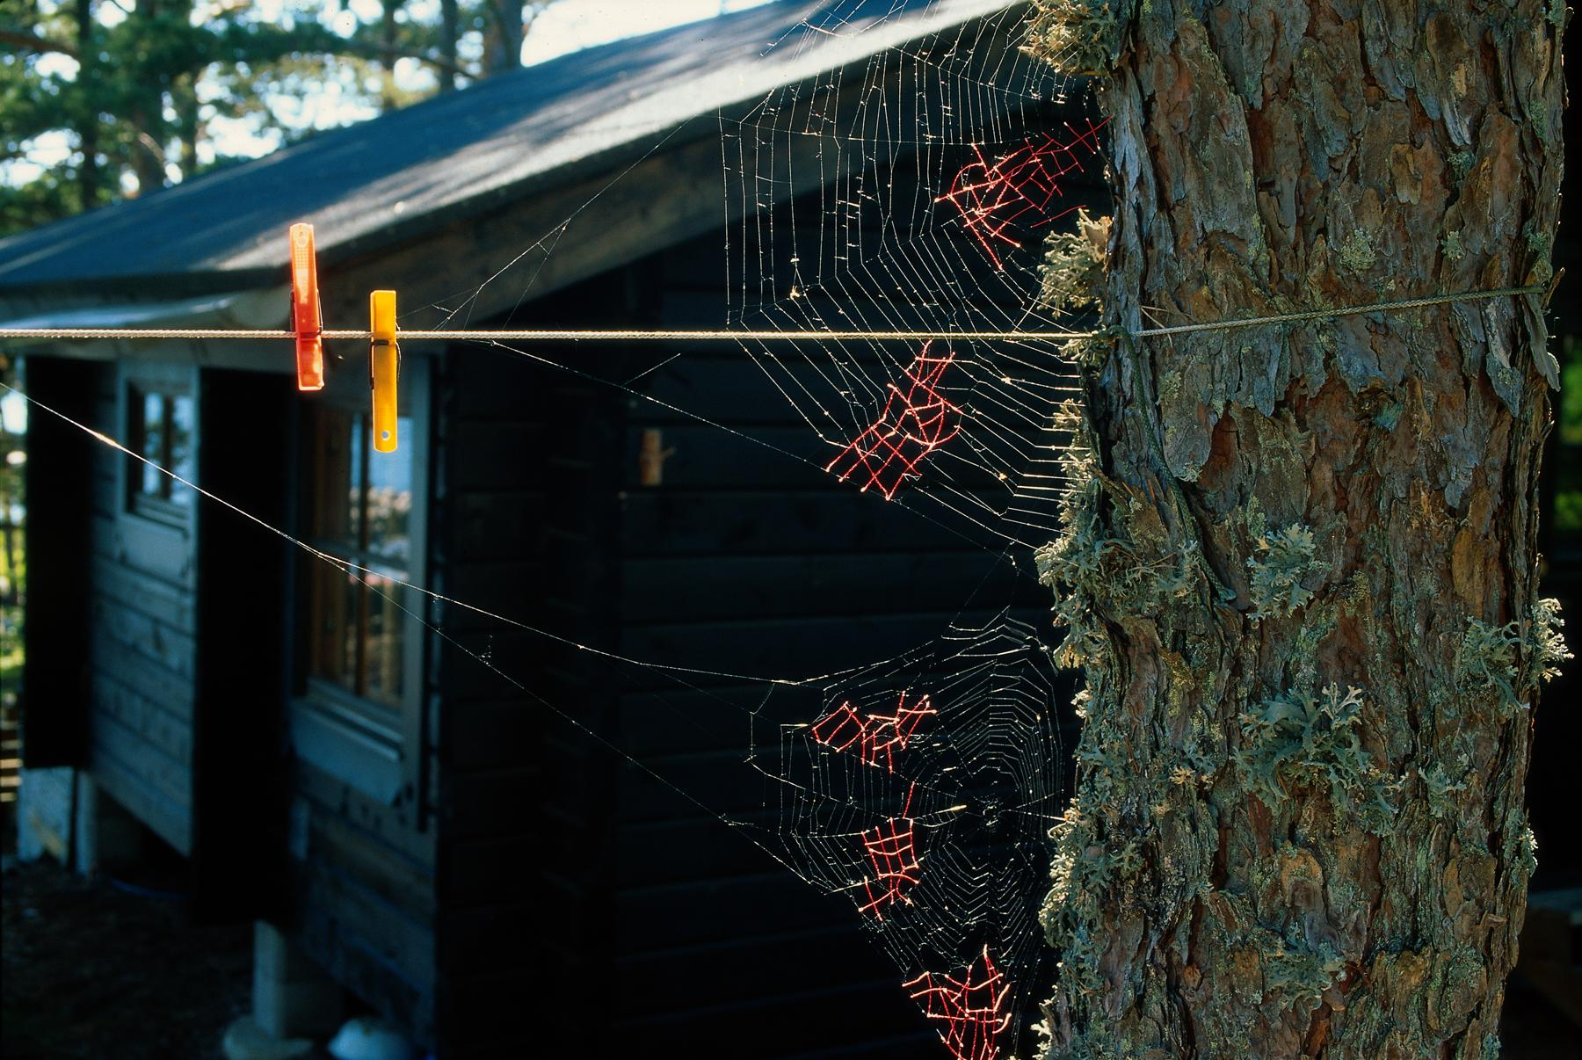
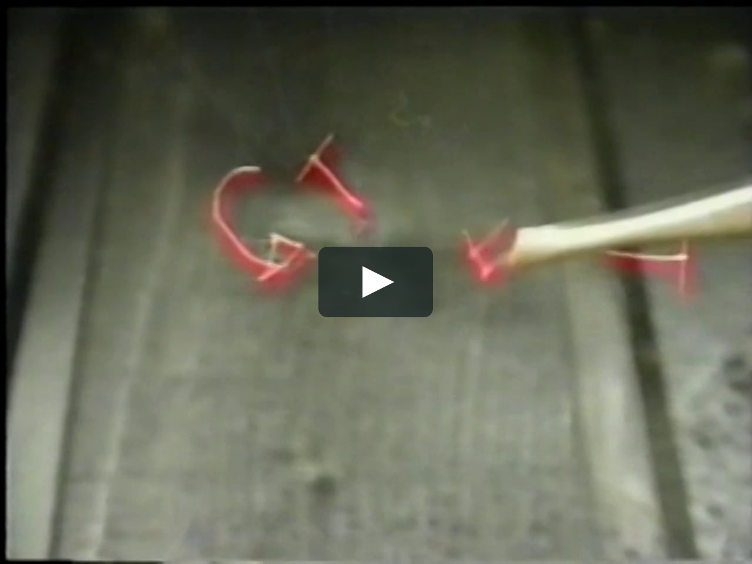
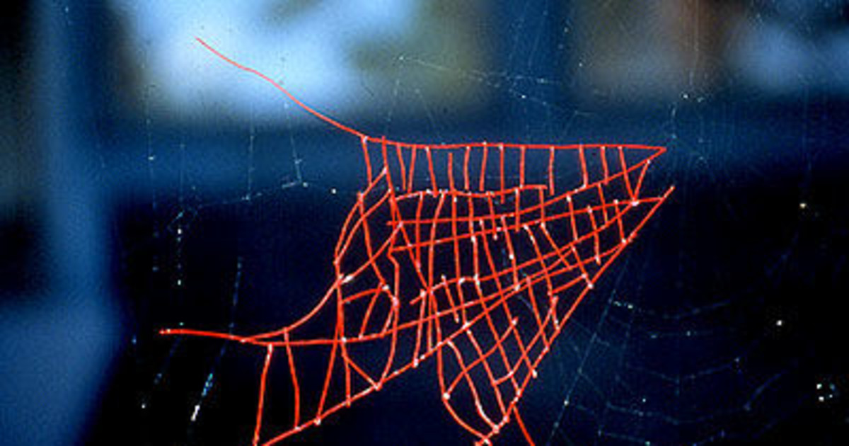

Slide 9
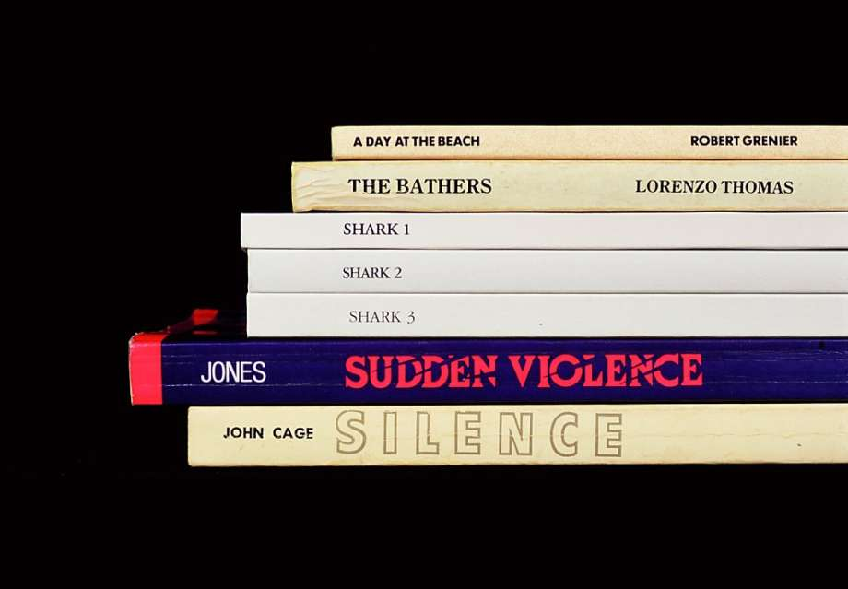

Slide 10
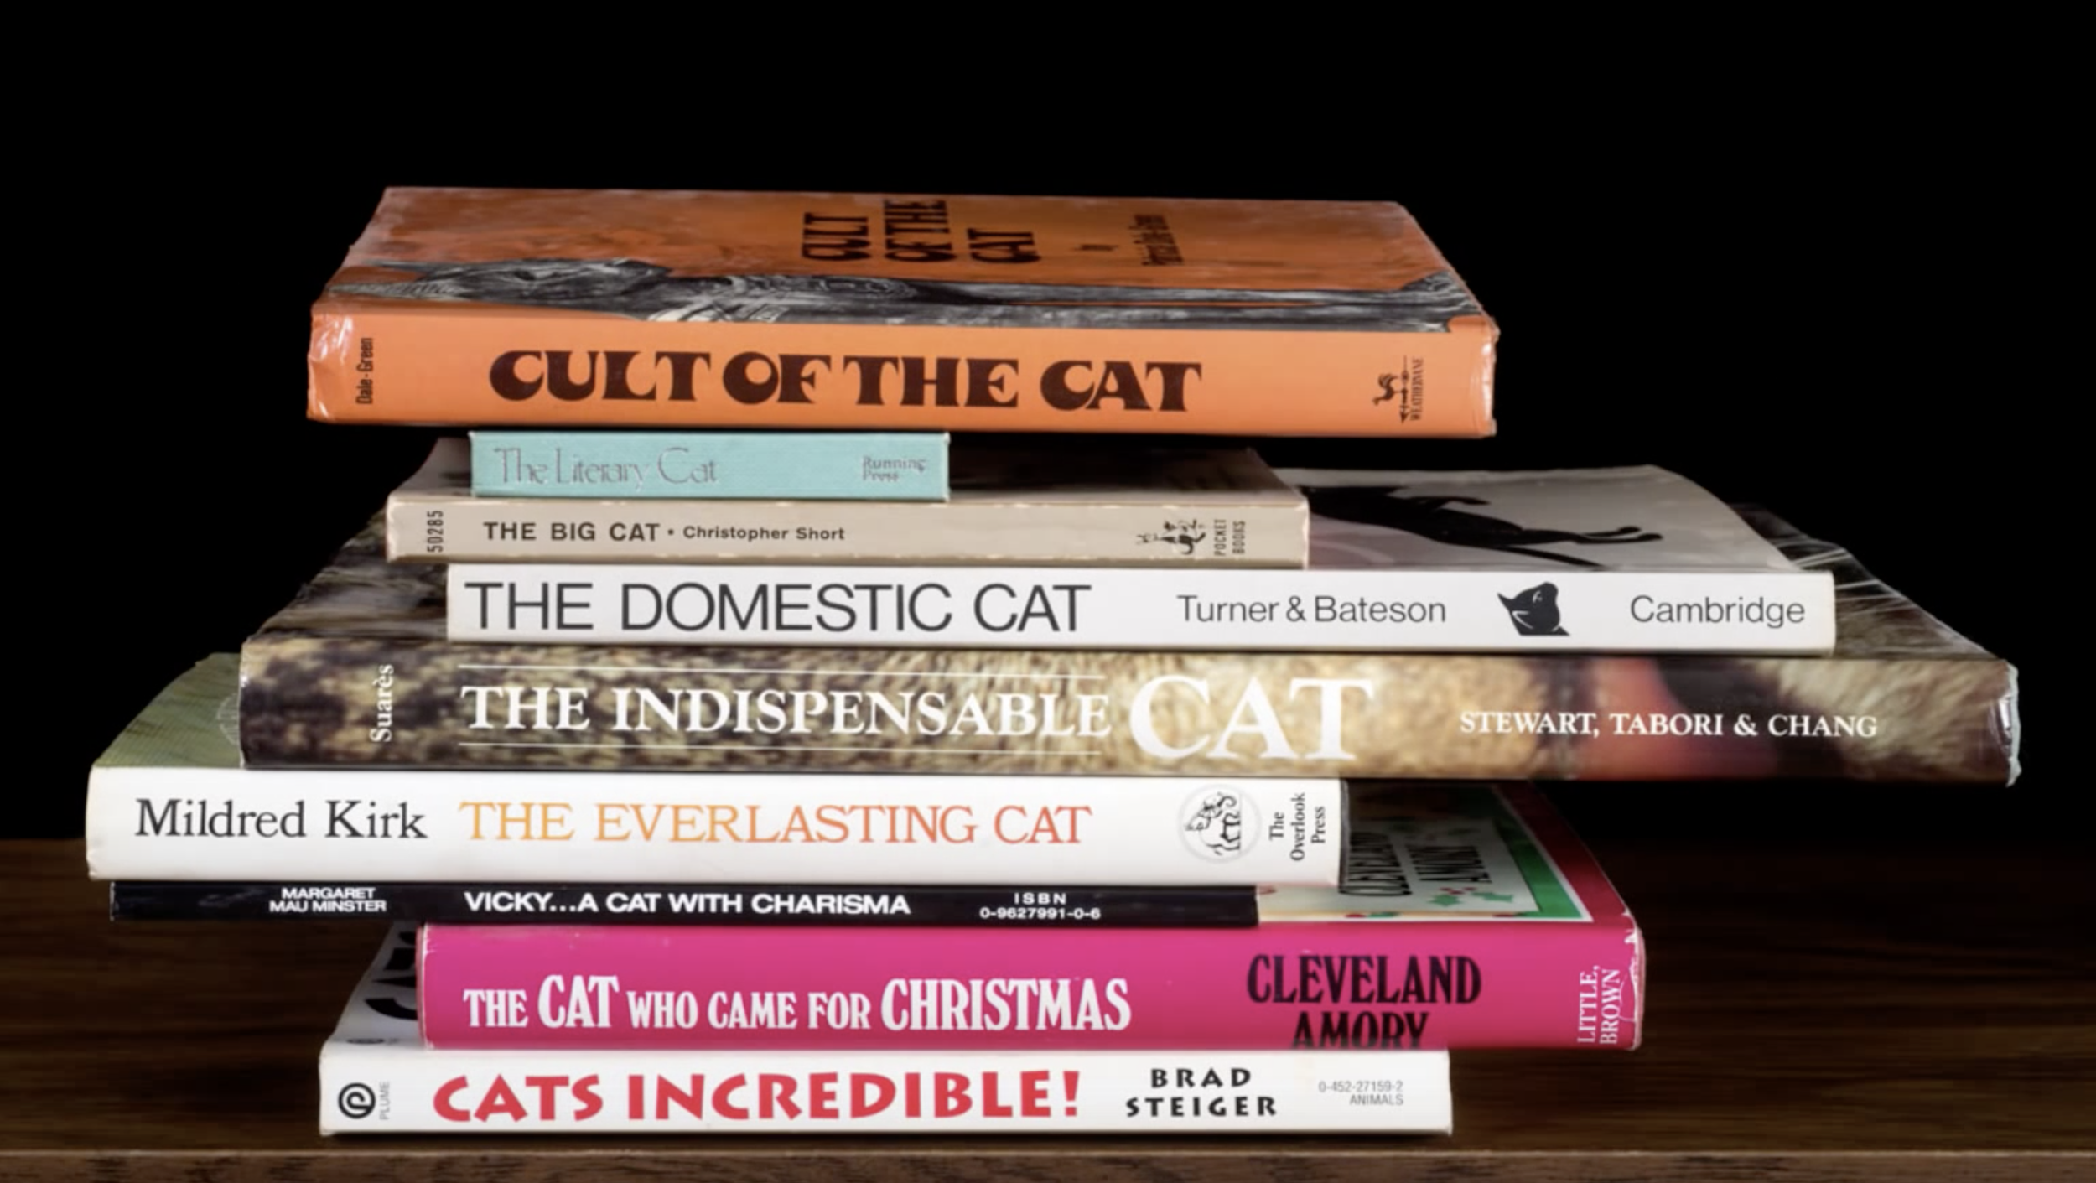

Slide 13
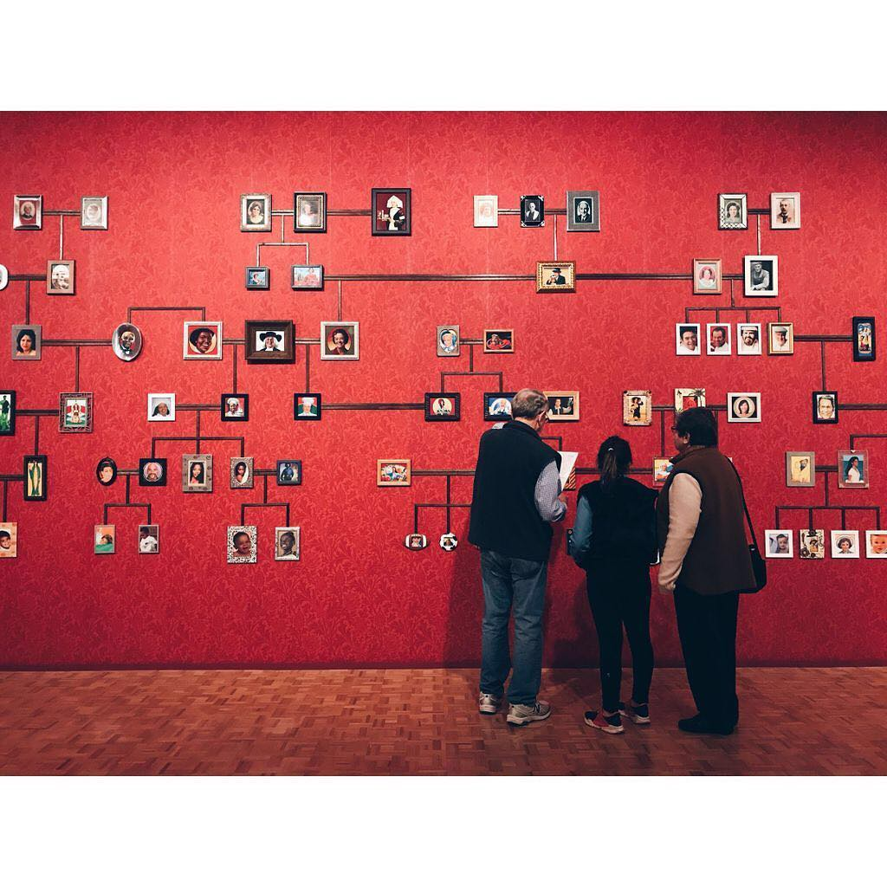

Slide 14
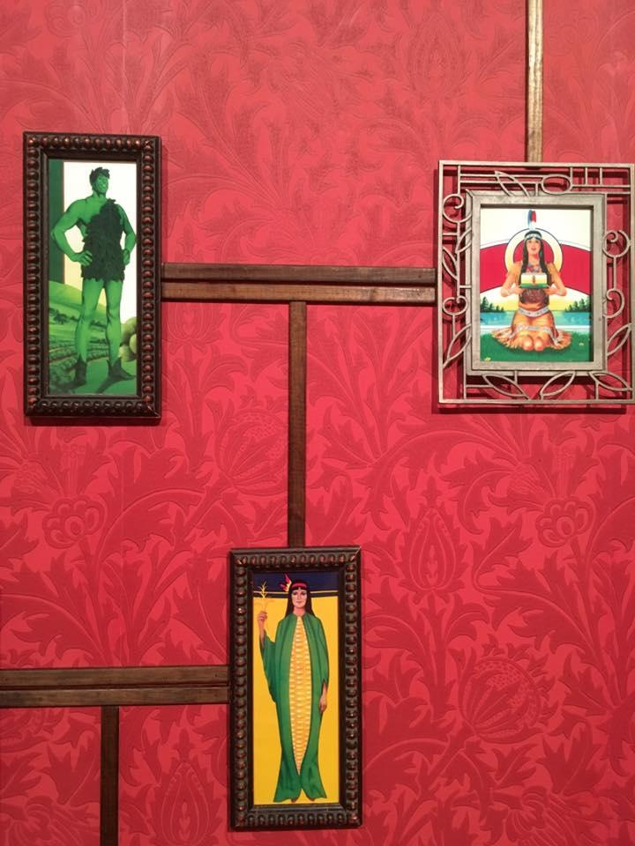
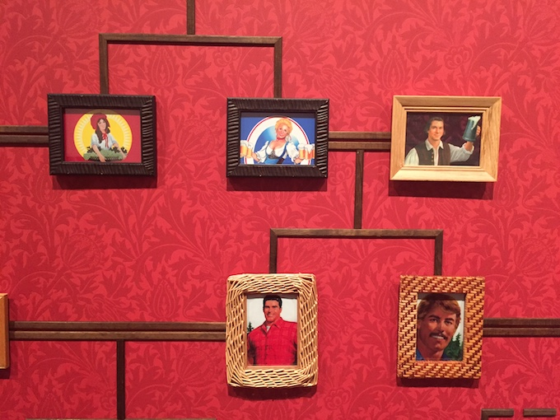

Slide 15
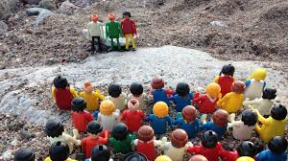

Slide 16
What is “conceptual” art?
art in which the idea presented by the artist is considered more important than the finished product, if there is one.

Slide 17
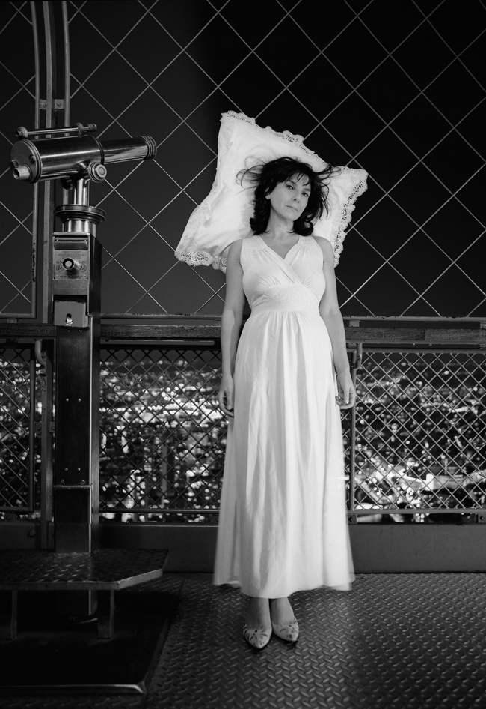
“It’s not a movement, it’s not a style, it’s a set of strategies,” Andrew Wilson, curator at the Tate

Slide 18
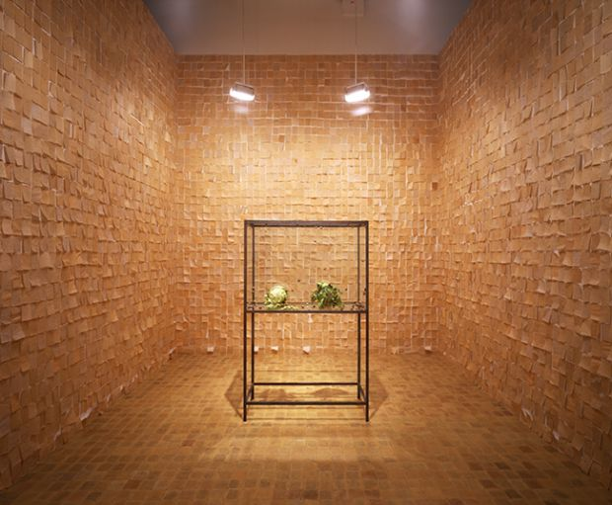
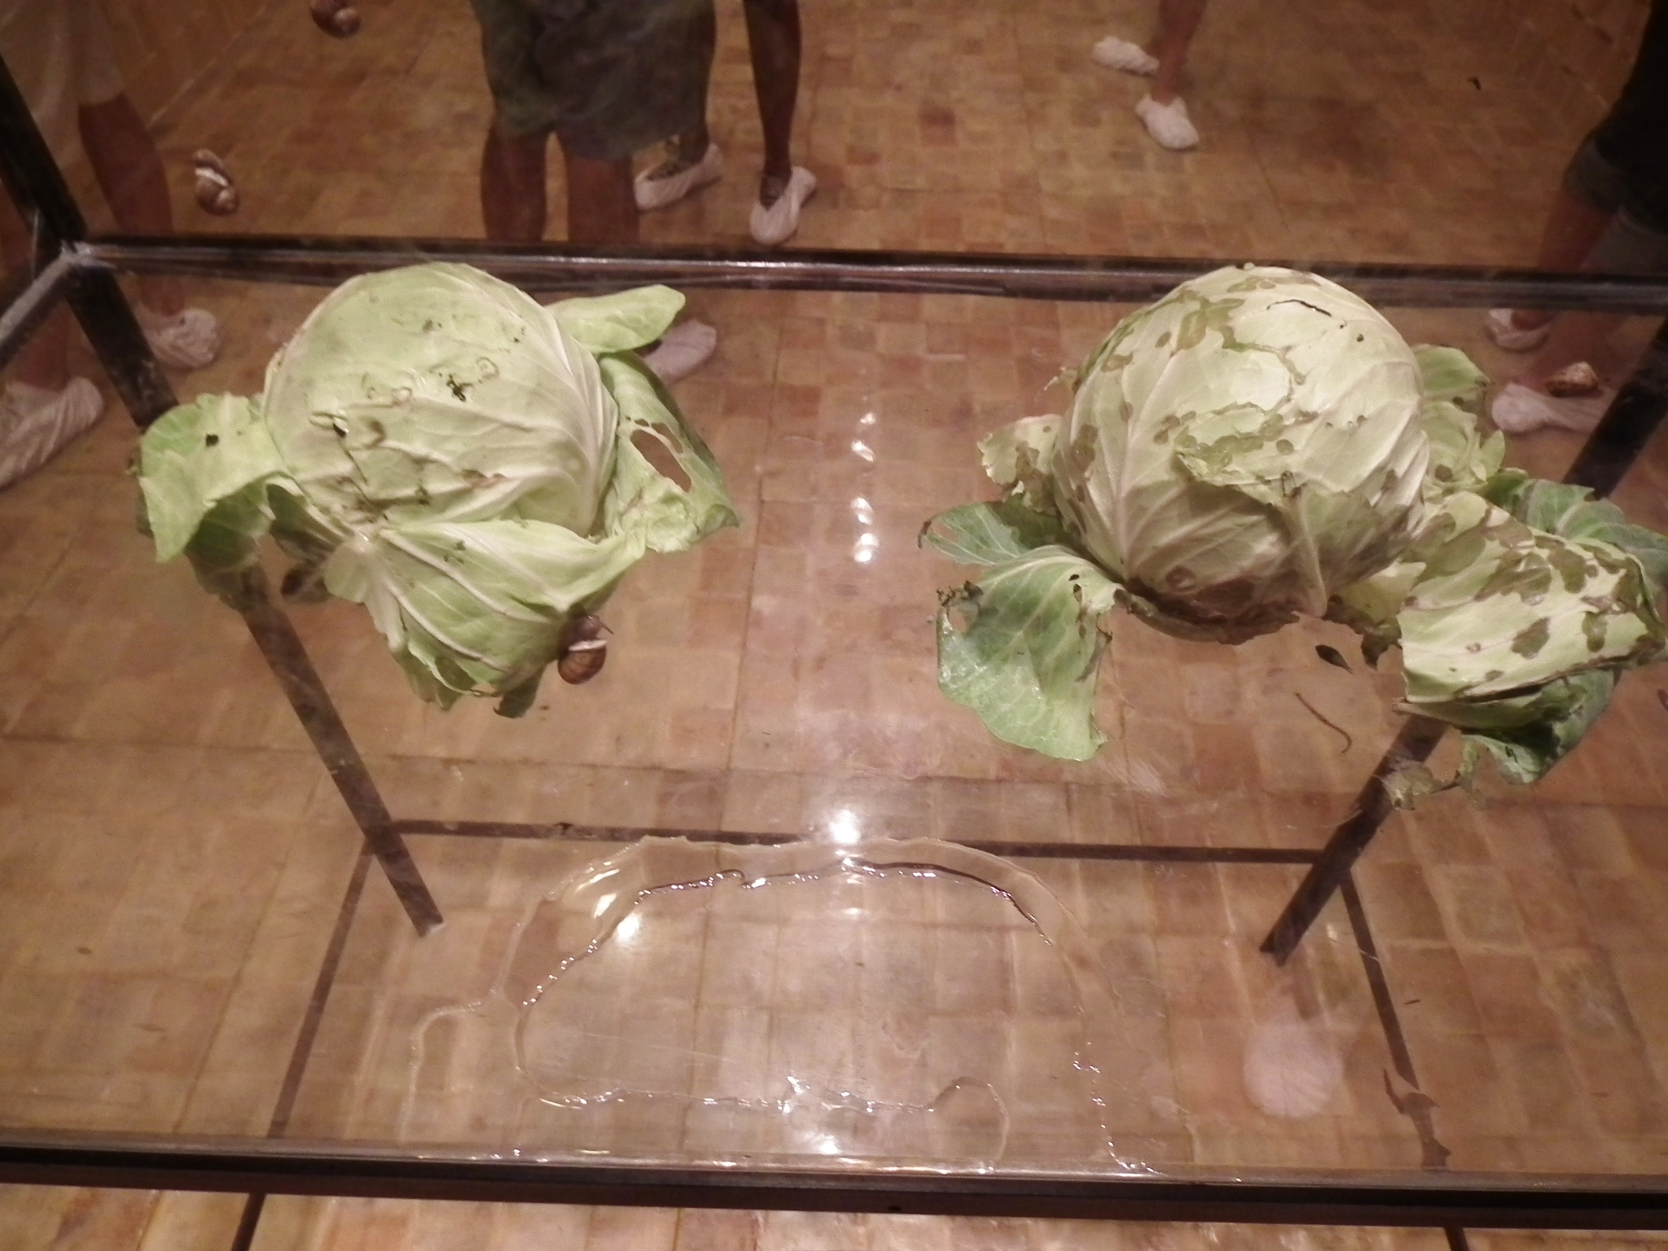
A bad conceptual work makes you feel that the idea isn’t worth finding. A good one spurs you to keep searching.
-Tate museum

Slide 19
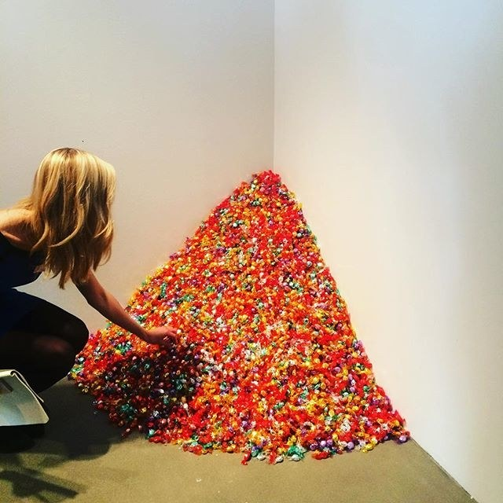
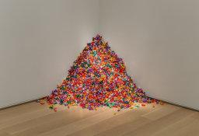
Felix Gonzalez Torres

Slide 20
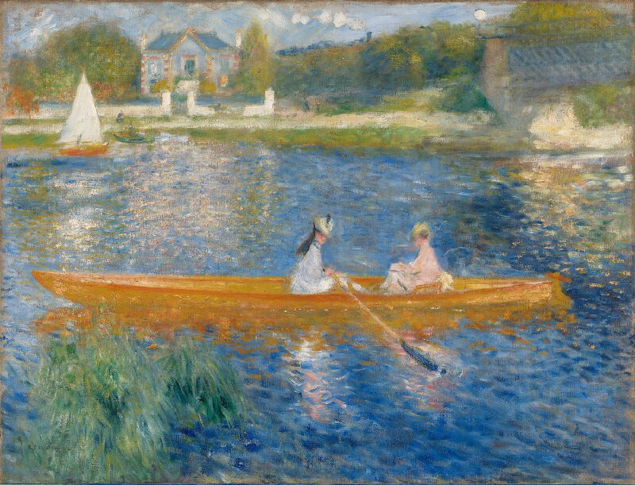

Slide 21
Conceptual art can be – and can look like – almost anything. This is because, unlike a painter or sculptor who will think about how best they can express their idea using paint or sculptural materials and techniques, a conceptual artist uses whatever materials and whatever form is most appropriate to putting their idea across – this could be anything from a performance to a written description.

Slide 22
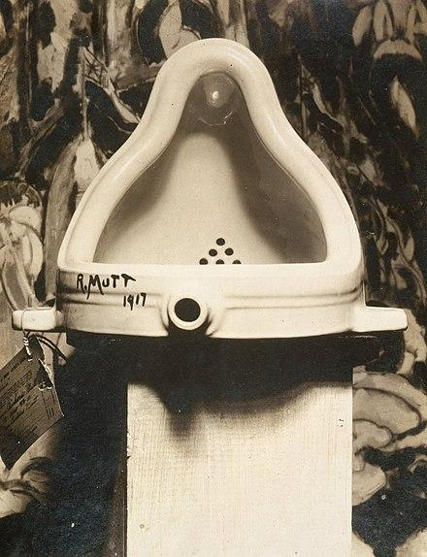
Marcel Duchamp
“The Fountain”
1917
Known as the first conceptual work

Slide 23
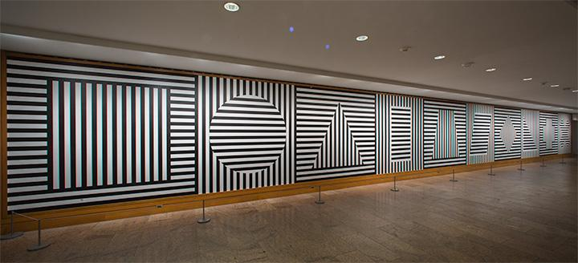
In conceptual art the idea or concept is the most important aspect of the work. When an artist uses a conceptual form of art, it means that all of the planning and decisions are made beforehand and the execution is a perfunctory affair. The idea becomes a machine that makes the art.
Sol Lewitt

Slide 24
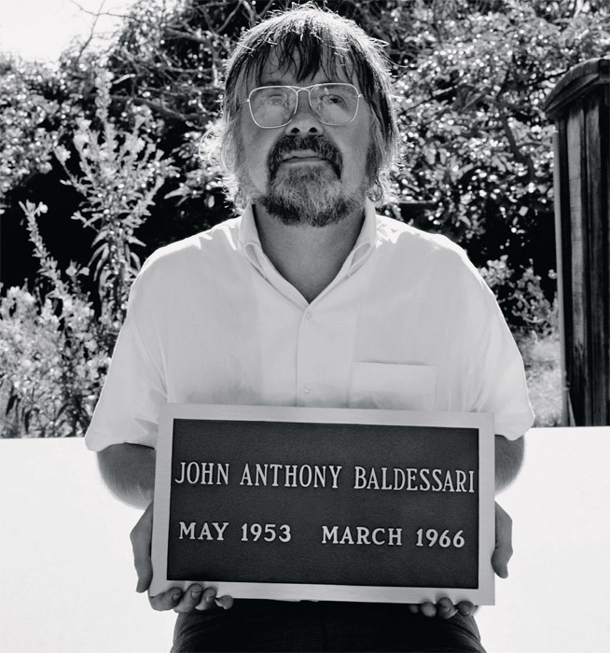
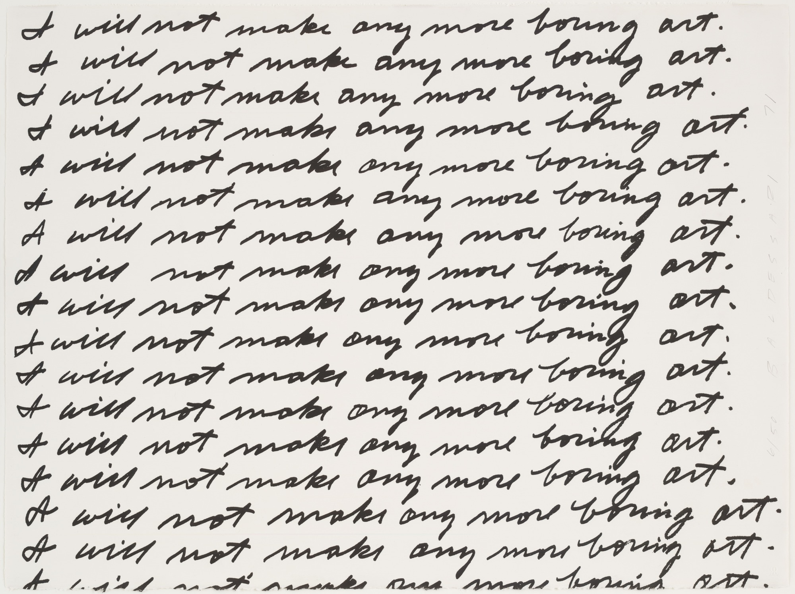
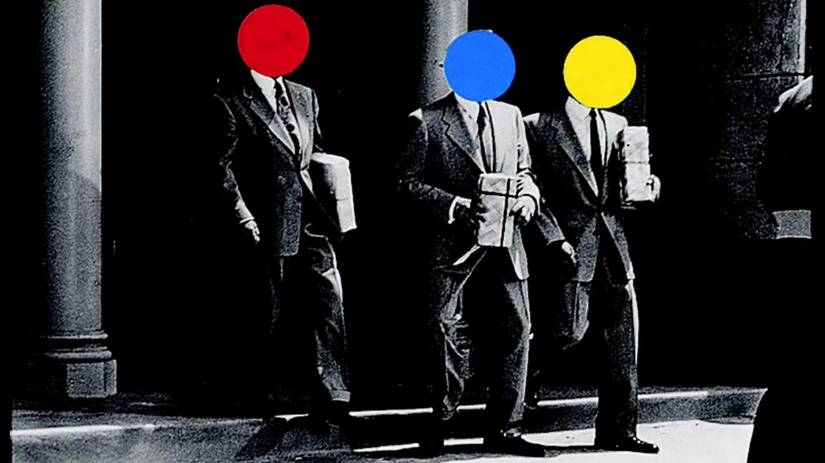
John Baldessari

Slide 25
Janine Antoni

Slide 26
Create conceptual art piece about the idea of “play”. Document it visually in some way.
Fill out the questionnaire on play to help generate ideas and use the following page for thumbnails
Your completed artwork is due February 14th
Notes:
Play is painful - stepping on leggos. Create a work that looks painful and spiky out of toys
Lost pieces to games, make flyers “missing for the last 15 years”
Feeling like I need to love all stuffed animals equally,

Slide 27
Choose the media that will be the most effective to express your idea
Documentation is critical, your documentation IS the artwork.
Tips:
-Think of multiple options
-Write write write
-Plan out your steps and materials
-Push yourself, take your idea one step further
-Be intentional with every decision

