Slide 1
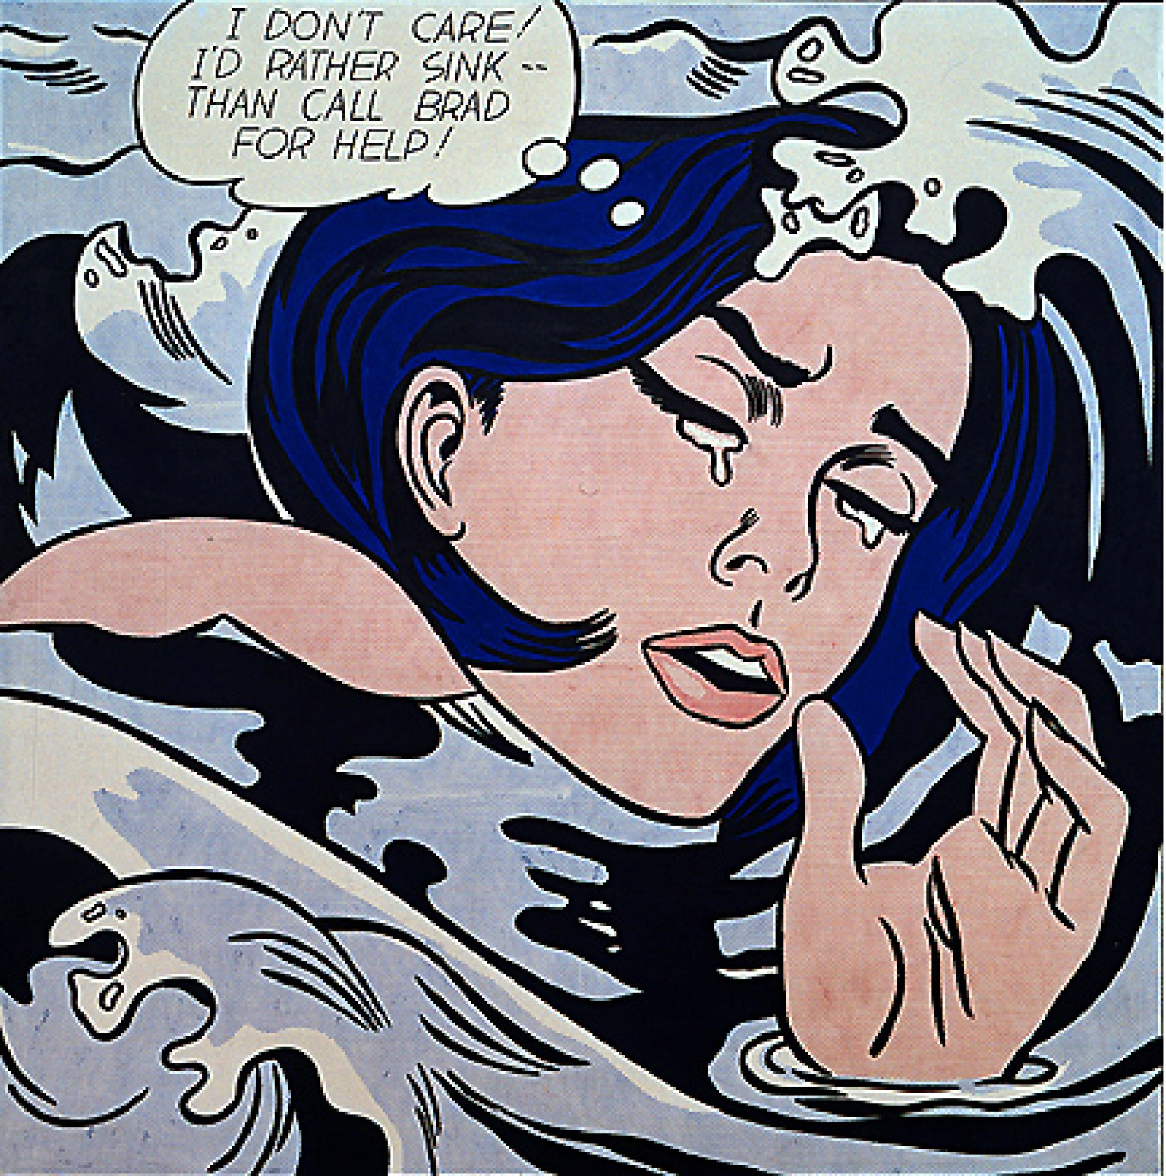
Drowning Girl
Roy Lichtenstein
1963

Slide 2

Roy
Lichtenstein
Key figure in the development of Pop Art
Best known for his focus on comics
Use of Ben-Day dots

Slide 3
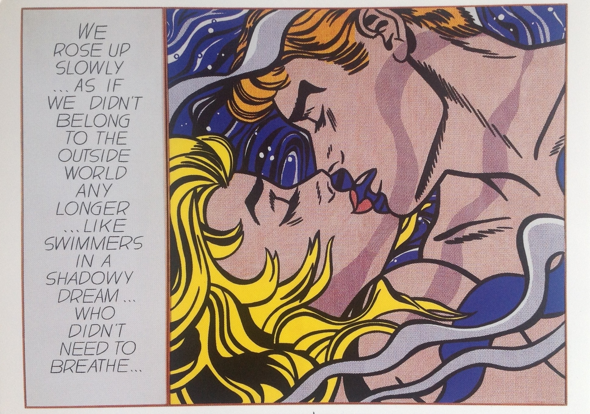

Slide 4


Slide 5
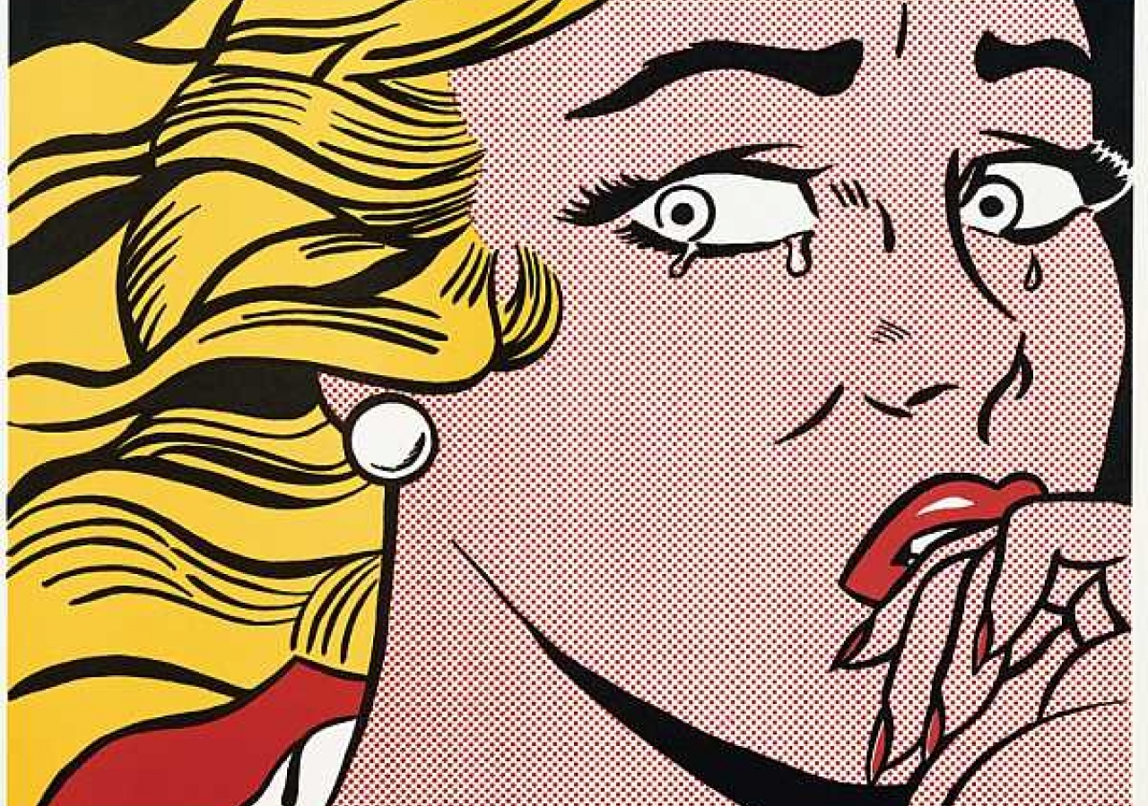

Slide 6


Slide 7
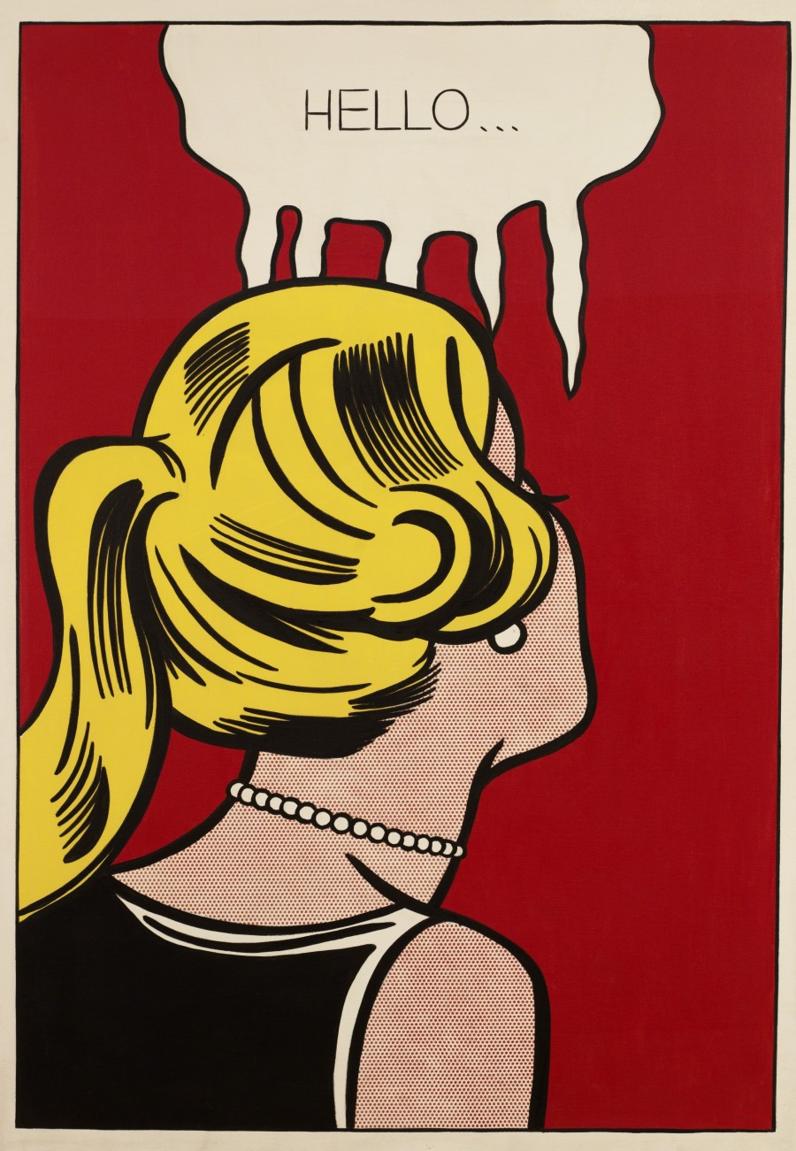

Slide 8
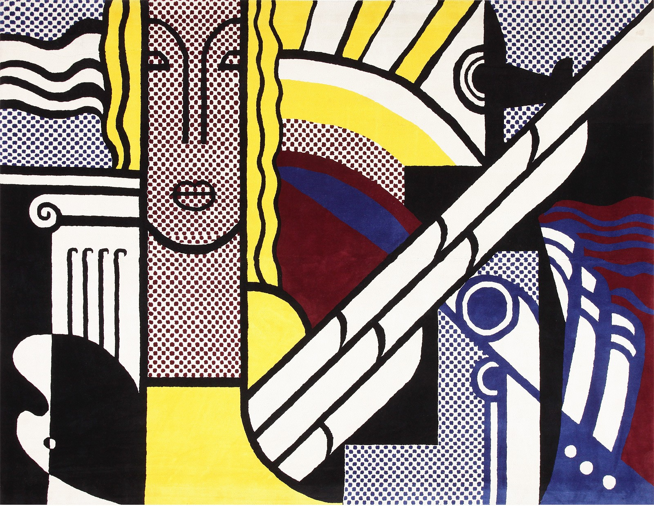

Slide 9


Slide 10
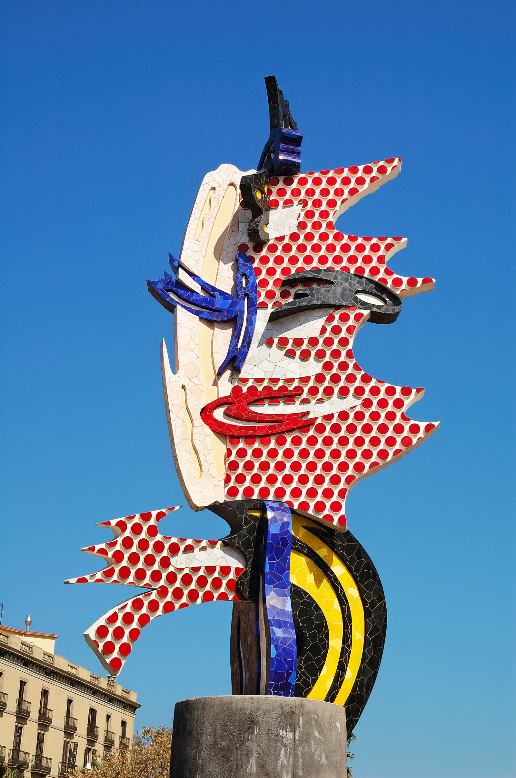

Slide 11
