Slide 1
“Swing,” Sam Gilliam, 1969

Slide 2
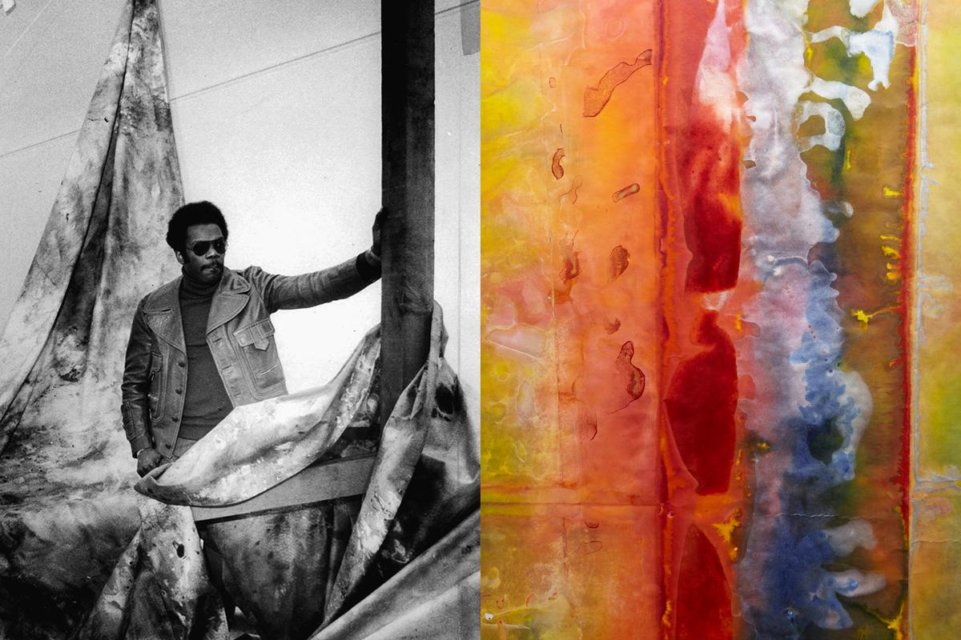
Sam Gilliam
Inspired by the Abstract Expressionist movement
Most well-known for his drapery pieces
Emphasizes color & movement

Slide 3
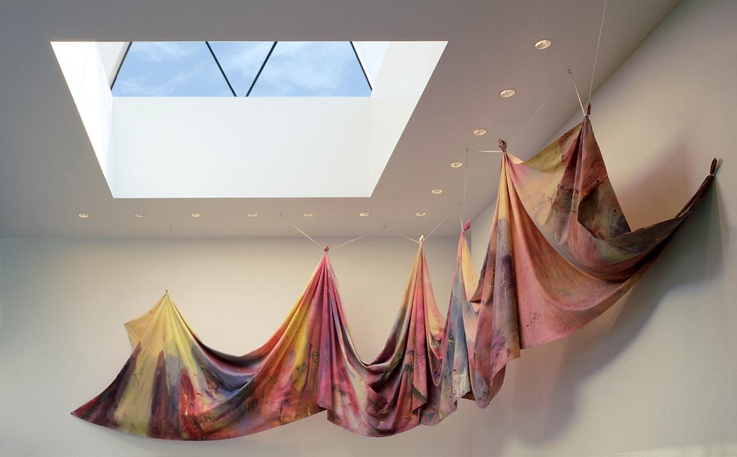
Would you call this a painting?
Why hang the canvas, rather than frame it?
How would this look if it were stretched into a frame?

Slide 4
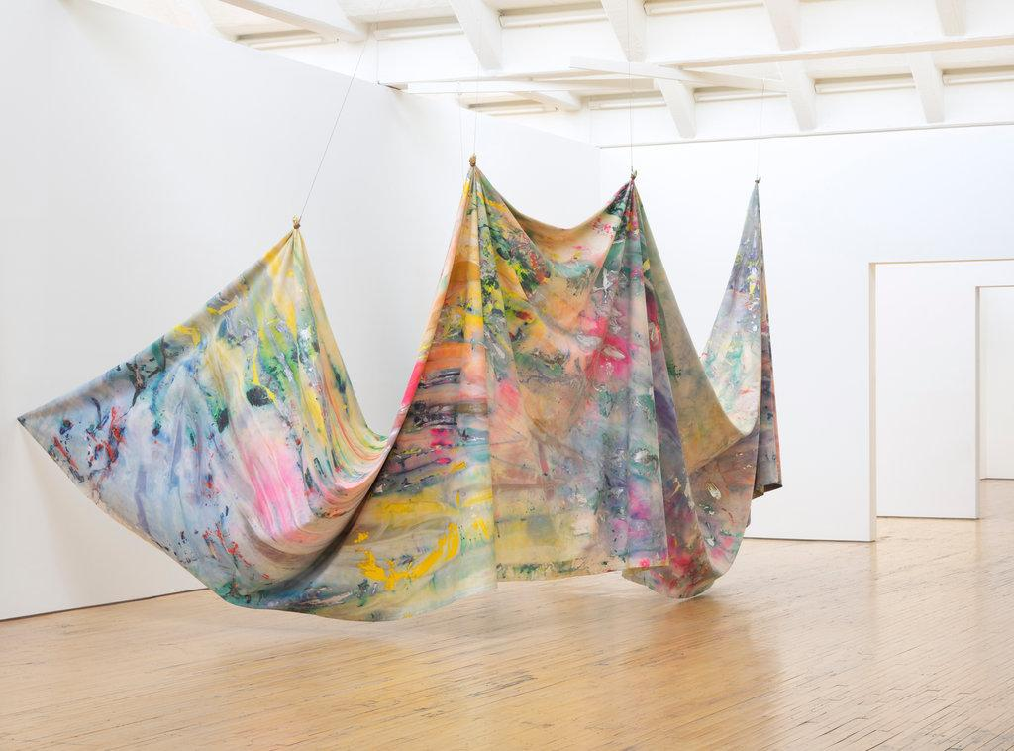
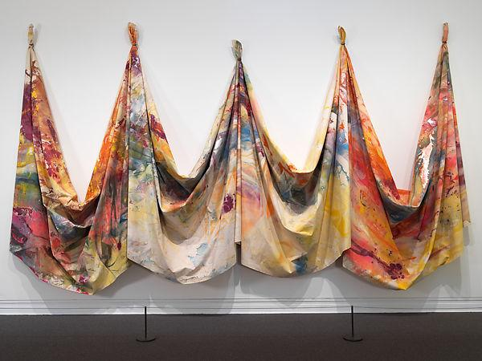
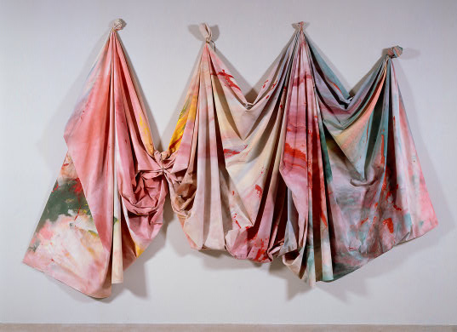

Slide 5
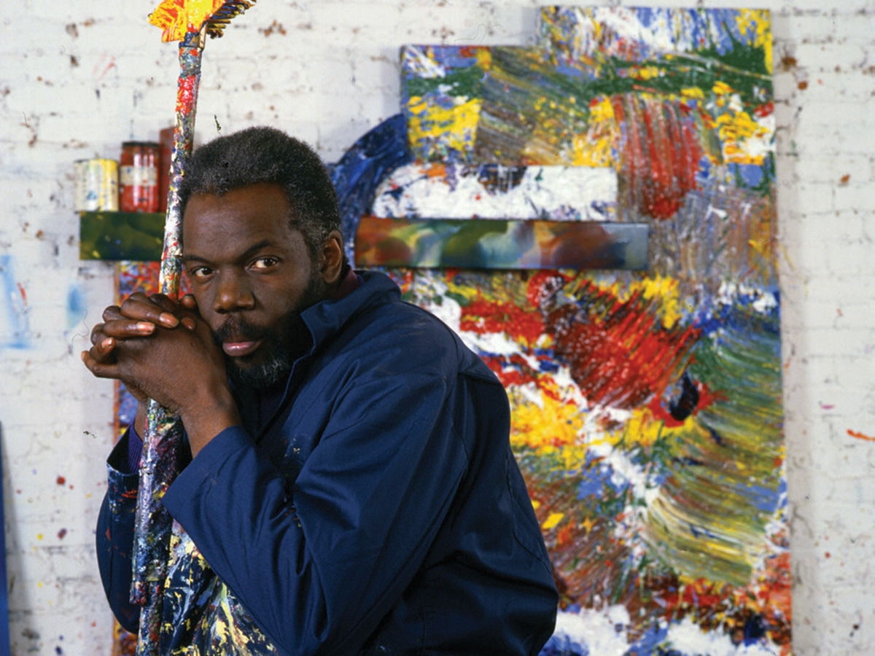
“Most painters are better when they’re older. They’re mature. Single-minded. And they have something to say because they practiced, made a lot of mistakes, and they’re cultured.”

