Slide 1
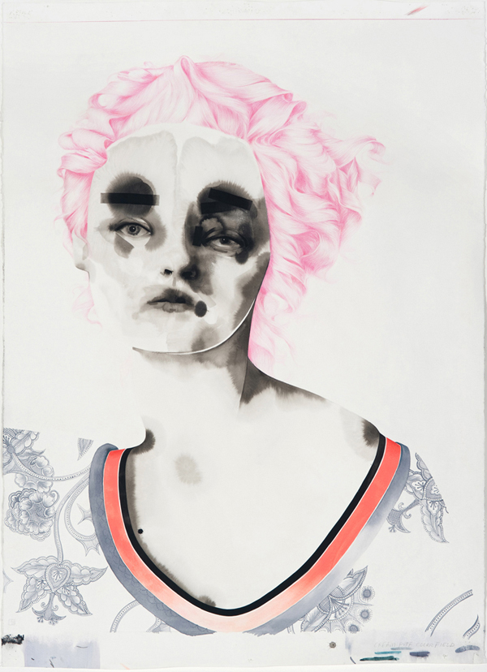
Cream Puff
2008
Storm Tharp
Ink, Gouache,
Colored Pencil
And Graphite On Paper

Slide 2
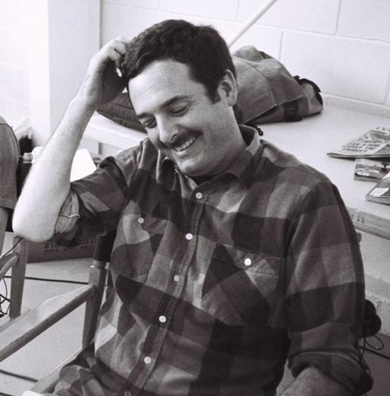
Storm
Tharp

Slide 3
“We become who we are through mistake and hesitation. We drift into identity. We could be anybody, but we are not.”
–Storm Tharp

Slide 4
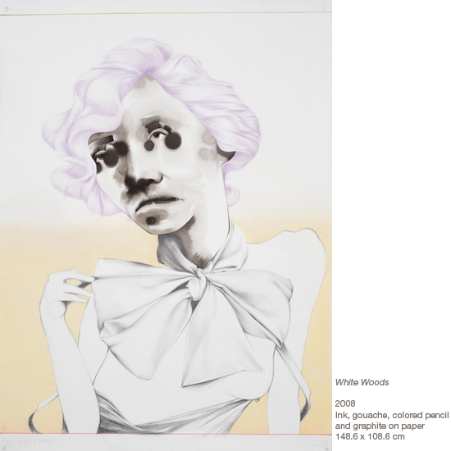
White Woods
2008
Ink, Gouache, Colored Pencil
And Graphite On Paper
14.6 x 108.6 cm

Slide 5
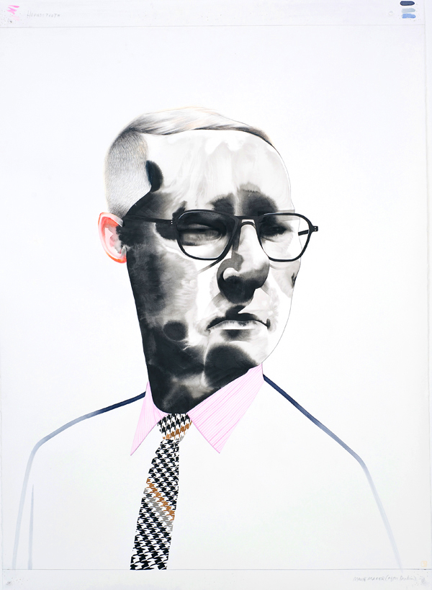
Houndstooth
2008
Ink, Gouache,
Colored Pencil
And Graphite On Paper

Slide 6
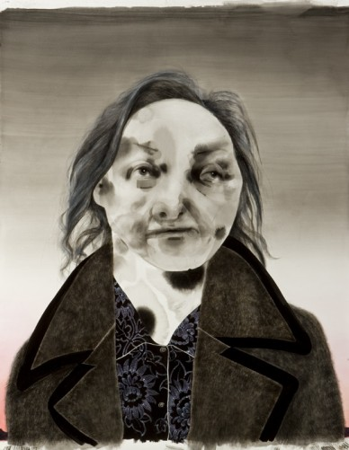
Two Studies (Rawsthorne) 2007 ink, gouache on paper 142 x 114 cm

Slide 7
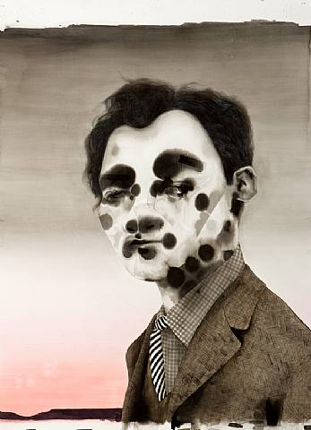
Two Studies (Bernard) 2007 ink, gouache on paper 142 x 114 cm

