Slide 1
The Gypsy
2008
Vik Muniz
(Pictures of Gargage Series)

Slide 2
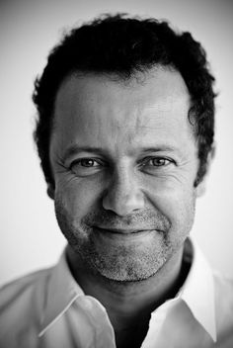
Vik Muniz
Brazilian Artist and Photographer
Works in Series

Slide 5
https://www.youtube.com/watch?v=sNlwh8vT2NU&list=PLV61n0aTVW90ZjMkiVtxDhAF4lDAM2fND

Slide 8
The Sugar Children
I was down in the Caribbean when I saw sugarcane workers’ children. They were wonderful. But their parents were so sad, really hard people. I realized they take the sweetness out of the children by making them work in the fields. It’s very hard work. All the sweetness from them ends up in our coffee. So I made drawings of them from sugar.

Slide 13
Pictures of Chocholate

